Slide 1


Policies Matter
Creating a favourable fiscal environment for cycling to work
 | ECF gratefully acknowledges financial support from the European Commission.
Holger Haubold, ECF Fiscal Policy Officer
Brussels, 20 February 2017

Slide 2

General Framework
Car dominant in commuting
> problems for environment, space
> health: air quality, inactivity
50% of new cars = company cars
< advantageous fiscal systems
Active modes of transport: only few incentives

Slide 3

EU Policy
EU Commission: “There are inconsistent taxation rules between transport modes and fuels, between and within Member States” (White Paper on Transport, 2011)
Need for fiscal level playing--field

Slide 4
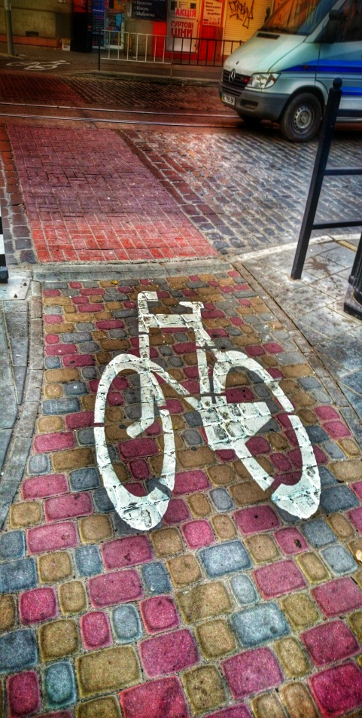
Fiscal Support for Cycling – Incentivising physical activity
Best practice example cycling: Belgium
Tax-free reimbursement: € 0.23/km
(ex.: 18km x 20d = 83€ per month)
Tax-free provision of company bikes for employees
120% deductible for companies:
costs for bikes + cycling infrastructure
ECF recommends: Follow this example!

Slide 5
Development of Cycling in Belgium
2013: 350.000 employees;
ca. 8% of workforce

Slide 6
UK: Loan/buying scheme
Employers lend bicycles free of tax to their employees.
Employee can buy the bike at the end of the lending phase.
To date: over 600.000 participants; growth in participation since introduction

Slide 7
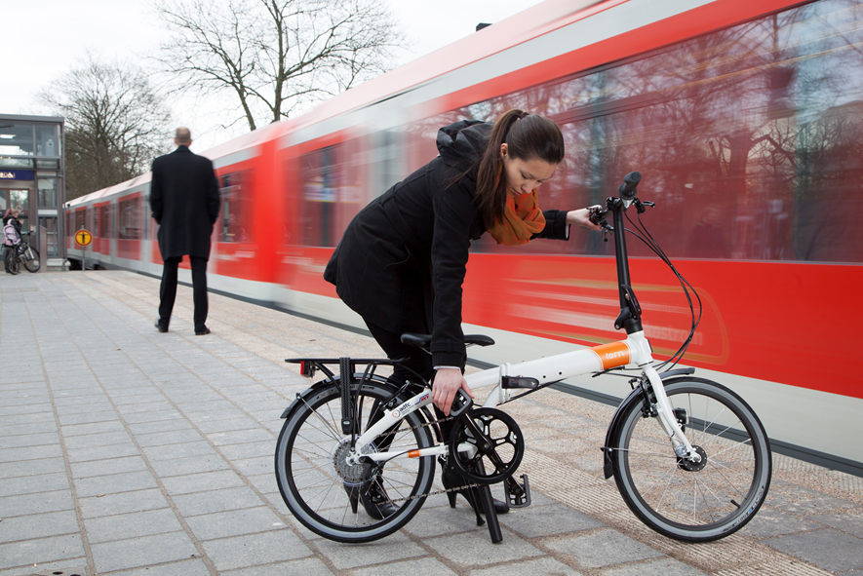
Public Transport
Possibilities for tax-free reimbursement of costs in many countries
ECF recommends: Allow for combination with fiscal incentives for cycling

Slide 8
Company Car Taxation:
Subsidising Inactivity
Germany: 12% of the selling price of a company car subject to income tax
  includes possibility to provide free fuel
  60% of company cars in new registrations
  direct fiscal loss: 23 billion €
UK, NL, DK: stricter tax rules (25% of the selling price is taxable income)
➔ decrease in company car registrations
& less CO₂ emissions
ECF recommends: yearly taxable benefit company cars at 50% of list price (real value)

Slide 9

Mode-Neutral Solutions
„Mobility Budget“: Tax-free mobility allowance as alternative to company car
BE pilot project: clear shift to sustainable commuting
ECF recommends: Experiment and implement!

Slide 10
Conclusions
More tax incentives for active mobility and/or higher taxation for individual cars needed
A cost-efficient and sustainable tax shift is possible.

Slide 11
Financial incentives for e-cycling

Slide 12
Mismatch in e-mobility funding

Slide 13
Financial incentives work:
The case of Austria
balanced e-mobility policy
purchase subsidies during market uptake
today: 3rd highest per capita e-bike sales in EU despite only average cycling levels

Slide 14
Other examples of existing funding schemes
Paris: 33% of the acquisition price, max. 400 € (individual application)
Spain:
  National subsidy: 200 € (individual application)
  Barcelona Metropolitan Area: 250 € (network of retailers)
Munich: 500 € for e-bikes, 1000 € for e-cargo bikes, only for small businesses (individual application)

Slide 15
Recommendations
purchase subsidies:
  generalised in market uptake phase
  targeted in mature markets (e.g. e-cargo bikes)
balanced e-mobility promotion strategies:
  research funding for all modes of transport
  include e-cycling infrastructure (parking, charging)

Slide 16
Thank you for your attention !
For more information
h.haubold@ecf.com @holgerecf
www.ecf.com @eucyclistsfed

