Slide 1
The Cycle Friendly
Employer Certification at the ADFC
Before and After the Participation
in the EU-Project Bike2Work
Notes:
Business plan
ADFC wanted to hand out 2 different certificates
Lower standard EU – higher standard German

Slide 2

Starting Point
  Certification and consulting of cycle friendly employers since 2005.
  Focus on large companies (< 250 employees).
  Detailed criteria, but too much emphasis on bicycle parking facilities.
  No business or marketing plan.
  No uniform products, services, pricing.
  Processes never defined.
  National headquarter neglected the program but received new boost through the EU-project Bike2Work.

Slide 3
The ADFC/EU Certification
Advantages of a combined ADFC/EU certificate:
  Exclusivity.
  EU-wide harmonized, transparent, and unbiased method.
  Streamlined criteria.
  International certification better for company‘s reputation.
  Online tools make the audit more transparent and cut the audit time
  in half.
Notes:
der Zeitaufwand für ein Audit verringert sich von 20 auf 10 Stunden.

Slide 4
Products and Services
  Certification (bronze, silver, gold)
  Re-certification (online/on-site) after 3 years
  Online self-evaluation (free)
  Guidebook (free)
  Basic consultation (workshop)
  Intensive consultation
  Distance analyses (automated tool)
  Mobility solutions – EcoLibro as partner
Notes:
3 levels, 3 years, transparent pricing since the self-evaluation tool streamlines the audit

Slide 5

Marketing – Target Groups
  Customers with high potential are companies…
  with bicycle leasing programs (approx. 3.000).
  B2W campain (MdRzA 30.000, 9.000 in Bavaria)
  with corporate health or environmental management.
  in sectors bicycle, environment, sport
  our sponsors
  Further potential customers:
  Companies with other certifications
  IT-companies
  Hospitals and health care providers

Slide 6
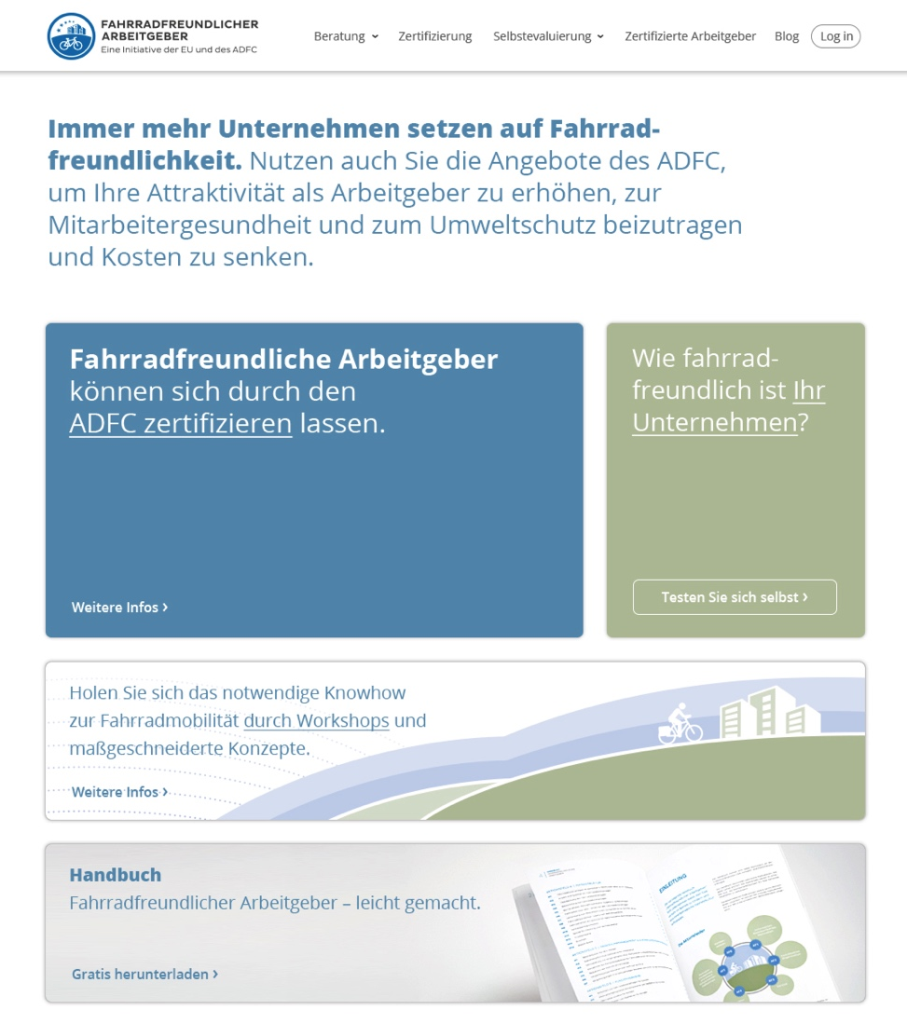
New Website with new features
  Call-to-Action buttons:
  After registration → Sales Leads:
    Download guidebook.
    Online self-evaluation.
  Newsletter
  Blog
  List of certified employers.
Notes:
Training beginning of March, Testphase

Slide 7
Thank you!

