Slide 1
ECF
Kevin Mayne
Brussels, 20 February 2017

Slide 2
Our project
Bike2work – the project
Benefits
Approach
Outcomes

Slide 3
Best practice in behaviour change
Break habits
Inform
Trigger
Trial
Reward
Make habits
Reinforce
Maintain
Support
Celebrate

Slide 4
The project
Funded by Intelligent Energy Europe
Project value € 1.8 Million
13 full partners, 1 associated partner
Policy Outcomes:
Public - private collaboration (SMEs included)
81,000 new cyclists created at a cost of €222 each
Prove behaviour change methodologies
Energy and CO2 savings

Slide 5
The consortium
BE | European Cyclists’ Federation | ECF
AT | Austrian Mobility Research | FGM-AMOR
UK | Cyclists’ Touring Club | CTC
DE | German Cyclists' Federation | ADFC
SI | Urban Planning Institute of the Republic of Slovenia | UIRS
MT | Paragon Limited | Paragon
BG | Bulgarian Cycling Association | BCA
FR | Nantes Metropole | NMCU
IT | Finproject | Finproject
HR | Cyclists' Union | SinBic
RO | Green Revolution Association | AGR
IT | Italian Federation Friends of Bicycle | FIAB
NL | Fietsersbond | Fietsersbond
DK | Danish Cyclists’ Federation | DCF

Slide 6
Bike2work – stated objectives
To create a modal shift from car to bike by increasing the number of participants in Bike-to-work campaigns, extending the coverage of ongoing Bike-to-work campaigns and introducing new promotional methods
To increase numbers of employers acting as bicycle-friendly employers and use this to engage a wider group of employers in energy efficiency and employee health actions, especially SMEs.
To increase the number of key actors involved and to deepen their involvement and commitment.

Slide 7
Our project
Bike2work – the project
Benefits
Approach
Outcomes

Slide 8
Good for employers because….
Business benefits
  Tax breaks & other national incentives
  Planning/ building regulation
  Attracting talent
Practical
  Cheap
  Easy to implement
  Employees and NGOs take the lead
Employees
  Health
  Motivation
  Productivity
Reputation
  Visible
  Green
  Public spirited
  Part of employer community

Slide 9
Good for cities and regions
Peak time congestion is number 1 priority
Business competitiveness encouraged
Commuting change tackles repeat trips
Public transport operators share benefits
New infrastructure can be targeted
Behaviour change techniques tested

Slide 10
Our project
Bike2work – the project
Benefits
Approach
Outcomes

Slide 11
Best practice in behaviour change
Break habits
Inform
Trigger
Trial
Reward
Make habits
Reinforce
Maintain
Support
Celebrate
Bike2work campaigns
Cycle friendly employers

Slide 12
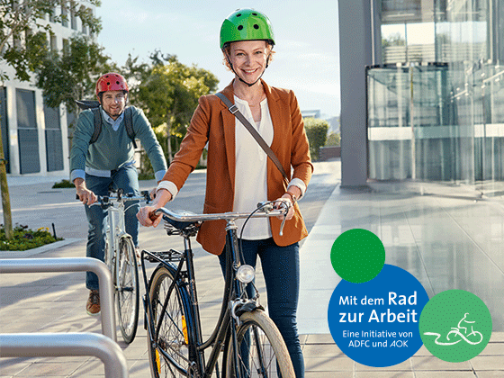

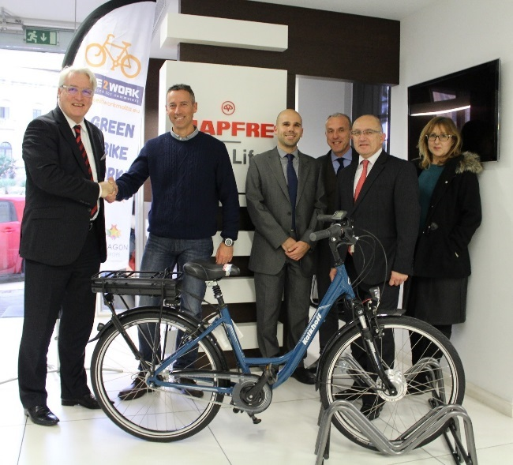



Slide 13
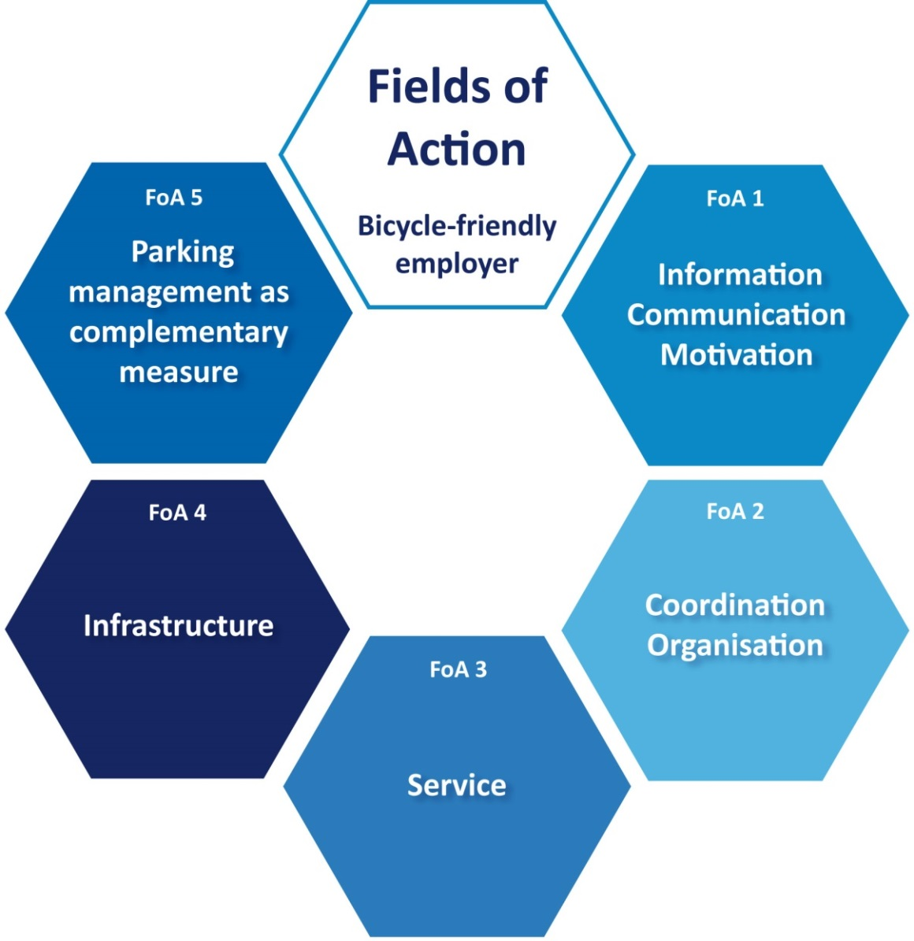
Towards an EU – wide standard
“Cycle Friendly Employer”

Slide 14
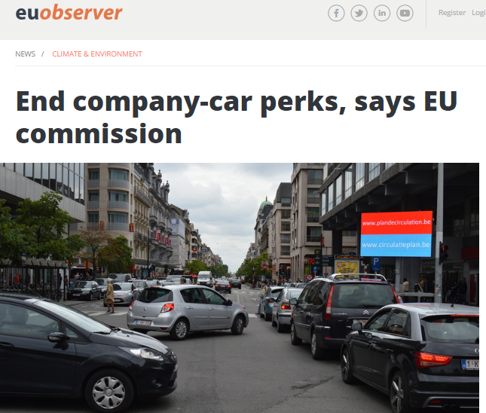
Responding to new opportunities – since 2012
E-bike market takes off
  E-bikes – Market grows over 1 million pa
  E-bikes – Speed pedelec type approval 2017
Phone apps become Big Data and ITS
  Digital Economy
  Smart Cities
  ITS and CITS
Ending the fiscal promotion of company cars becomes mainstream policy
  OECD/EU recommendations

Slide 15
Our project
Bike2work – the project
Benefits
Approach
Outcomes

Slide 17
Our project
Bike2work – the project
Benefits
Approach
Outcomes
And “thank you”

Slide 18
Thank you
www.bike2work-project.eu
@eubike2work
ECF
Kevin Mayne
Brussels, 20 February 2017

