Slide 1
European Funds – 6billion campaign 3rd Webinar
Martin Fisher, Ed Lancaster,
Adam Bodor
European Cyclists’ Federation (ECF)
Notes:
Welcome

Slide 2
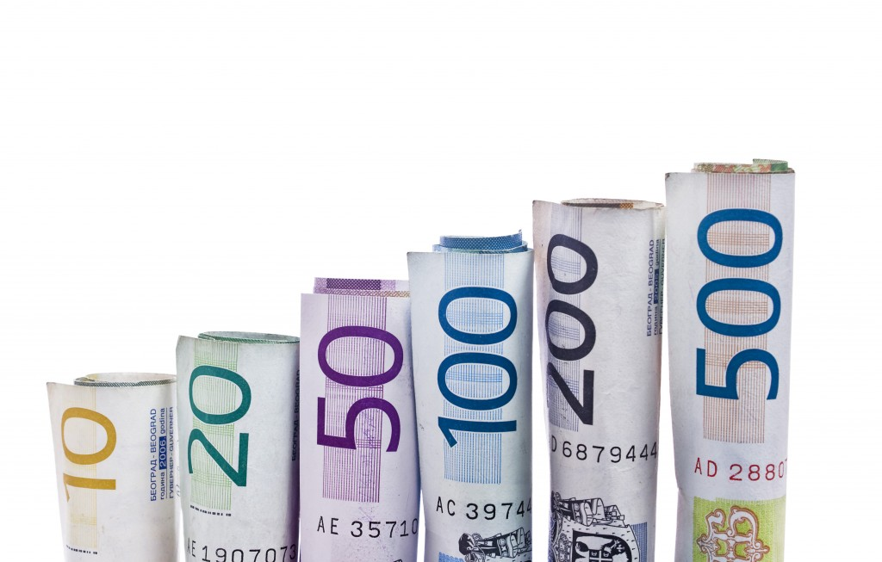
Purpose of this webinar:
To wrap up (EU periods, funds, why should act now, objectives, strategic planning) and to check what`s the situation in your country
To wrap up how to plan a campaign, how to run a campaign
To evaluate your results....

Slide 3
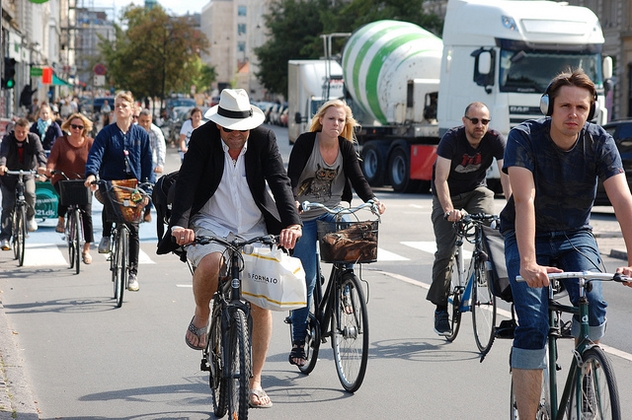
ECF’S KEY GOAL & APPROACH
Doubling cycling to 15% by 2020.

Slide 4
How much does the EU spend on cycling currently?
EU resources for cycling between 2007 – 2013 were 0.6 billion Euro
Hungary, Poland, Czech Republic and Germany all spent over 100 million Euro
Notes:
During the current financial period the EU is spending 600 million euros on cycling. This sounds a lot but when you consider that 4 countries contributed over 100 million each, it means that the other countries are not contributing much.
Funding of cycling also only represents 0.7% of EU co-funding of transport infrastructure.
So, the ECF believes that the EU could be doing more which is why it is targeting…[see next page]

Slide 5
How much do we need?
The ECF is targeting 6 billion Euro for cycling between 2014 -2020!
Notes:
…6 billion Euros to be spent during the next financial period (2014 – 2020).
Last year we launched the ECF’s 6 Billion Campaign to make our Members aware of the possibilities out there and to work with them to realise this goal. Material has been made available through our website and we have been advising some of our individual Members about what they can do in their country.
One of the ECF’s French member associations, the Départements et Régions Cyclables (DRC), has been leading the way in lobbying on this issue at a national level. During the first week of February, the DRC organised a ‘More Euros for Cycling’ workshop in Strasbourg when the European Parliament’s Plenary was in town. This successful event raised awareness of the benefits of investing in cycling amongst French MEPs and other key decision makers and stakeholders.
Of course, in the light of the EU budget agreed by the European Council at the start of February, there are likely to be even more pressures on the EU’s resources, which it will be even more important to emphasise the cost effectiveness of investing in cycling.

Slide 6
Where can the money come from?
Notes:
We have identified 4 main sources of funding at the EU level:
Funds directly from the EU institutions (executive agencies);
The Cohesion Policy;
The Rural Development Fund; and
Funds for countries that neighbour the EU (this last one is not relevant for NRW!).
I will go through the first three in more detail for you with some examples of how they have already been used to fund cycling projects.
It is worth noting that the decisions related to how the funds are spent at a detailed (project) level are mainly decentralised or under shared management (Members States / EU). The only decisions made in Brussels (other than setting the overall budget) are those coming directly from the EU’s executive agencies.

Slide 7
How to capture some of these resources?
We need a clear reference to cycling in all relevant Frameworks and Operational Programmes!
At a national level:
National Strategic Reference Frameworks.
Operational Programmes for Transport, Tourism, Environment etc.
At a regional level:
Operational Programmes for each region.
Notes:
How to capture some of these resources?
Well, it is so much easier to apply for funding for cycling if it is already mentioned as a priority in the relevant Frameworks and Operational Programmes at a national and regional level.
At a national level there is the National Strategic Reference Framework - basis agreement between the EU and the Member States on what EU Funds should be spent on in each country. This is further defined in Operational Programmes, which set out the priorities in relation to specific topics or regions. There several topics that could reasonably include a reference to cycling: Transport, Tourism, Environment, Regional Development and Rural Development.
Furthermore, each state prepares it’s own Operating Programme, setting out its priorities for the next period. It is likely that the Managing Authority for the current period (2007-2013) will also be leading on it for the next (2014-2020). For NRW, the Managing Authority is currently:
Ziel 2 Sekretariat im
Ministerium für Wirtschaft, Energie, Bauen, Wohnen und Verkehr des Landes Nordrhein-Westfalen
Haroldstr. 4
D-40213 Düsseldorf
Tel.: 0049/211/837-2287
Fax.: 0049/211/837-2665
E-mail.: office@ziel2.nrw.de
Web: Ministry of Economic Affairs and Energy

Slide 8
Why do we have to act now?
EU prepared regulations and guidelines that will form framework
European, national and regional bodies confirm priorities for funding
New funding period starts (calls for proposals etc.)
2012
2013
2014
Notes:
Timing is critical. The new funding period commences in 2014. At the EU level a lot of the work was already undertaken last year. The national and regional authorities will need to confirm their priorities this year. So, if we are to influence what is included in the frameworks and operational programmes we need to act now.

Slide 9
What do you want to achieve?
To ask for “money” is not enough….
You need a strategy or 2☺:
For the actions you want to get financed, actions which are solving problems regarding cycling and help to achieve your objectives
For your campaign to influence the decision makers

Slide 10
To plan your objectives to achieve and actions to finance – Why-Why Tree
Effect
Effect
Effect
Main Problem
WHY?
WHY?
WHY?
Cause 1
Cause 2
Cause 3
WHY?
WHY?
WHY?
C1.1
C1.2
C2.1
C2.1
C2.1
C3.1
C3.2
Notes:
This demonstrates the basic structure of a problem tree

Slide 11
What is the situation in your country? What do you want to achieve?
What is the current situation? What are your objectives regarding cycling? Example: to reach 22% by 2020 (from 19% now) Is it your objective only or supported by the official bodies as well? (Example: not that’s the NGO`s proposal)
What kind of actions do you need? Example: to construct 2.000km new bike route, training for school kids etc. (all described in an unofficial national cycling concept)
How much EU money do you need between 2014-2020? Example: 250million Euro (equal with 2007-2013)

Slide 12
What kind of references do you have now? How much money is earmarked for cycling?
For 2007-2013 and in the proposed documents for 2014-2020
At a national level:
National Strategic Reference Frameworks (Example: yes we have “cycling” explicitly mentioned in the draft 2x, but we need more)
Operational Programmes for Transport, Tourism, Environment etc. (Example: the draft Transport Operational programme mention, but not as a main activity, just as a side issue, to take into account)
At a regional level:
Operational Programmes for each region (Example: cycling is well represented, mentioned in the draft version, but the earmarked resources for regional - local transport in general are not enough)
Notes:
How to capture some of these resources?
Well, it is so much easier to apply for funding for cycling if it is already mentioned as a priority in the relevant Frameworks and Operational Programmes at a national and regional level.
At a national level there is the National Strategic Reference Framework - basis agreement between the EU and the Member States on what EU Funds should be spent on in each country. This is further defined in Operational Programmes, which set out the priorities in relation to specific topics or regions. There several topics that could reasonably include a reference to cycling: Transport, Tourism, Environment, Regional Development and Rural Development.
Furthermore, each state prepares it’s own Operating Programme, setting out its priorities for the next period. It is likely that the Managing Authority for the current period (2007-2013) will also be leading on it for the next (2014-2020). For NRW, the Managing Authority is currently:
Ziel 2 Sekretariat im
Ministerium für Wirtschaft, Energie, Bauen, Wohnen und Verkehr des Landes Nordrhein-Westfalen
Haroldstr. 4
D-40213 Düsseldorf
Tel.: 0049/211/837-2287
Fax.: 0049/211/837-2665
E-mail.: office@ziel2.nrw.de
Web: Ministry of Economic Affairs and Energy

Slide 13
Who should be convinced? Who are your allies and who is against?
 | Institutions |  | Potential target groups |  |  | Others
STAKE-HOLDER
Issues
Interests
Potential
Interaction
Other’s action
Notes:
How to capture some of these resources?
Well, it is so much easier to apply for funding for cycling if it is already mentioned as a priority in the relevant Frameworks and Operational Programmes at a national and regional level.
At a national level there is the National Strategic Reference Framework - basis agreement between the EU and the Member States on what EU Funds should be spent on in each country. This is further defined in Operational Programmes, which set out the priorities in relation to specific topics or regions. There several topics that could reasonably include a reference to cycling: Transport, Tourism, Environment, Regional Development and Rural Development.
Furthermore, each state prepares it’s own Operating Programme, setting out its priorities for the next period. It is likely that the Managing Authority for the current period (2007-2013) will also be leading on it for the next (2014-2020). For NRW, the Managing Authority is currently:
Ziel 2 Sekretariat im
Ministerium für Wirtschaft, Energie, Bauen, Wohnen und Verkehr des Landes Nordrhein-Westfalen
Haroldstr. 4
D-40213 Düsseldorf
Tel.: 0049/211/837-2287
Fax.: 0049/211/837-2665
E-mail.: office@ziel2.nrw.de
Web: Ministry of Economic Affairs and Energy

Slide 14
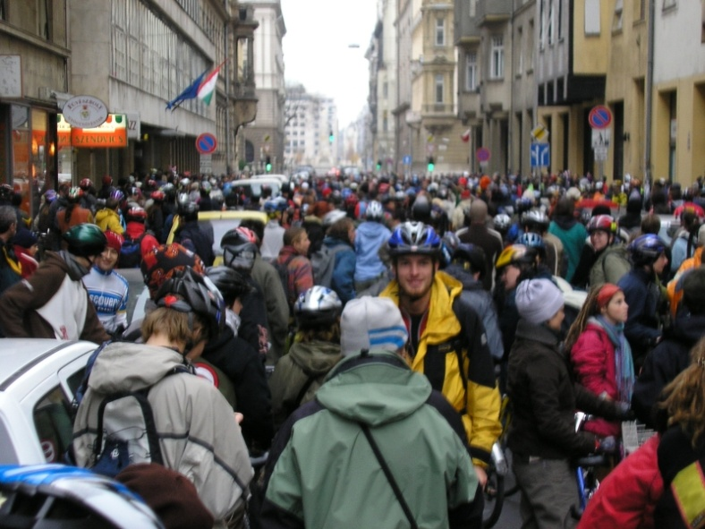
What is your next step? What are your difficulties?
What kind of actions do you plan? Position paper, declaration, viral marketing, bilateral meetings, conference, press and media campaign, street demonstration etc….
What is the time plan in your country? What is your time plan?
How can we help you?

Slide 15
Our contacts:
6billion@ecf.com
a.bodor@ecf.com
e.lancaster@ecf.com
Notes:
If you would like to know more about this contact please contact Adam Bodor and Ed Lancaster

