Slide 1
Cycle into the future
Erik Štefanek, SLOVAKIA
oz Mám rád cyklistiku

Slide 2
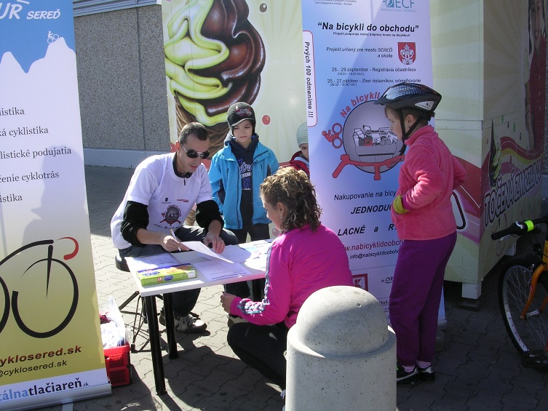
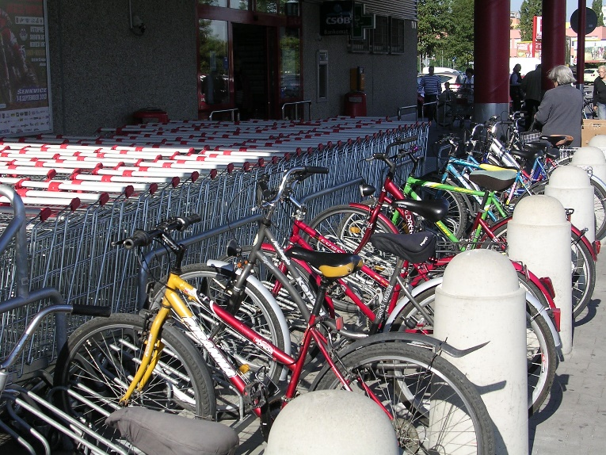
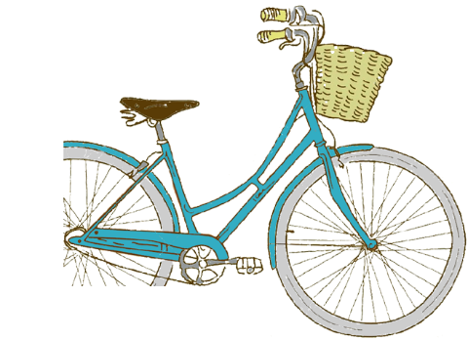
Bike to shop (Na bicykli do obchodu)
Motivate the people to shop by bike
Focus on the cycling infrastructure
Apply on the shop owners to improve the infrastructure near their shop

Slide 3
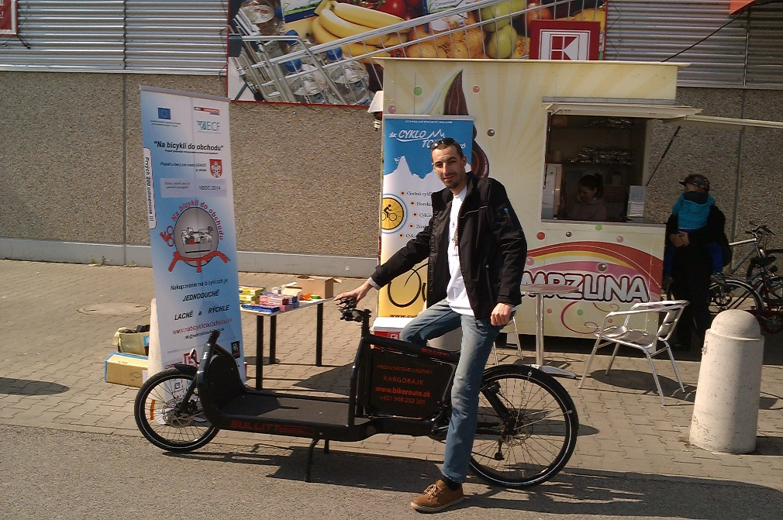
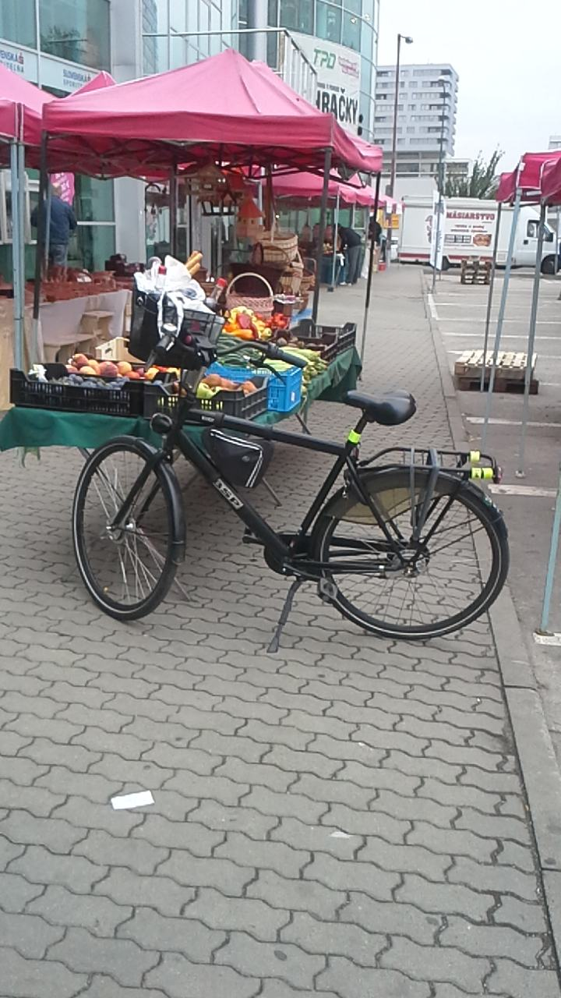
Shopping on a bike is
SIMPLE
CHEAP
HEALTHY
FASTER
CARGO BIKES for heavy goods
Bonuses and discounts
Photo contest for customers

Slide 4
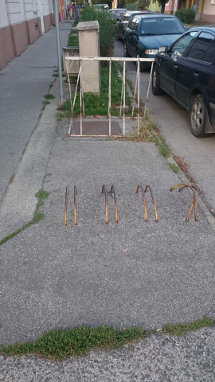
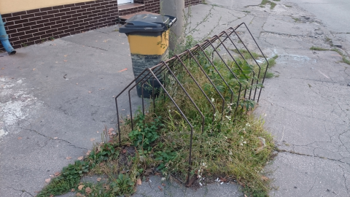
I am afraid of visiting the shop on a bike due to the traffic and missing cycling infrastructure.
Ask the shop owners for improvements
Talk to the city officials

Slide 5
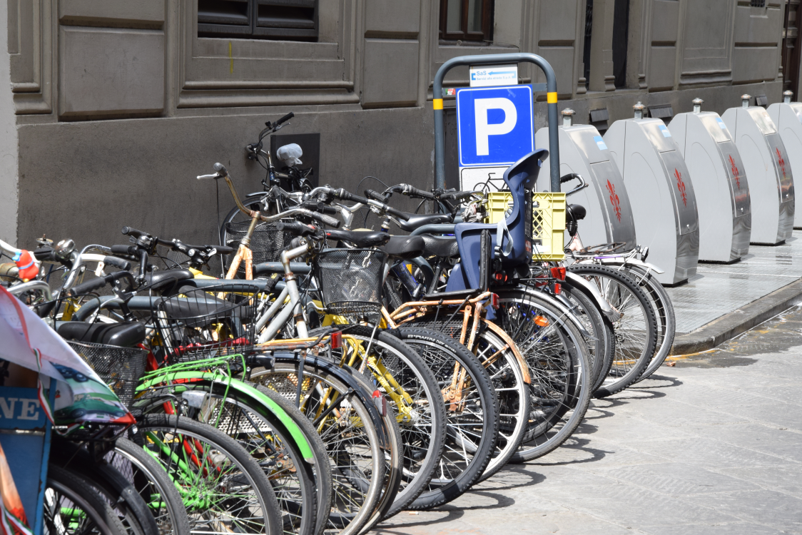
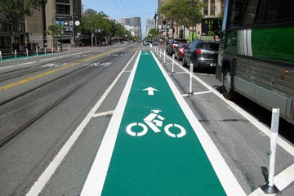
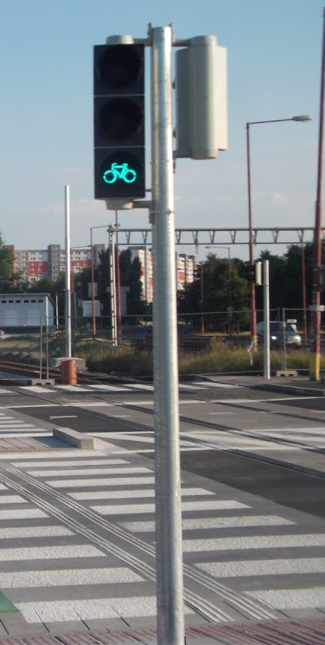
How it should look like...
Florence, Italy
Bratislava, Slovakia

Slide 6
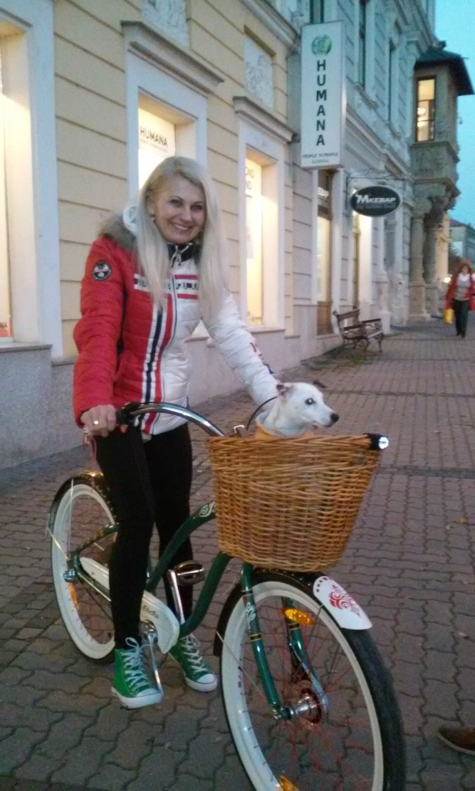
Bike to shop day
California, USA
(35 cities involved in the project)
Thank you for your attention!
More informations about the project on www.mrc.sk & www.nabicyklidoobchodu.sk
or by e-mail: cyklistika@mrc.sk
Andrea Štulajterová, Banská Bystrica

