Slide 1
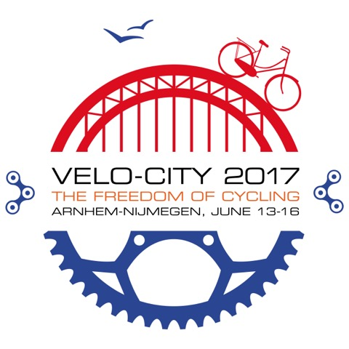
Rijnwaalpad
14th of september, 2016
Notes:
Introduction: Martijn Post, on behalf of Province of Gelderland
RijnWaalpad: 17km lang. € 17mln kosten. Ca € 1mln / km. Inclusief 2 tunnels en 1 fietsbrug, grondverwerving etc. Tunnel: ca € 3mln Fietsbrug: ca € 3,2mln Fietsstraat: ca € 500.000,- / km Fietspad: x 250.000,-/KM
Verlichting: LED-verlichting, apart aanbested (tendering), 5% duurder, 30 jaar onderhoudscontract, 2 routes 500-600 stuks

Slide 2
The challenge
Two seperate cities in 1950 (Arnhem en Nijmegen);
Rapid urbanization since;
An urban region in 2016;
(Mobility) Challenges on a regionale scale
Time for cycle planning!

Slide 3
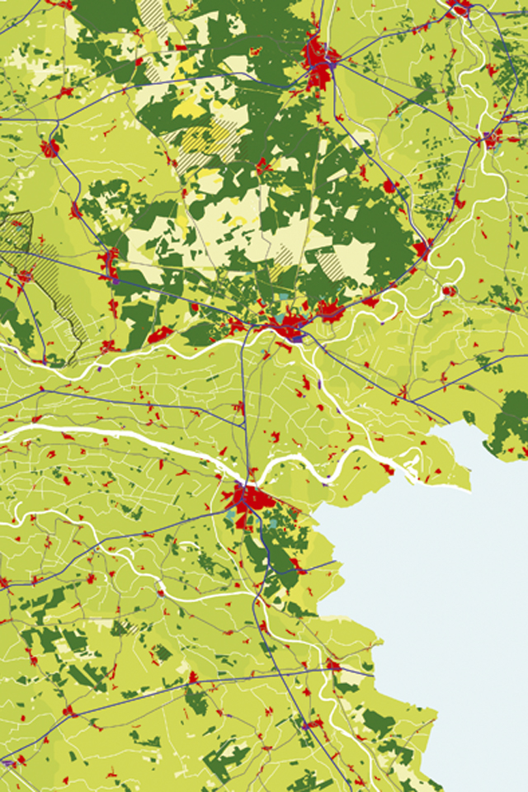
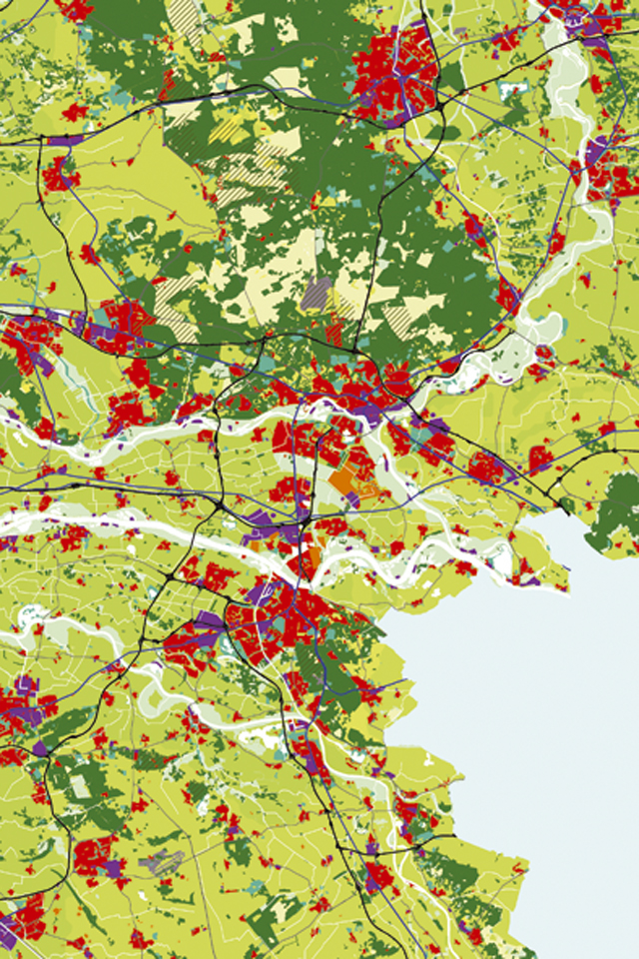
the City Region
1950
the City Region
2010
Notes:
In 1950 two cities. Since then rapid ubanization, an Urban region has formed. Challenges on a regional level, time for cycle planning

Slide 4
Implementing in the existing city
Analyze the demand (existing and future cyclists);
Define bicycle network;
Start implementing small improvements (growth of the amount of cyclists);
Bigger improvements when cycling becomes a political factor → Cycle Highways.

Slide 5
Example: step 2 in Amsterdam

Slide 6
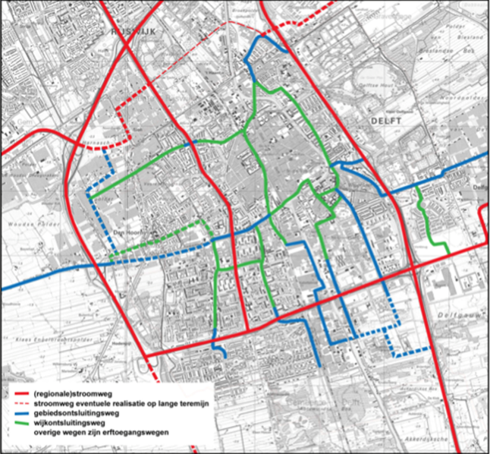
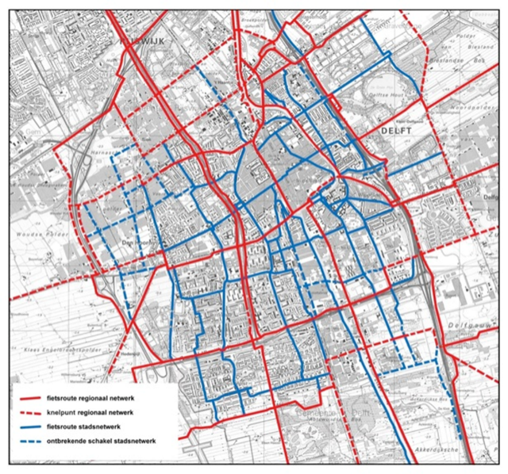
Example: step 2 in Delft
Notes:
Het stratenpatroon van Delft – the planning work of decades

Slide 7
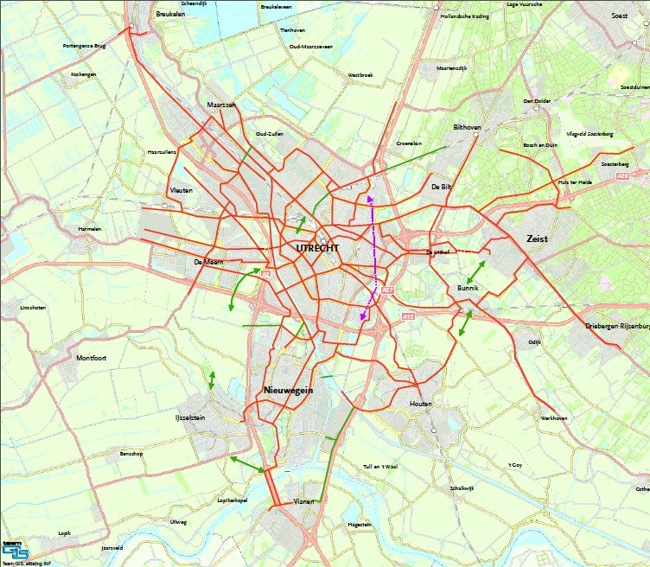
Notes:
Also in Utrecht
- Difference in highways, railways and cycle.

Slide 8
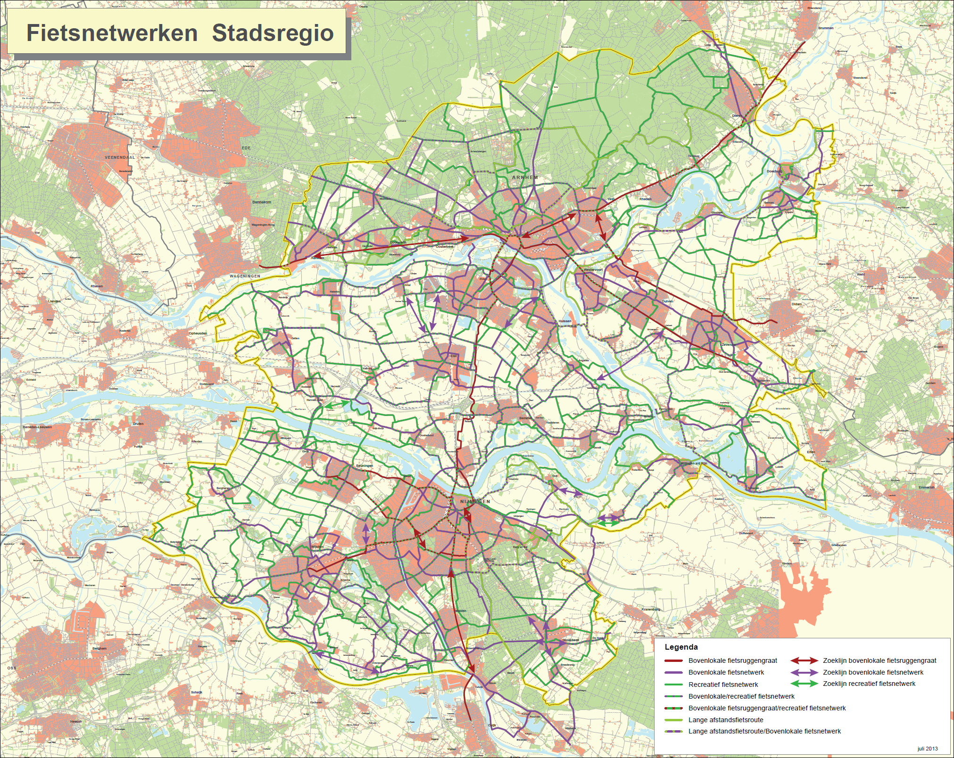
Notes:
Different levels of network design – very detailed

Slide 9
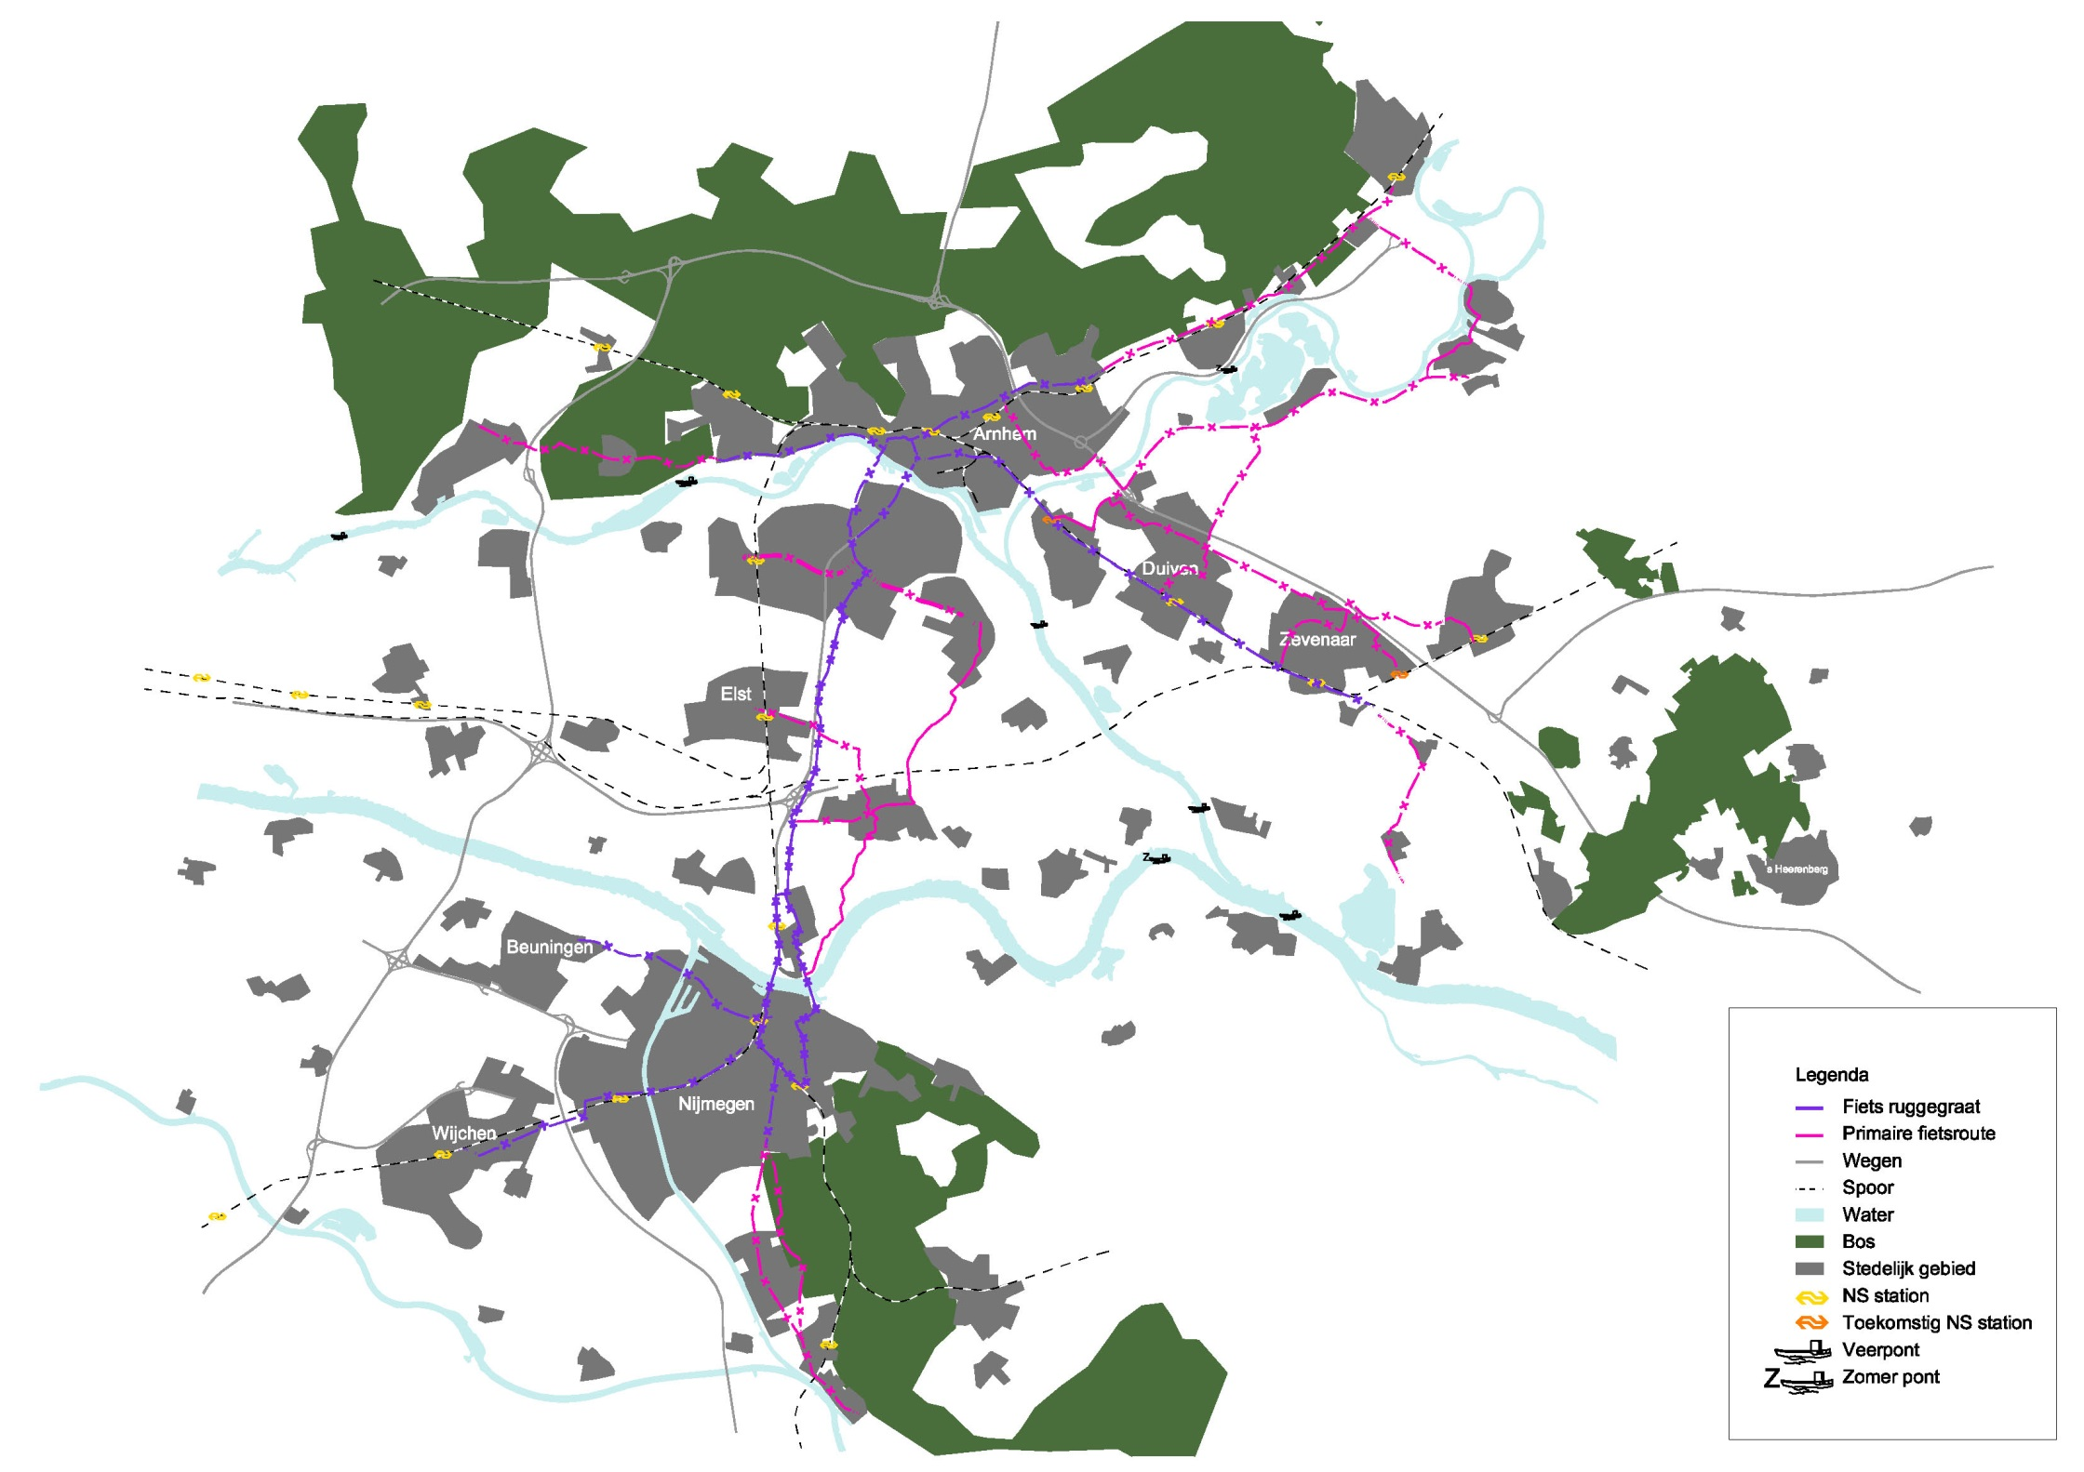
Notes:
To the main lines: super cycle highways

Slide 10
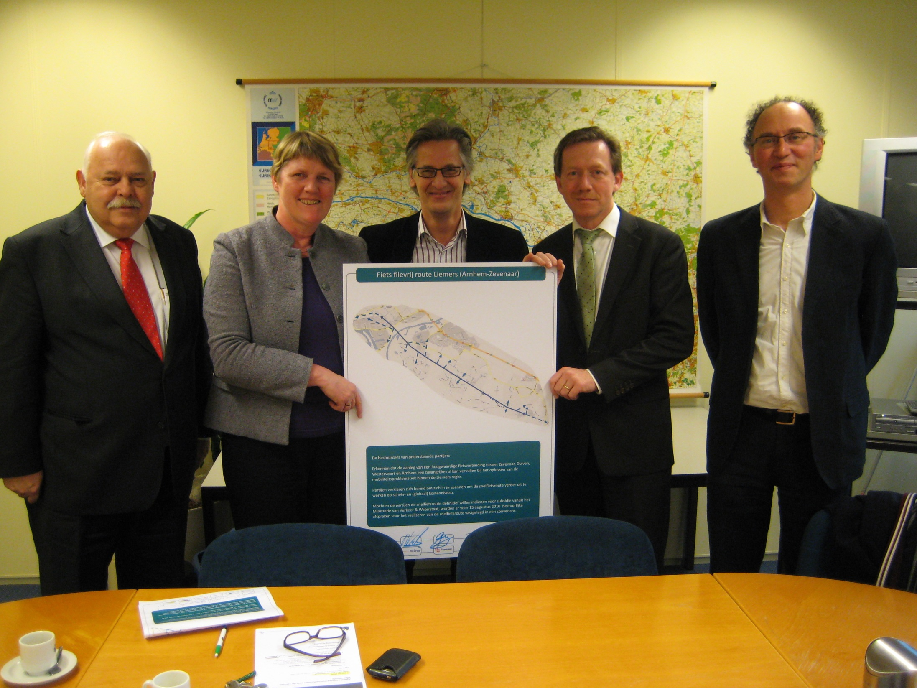
Step 4: political support
Notes:
We have arranged broad political support

Slide 11
Together with the municipalities
Notes:
The province works closesely toegether with municipalities
And political agreements are made, including millions of funding

Slide 12
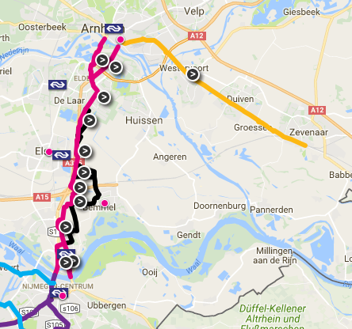
Rijnwaalpad
17 km long;
€ 17 mln.
Including 2 tunnels, 1 bridge
4 municipalities
New Bike paths
Use of existing roads
Connecting attraction points
Integration with
public transport

Slide 13
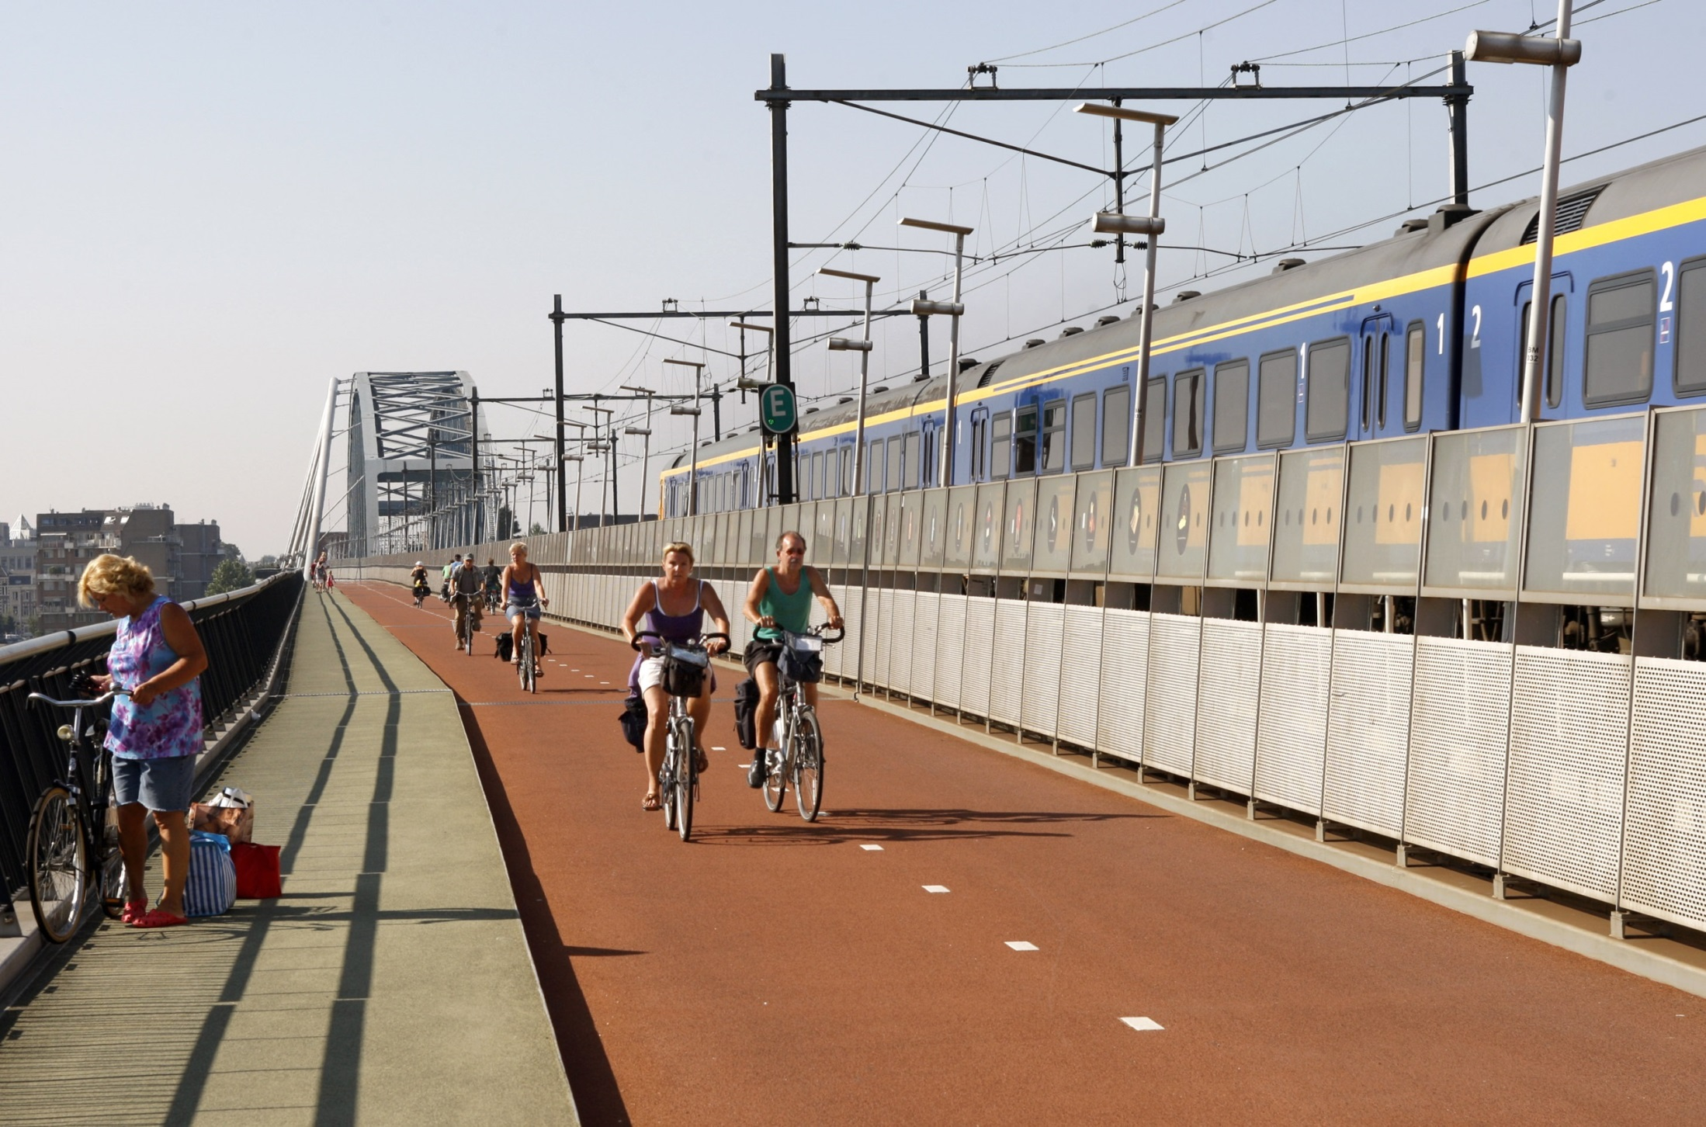
Waalbridge
Notes:
With the planning process we are able to build great infrastructure

Slide 14
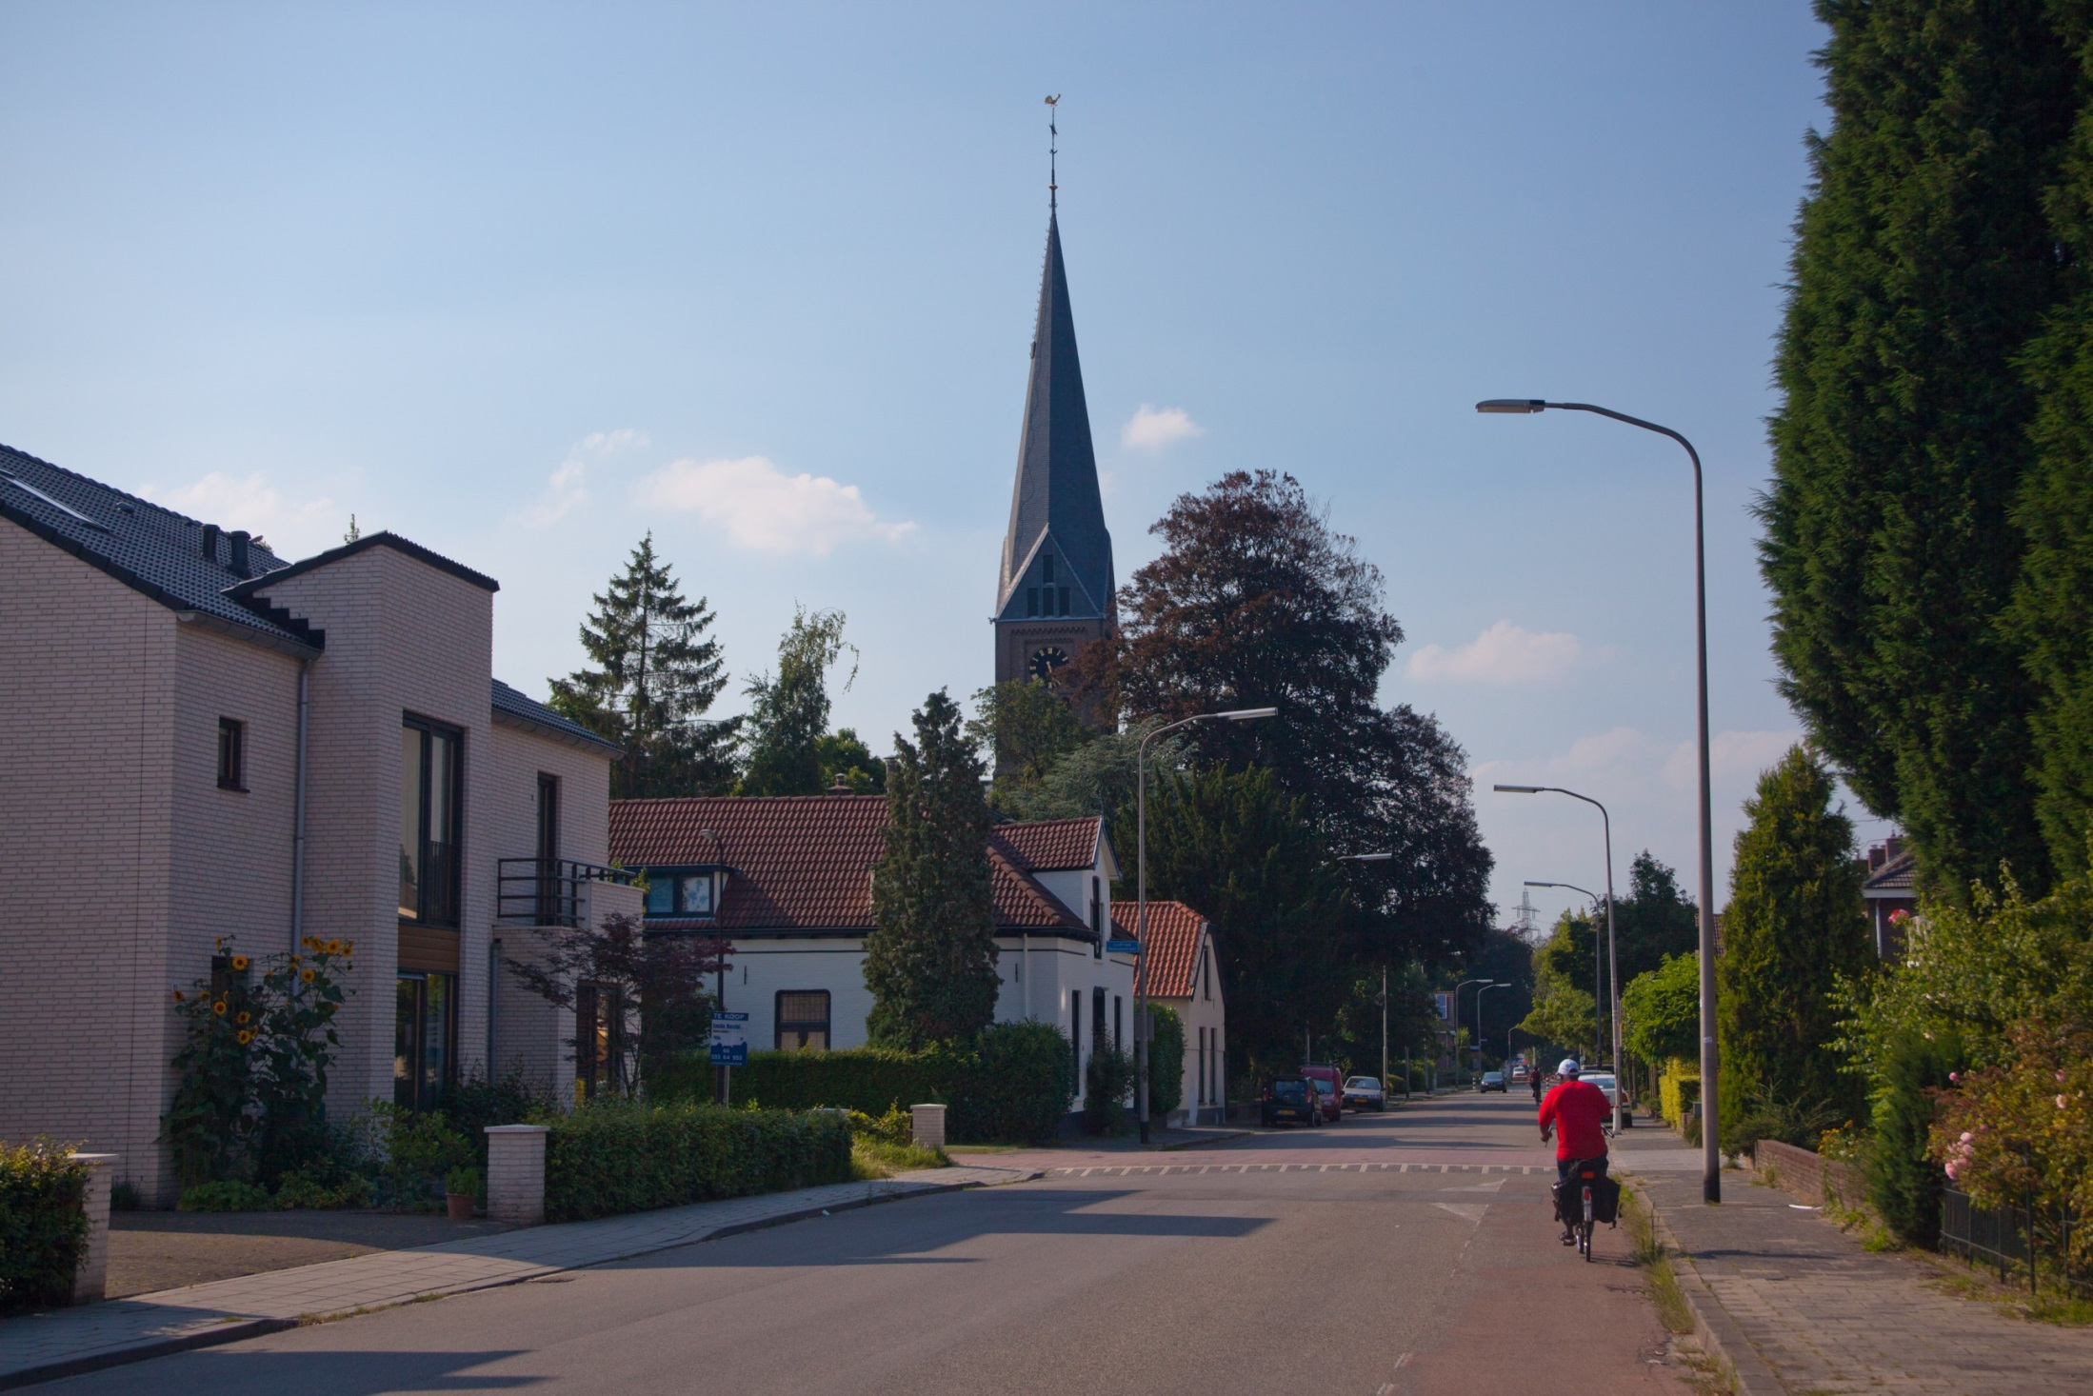
Before
Notes:
We re-CYCLE infrastructure

Slide 15
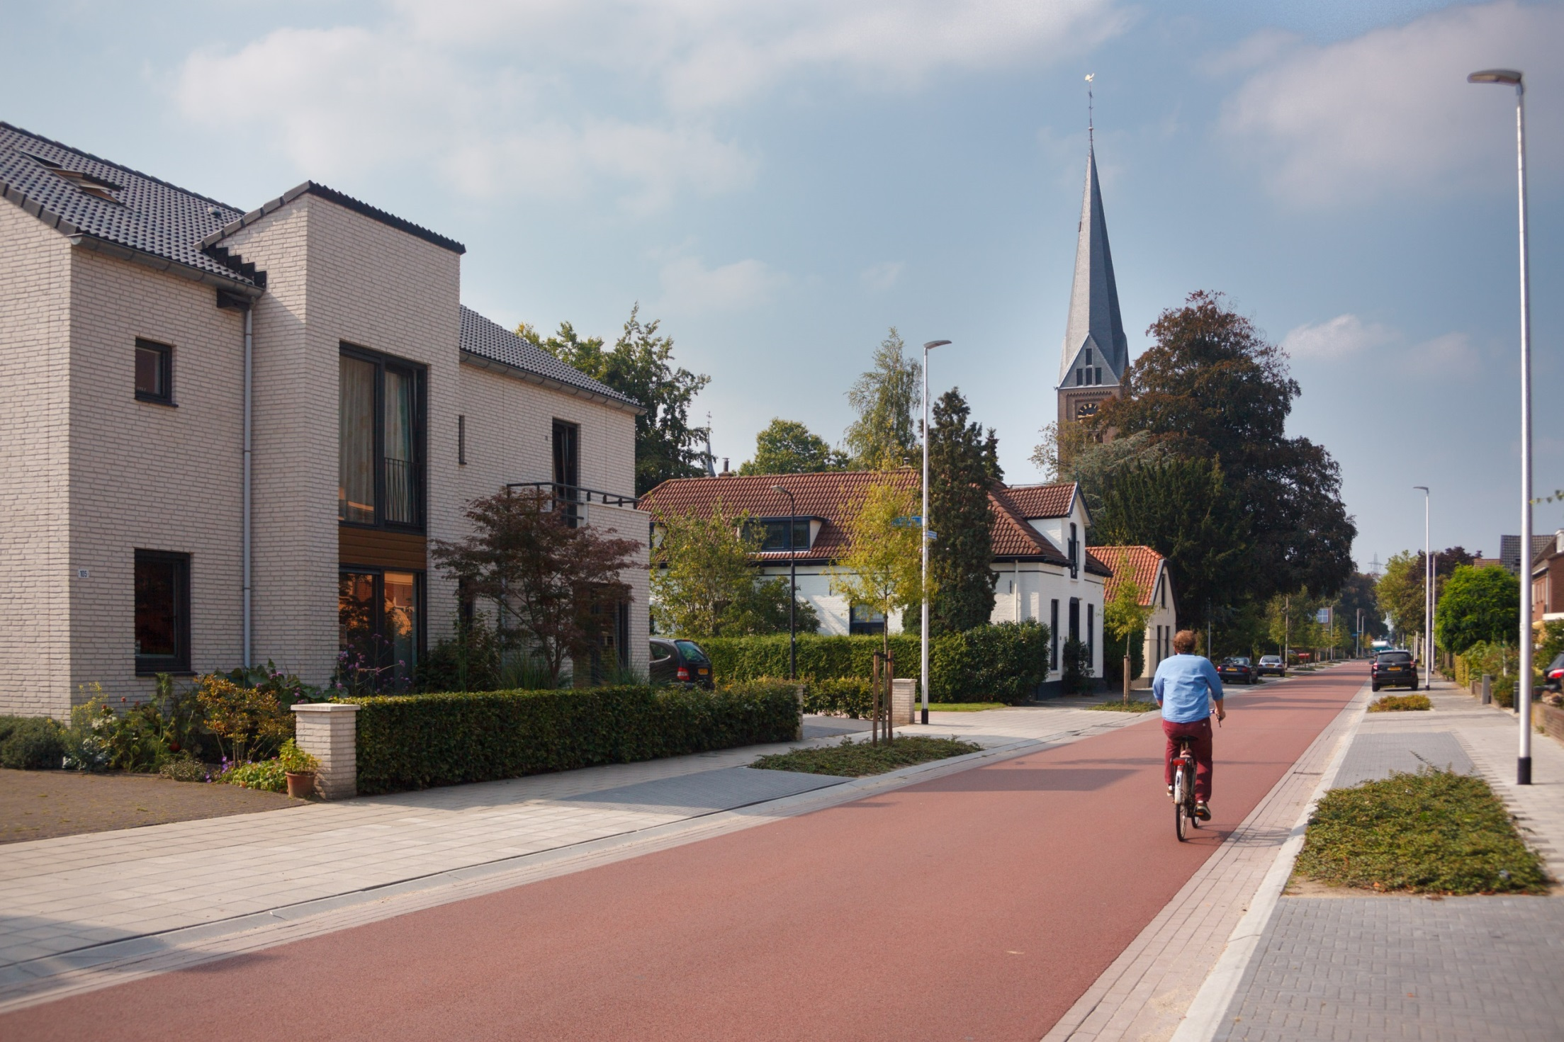
After
Notes:
Using former wide roads. In the meantime improving the quality of public space, planting trees and providing parking

Slide 16
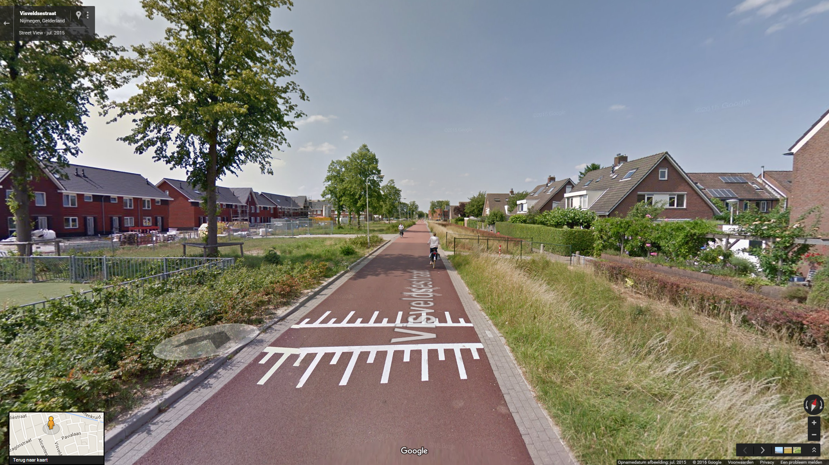
Notes:
Filtered permeability: the bicycle can go on the shortest route, the car takes the long way

Slide 17
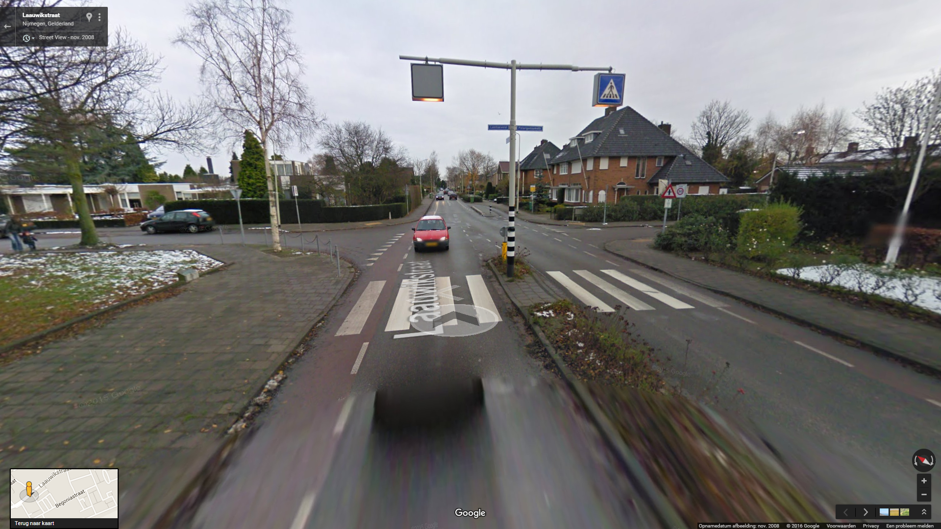
Before
Notes:
Redesigning streets into cycling streeds

Slide 18
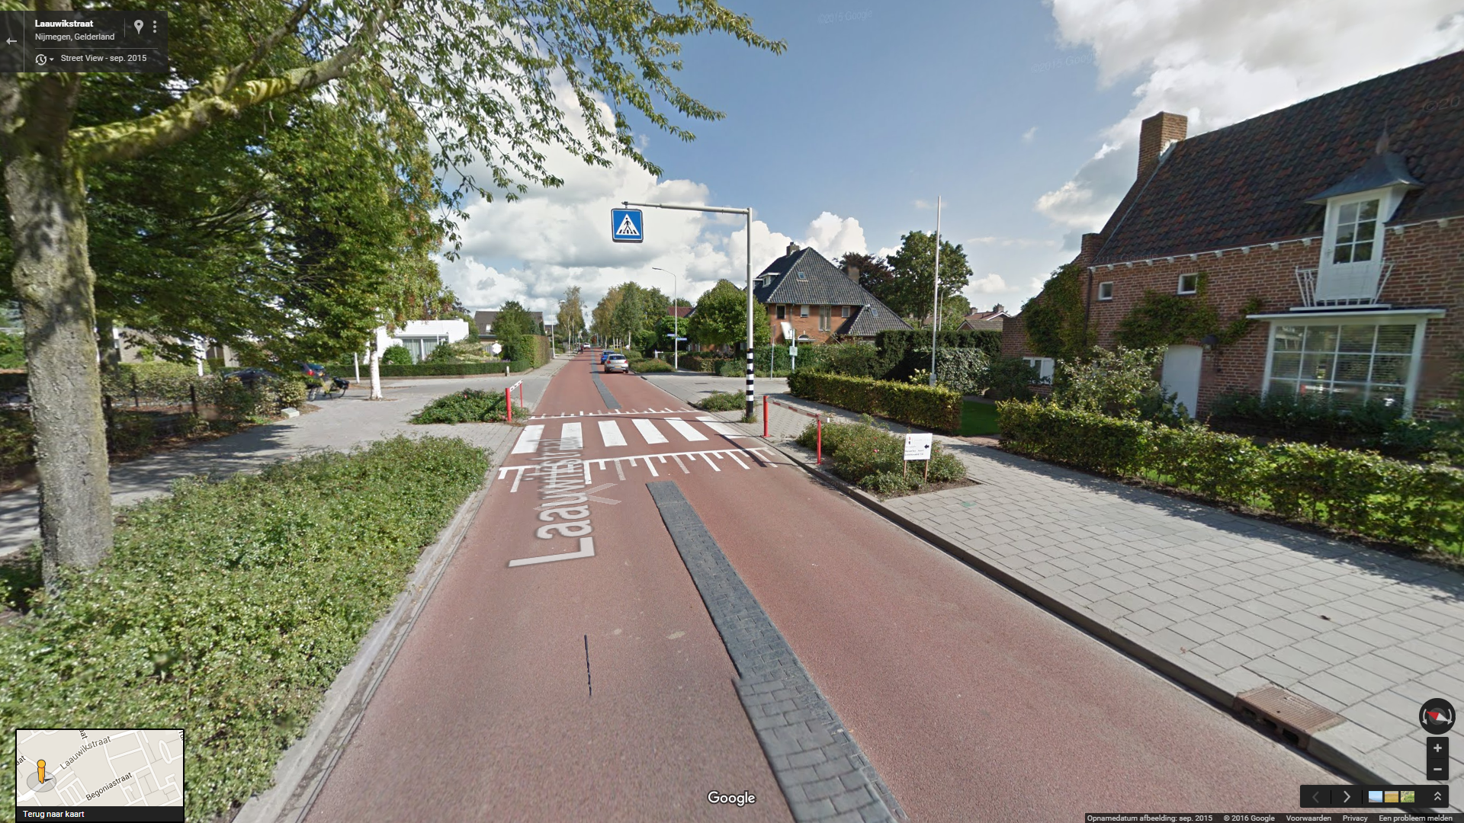
After
Notes:
Where car is the guest

Slide 19
Notes:
Our heavy infrastructure is reaching it’s limits due to our succes

Slide 20
Multi-use
Notes:
But other user’s find our routes

Slide 21
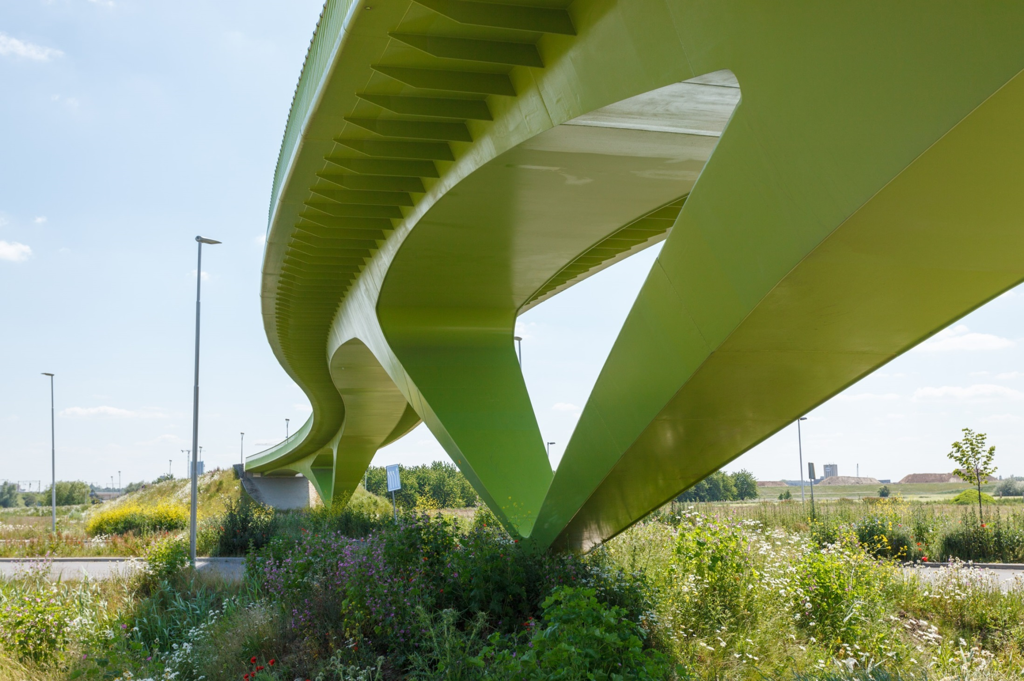
Crossing the Ring Road
Notes:
Sleek architecture, light buildings

Slide 22
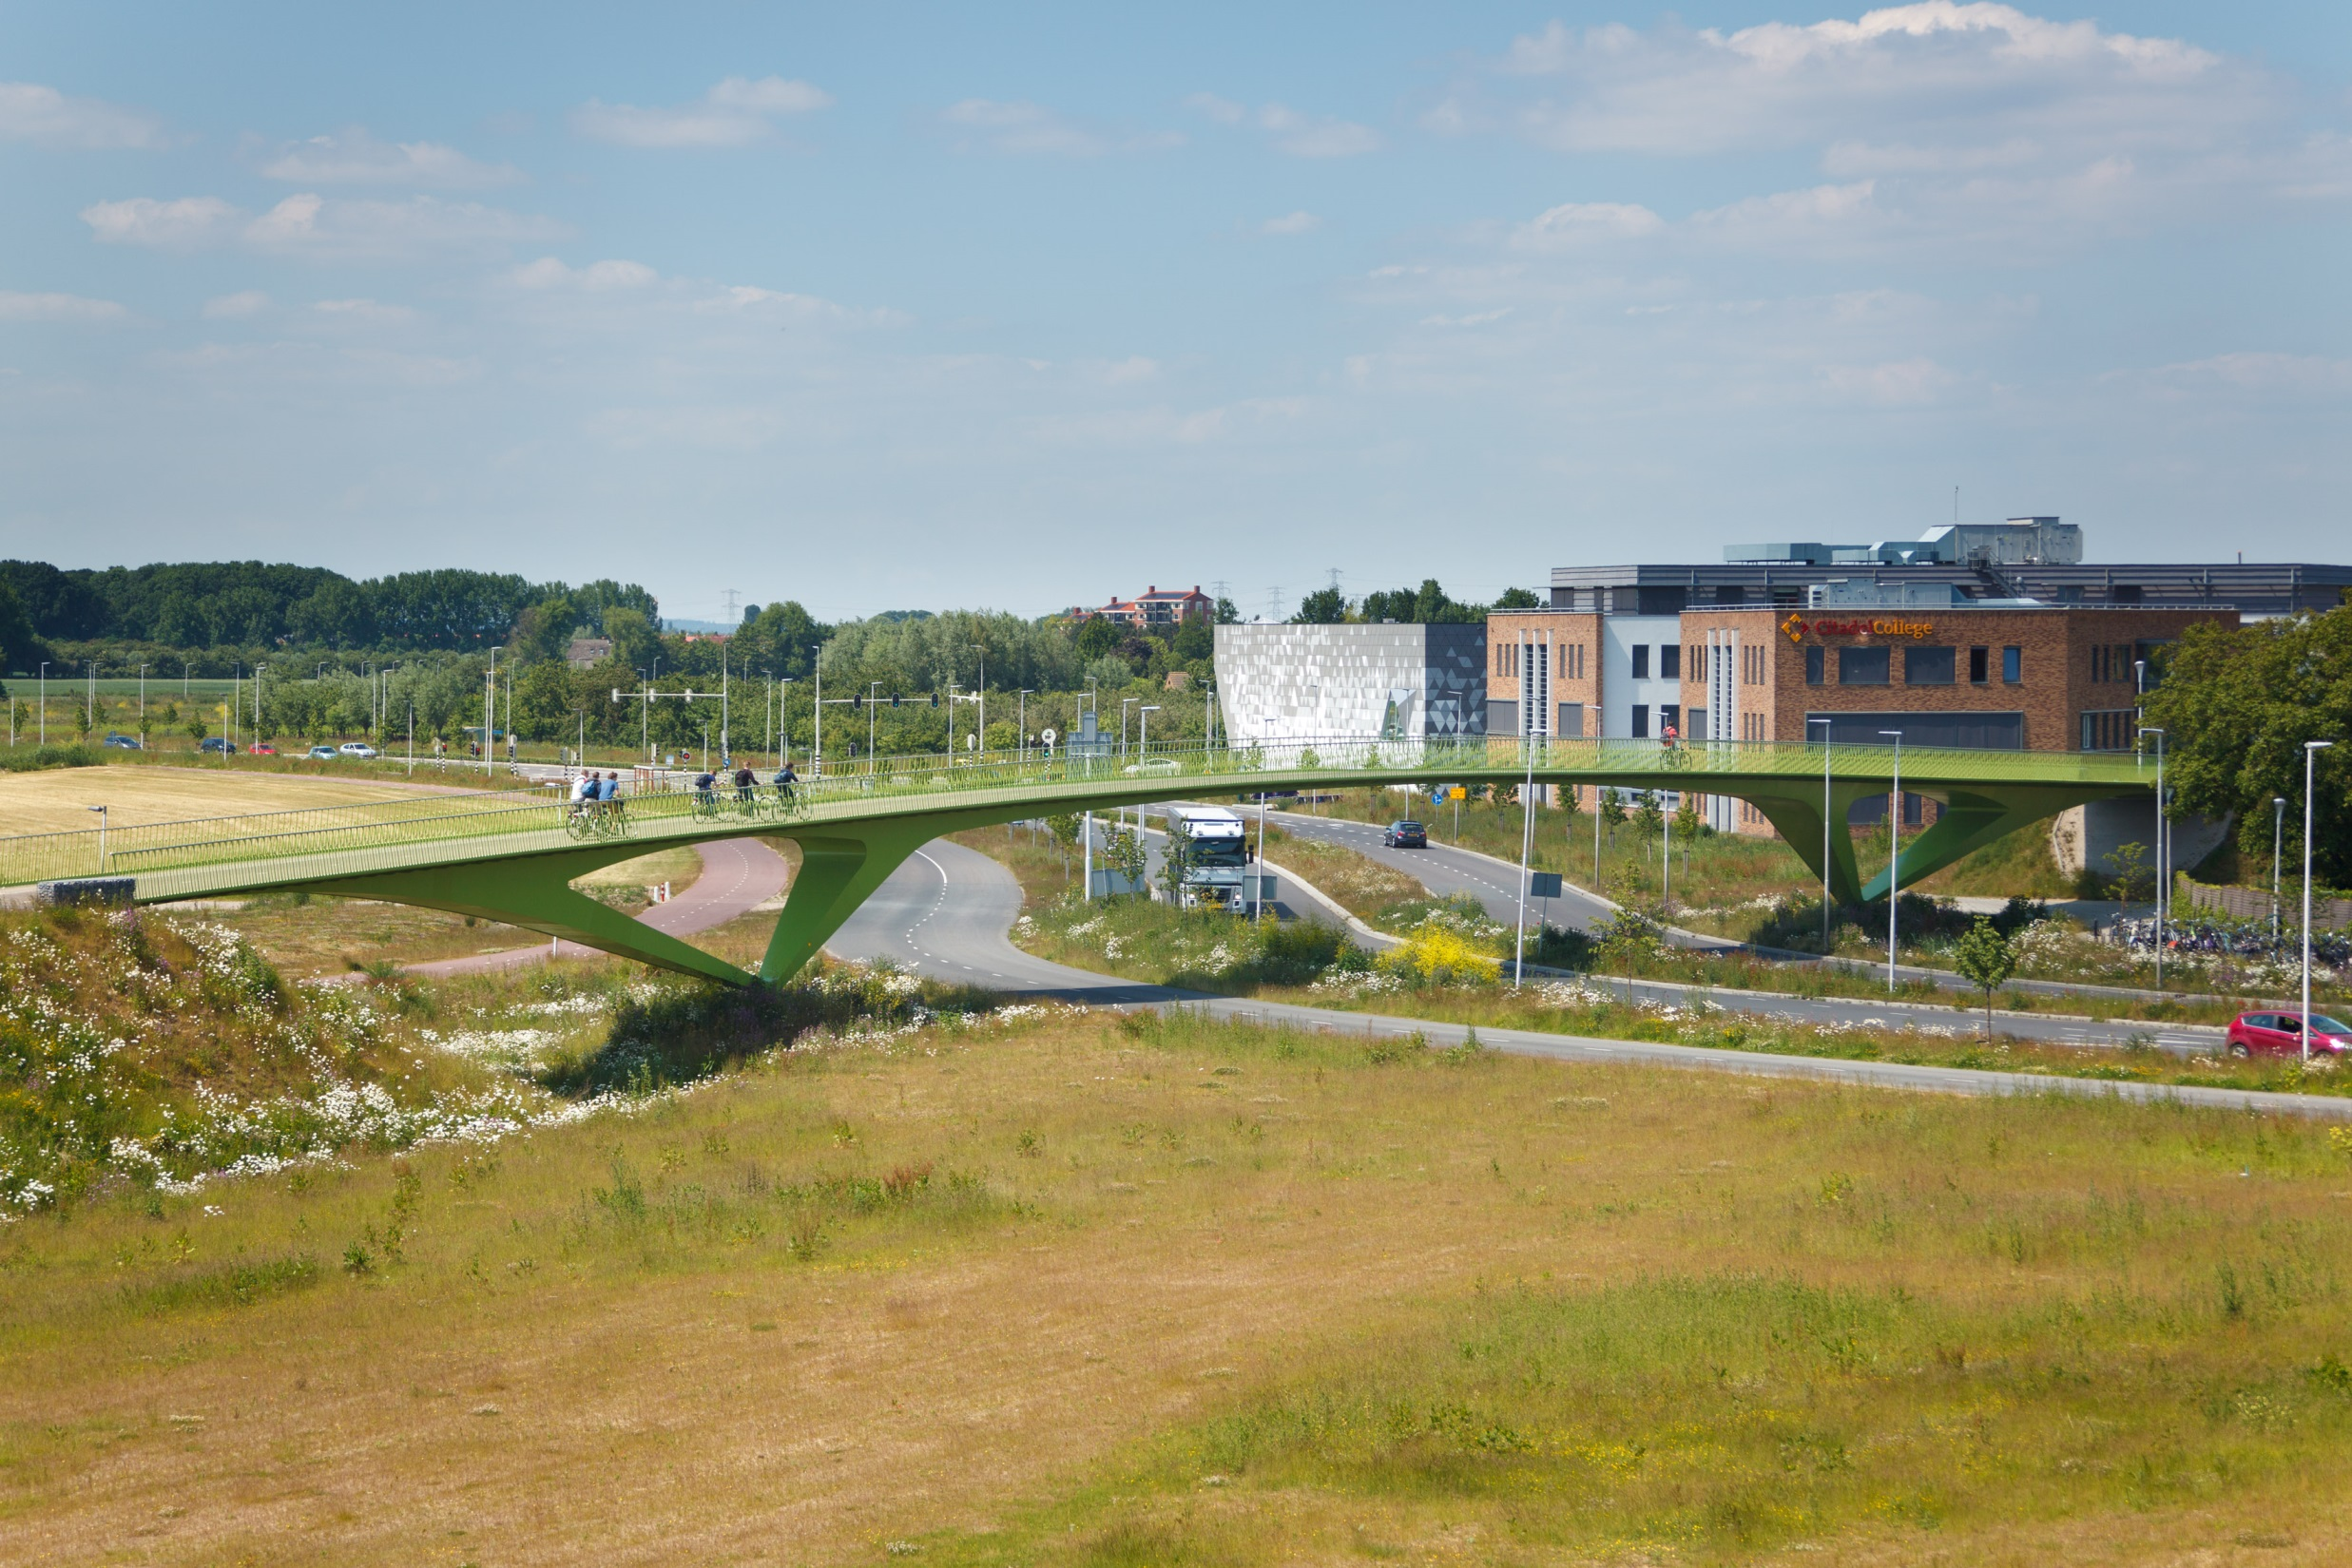
Crossing the Ring Road
Notes:
Creating landmarks

Slide 23
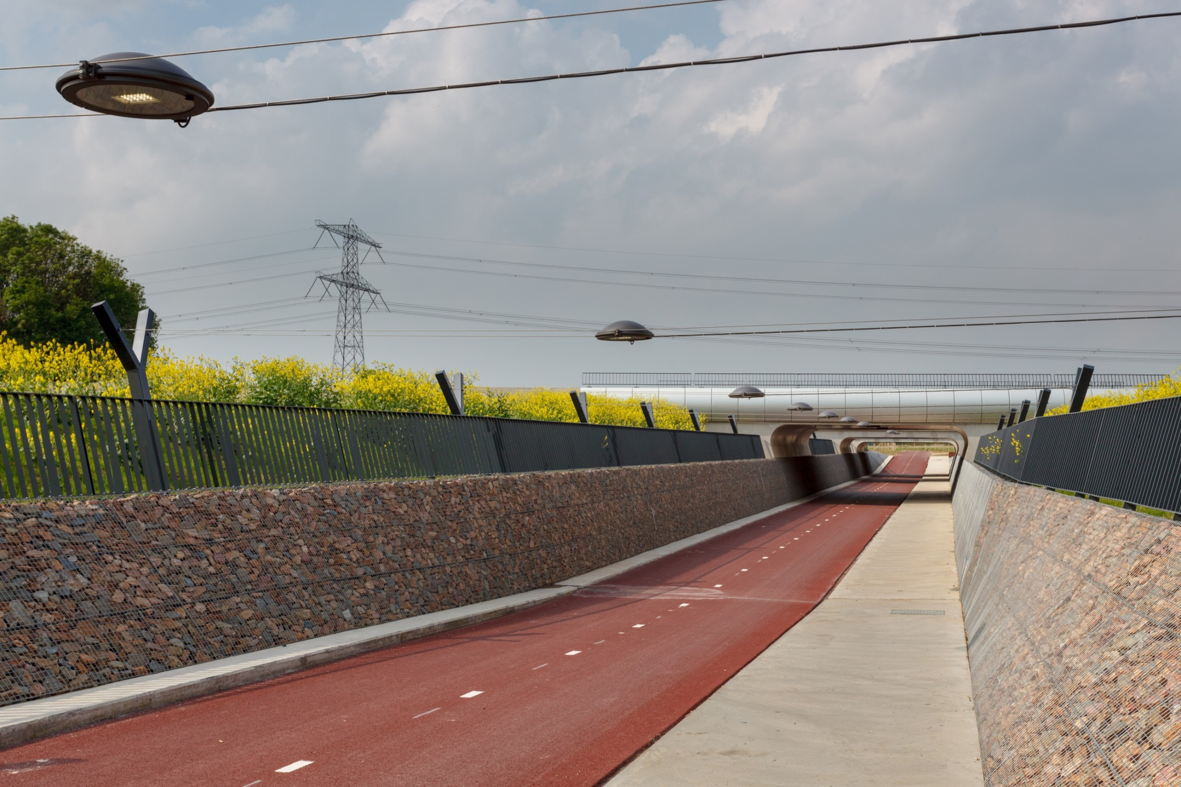
Highway tunnel [A15]
Notes:
Building great underpasses

Slide 24
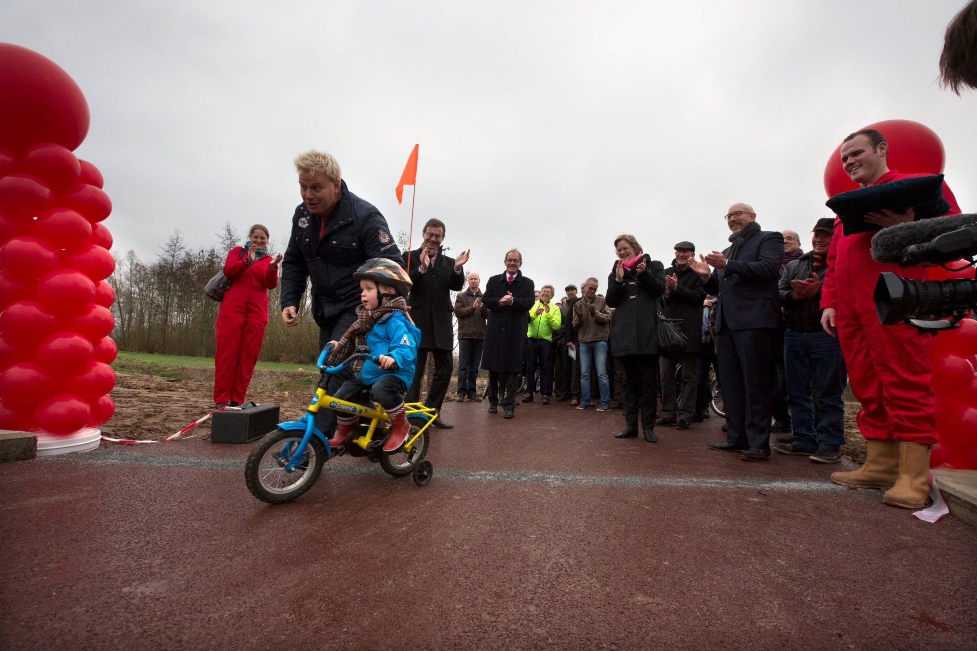
Grand opening
Notes:
But it still is on the human level: the first user of the underpass. (Every week when he visited his grandpa he visited the construction site. The little boy was excited about the big construction project and excited to cycle through). It was an unplannend event!

Slide 25
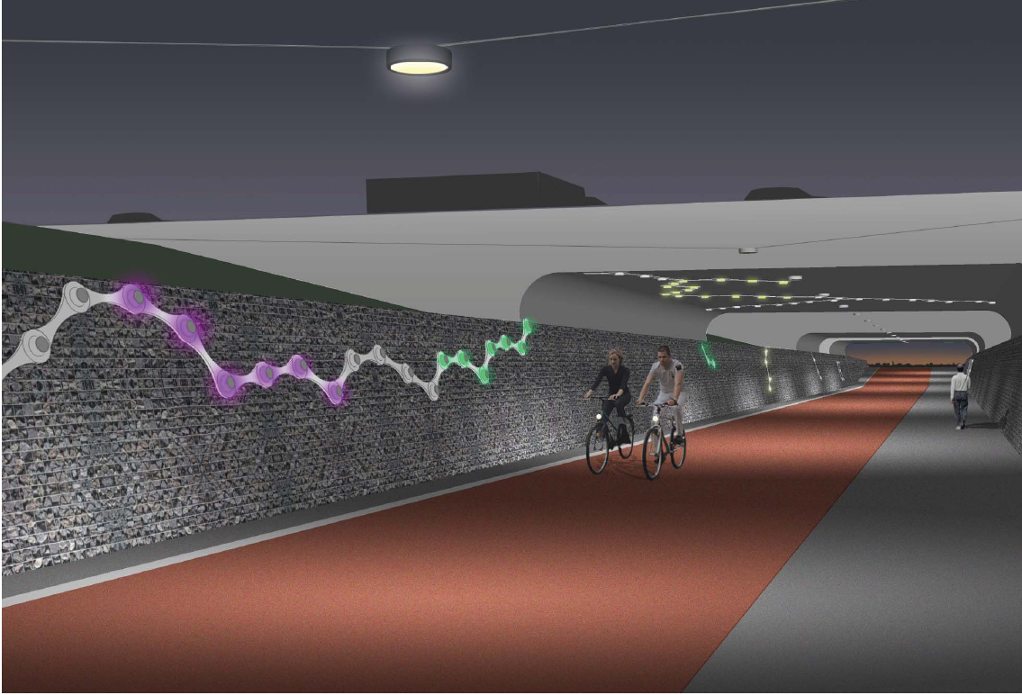
Notes:
With an app you can control the lighting in the tunnel

Slide 26
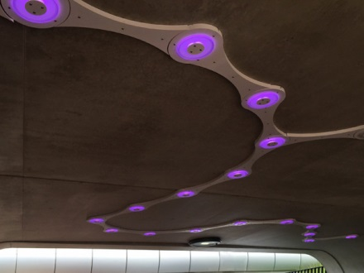
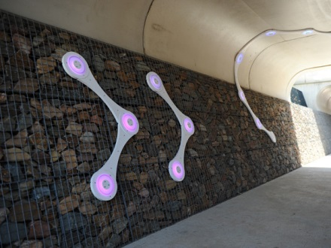
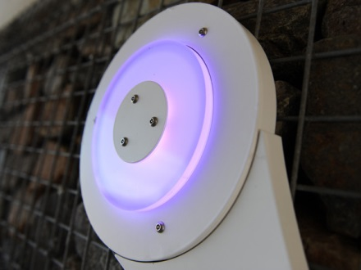
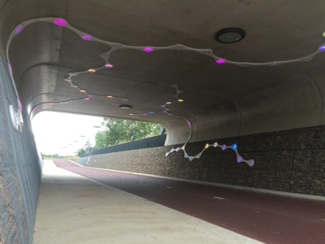
Notes:
More often you ride, the more colours you get. If somebody who rides more often comes through, his/her colour will show, not yours. Encouraging you to ride more. Additional the tunnel is enhanced from a possible creepy place to an attractive place.

Slide 27
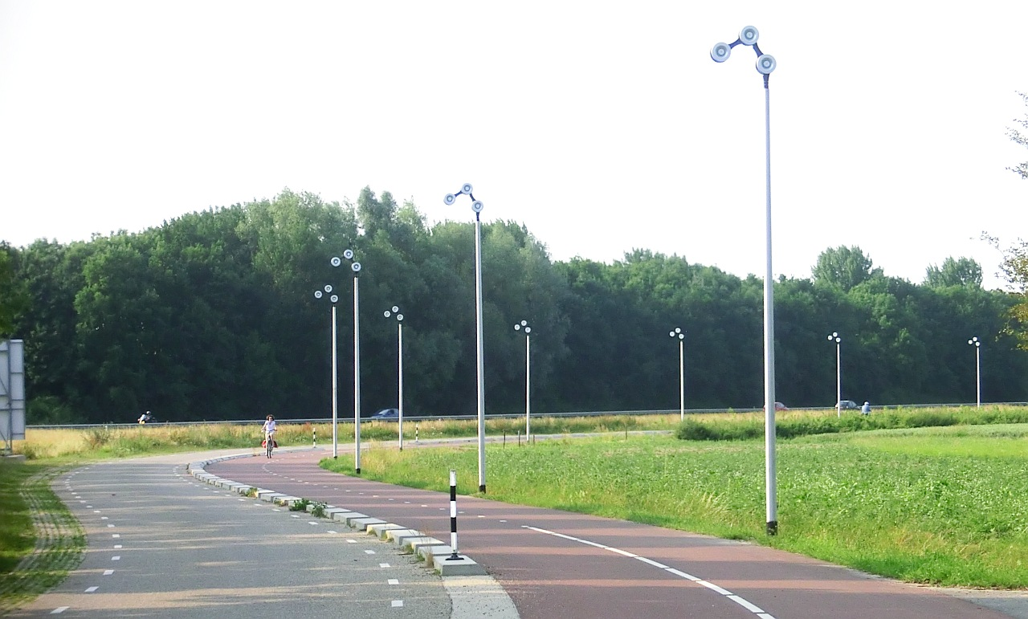
Notes:
Lighting which symbolizes part of a bicycle chain
Usage: 2.000 till 5.000 a day.
Strongly depends on the location.

Slide 28
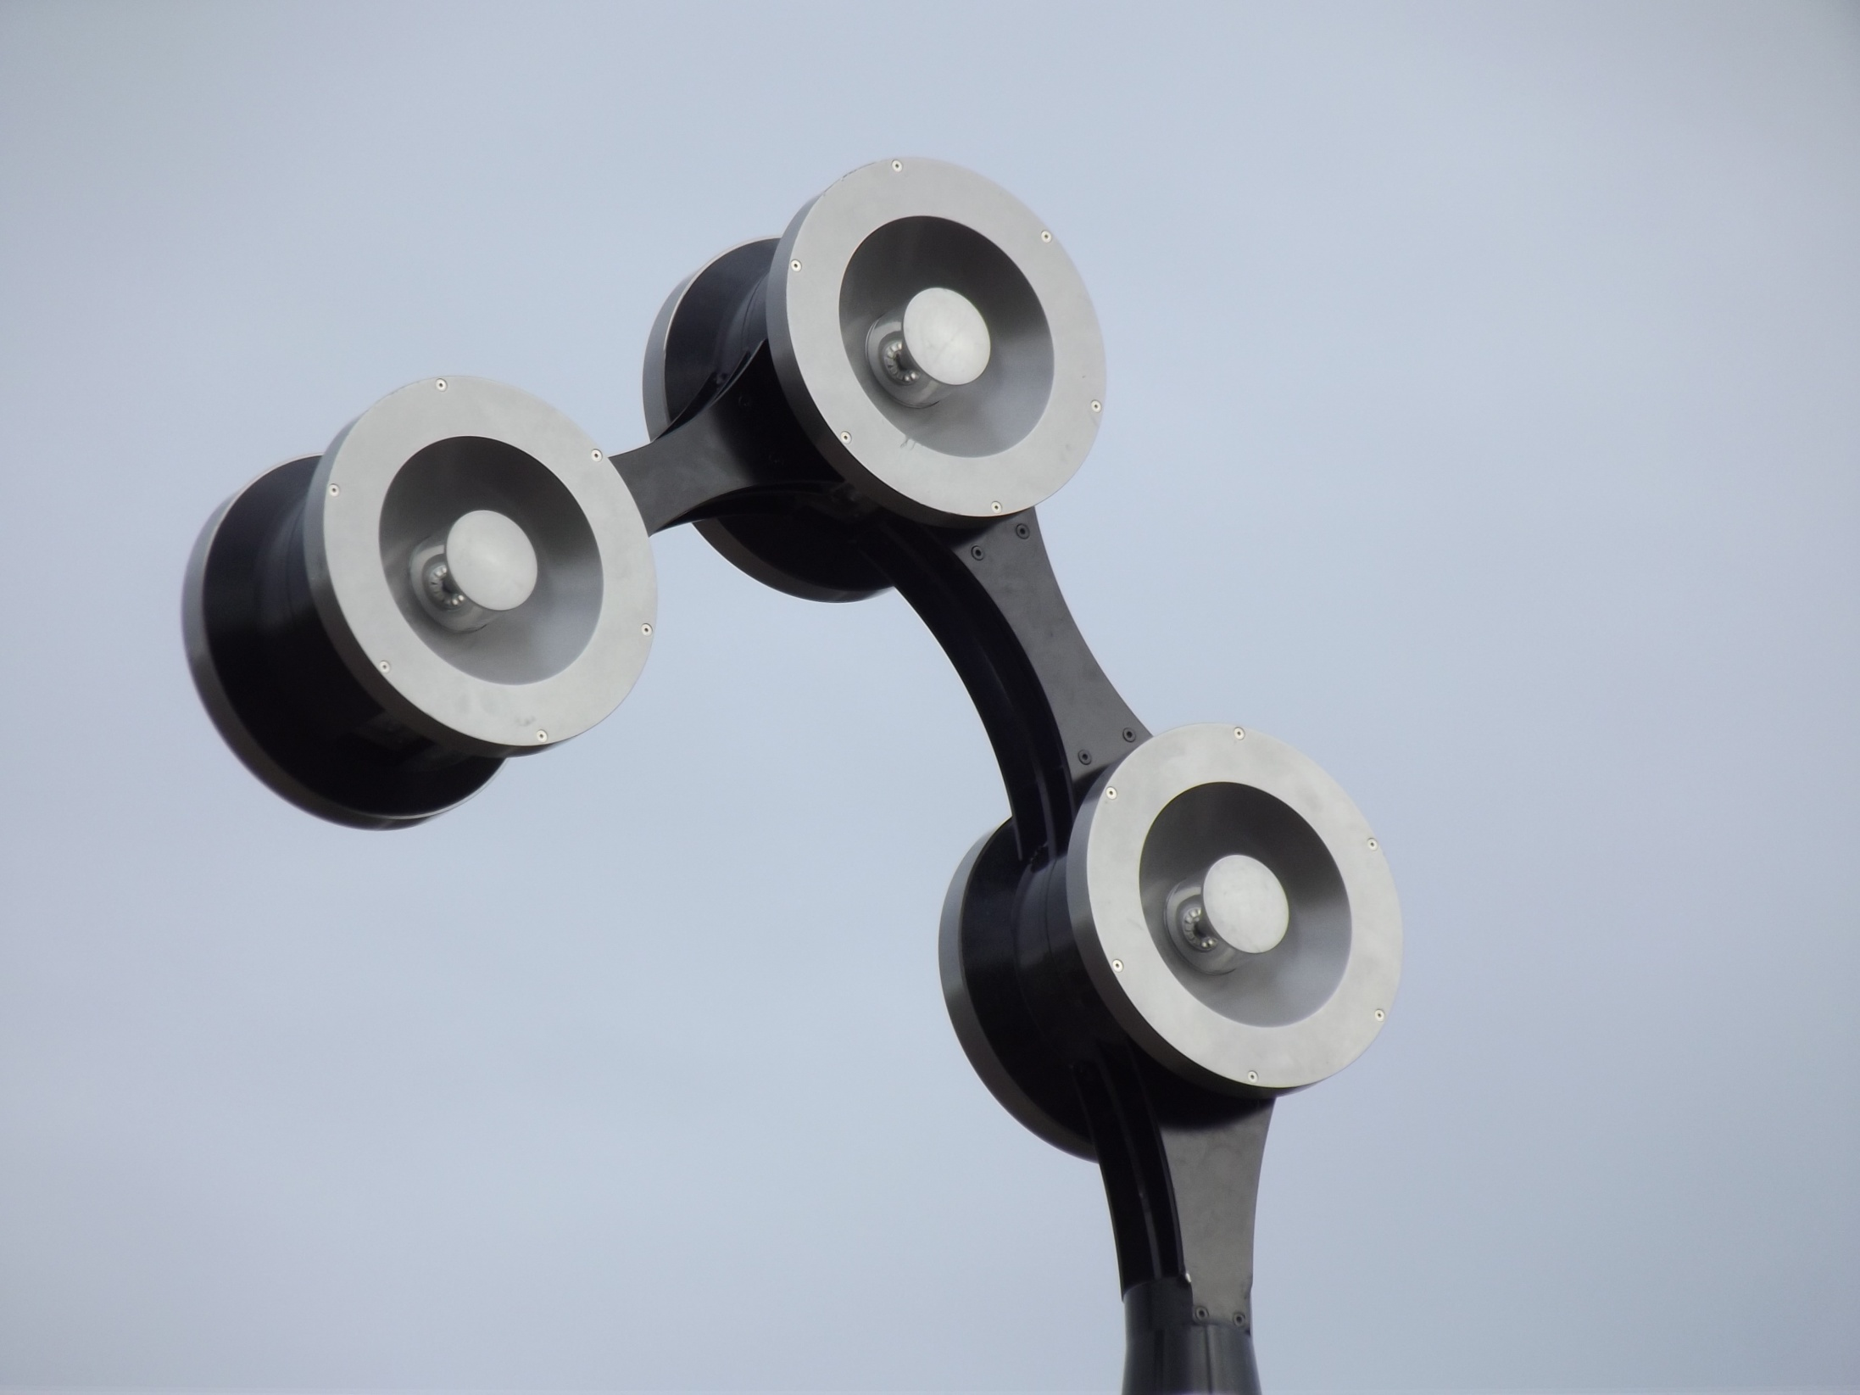

Slide 29
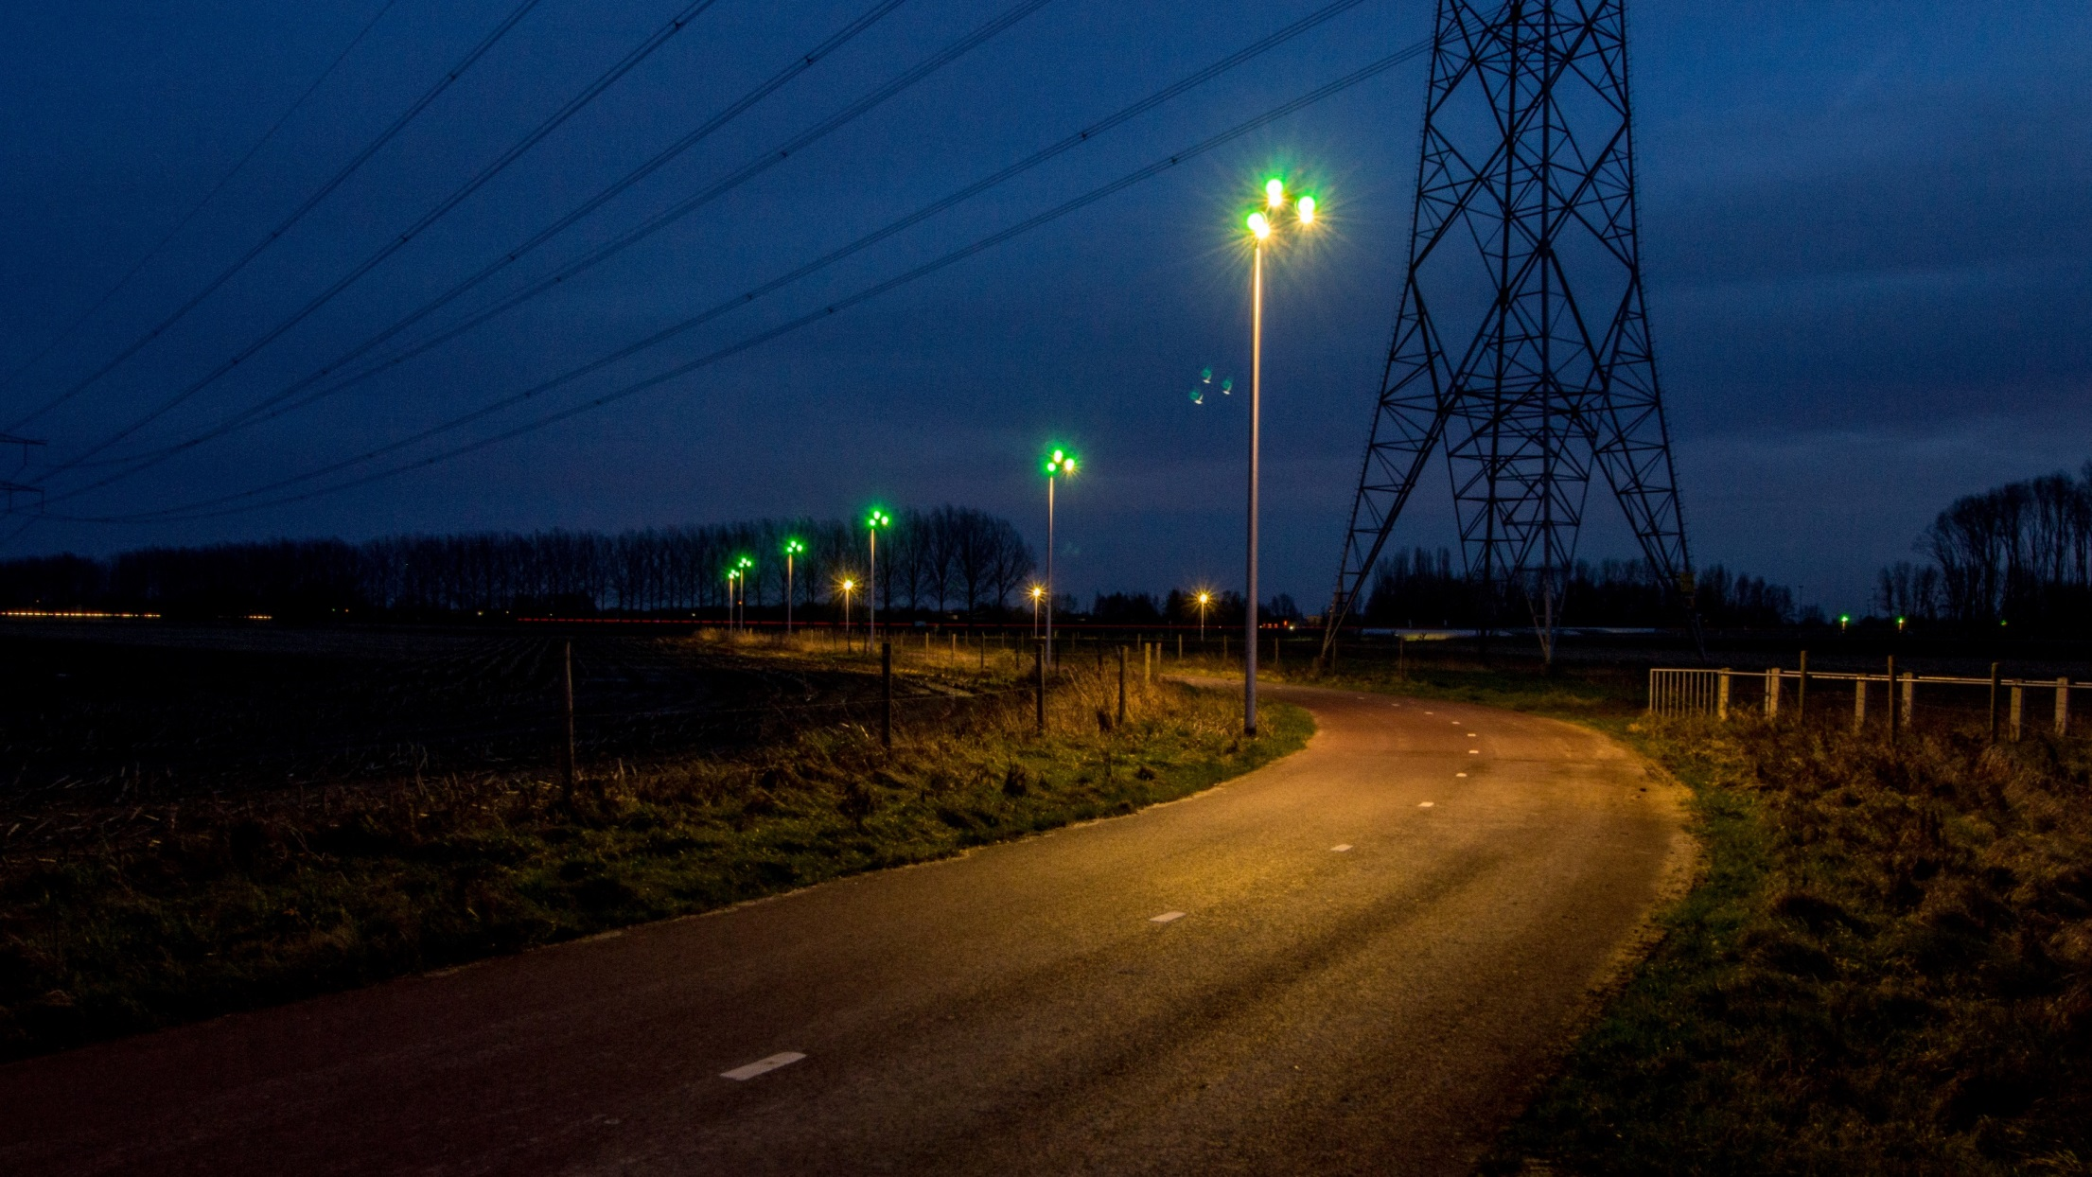
High-tech wayfinding
Notes:
Lights up in the evening. Green towards Nijmegen, Purple towards Arnhem. High tech wayfinding.

Slide 30
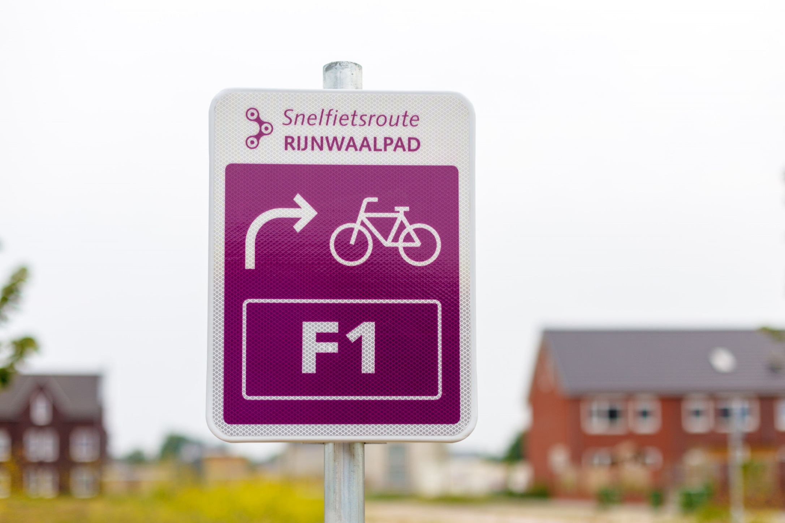
A problem…
Notes:
We have some low-tech wayfinding as well

