Slide 1

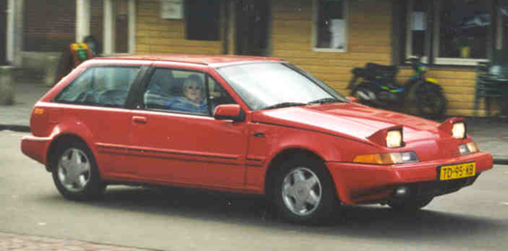
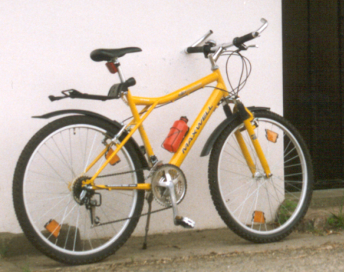

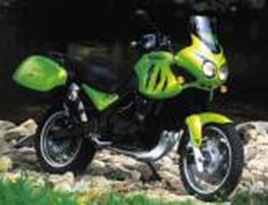
Design Standards: straitjacket or ticket to freedom
Hillie Talens, project manager

Slide 2
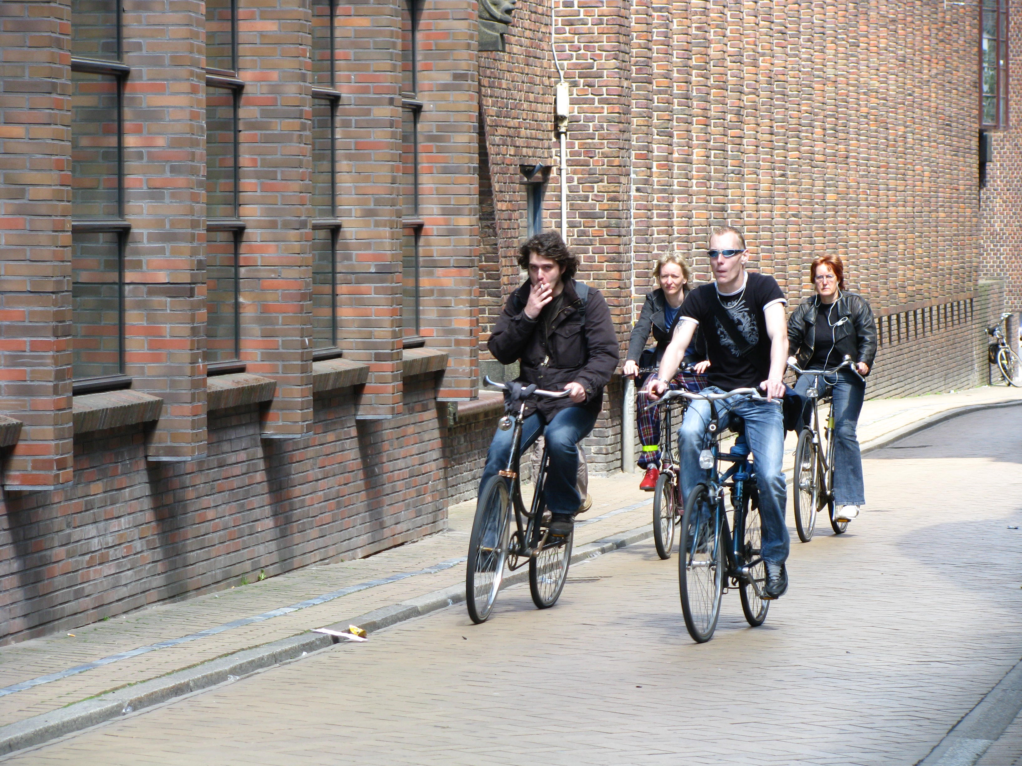
There is more to cycling than infrastructure?

Slide 3
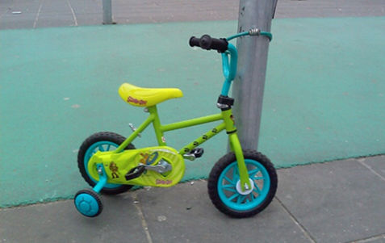
Not just infrastructure
Logical part of society
Bicycle as default
Vehicle safety
Laws and regulations
Cycling inclusive policy
Smart environmental planning
Discourage car use
Bicycle parking

Slide 4
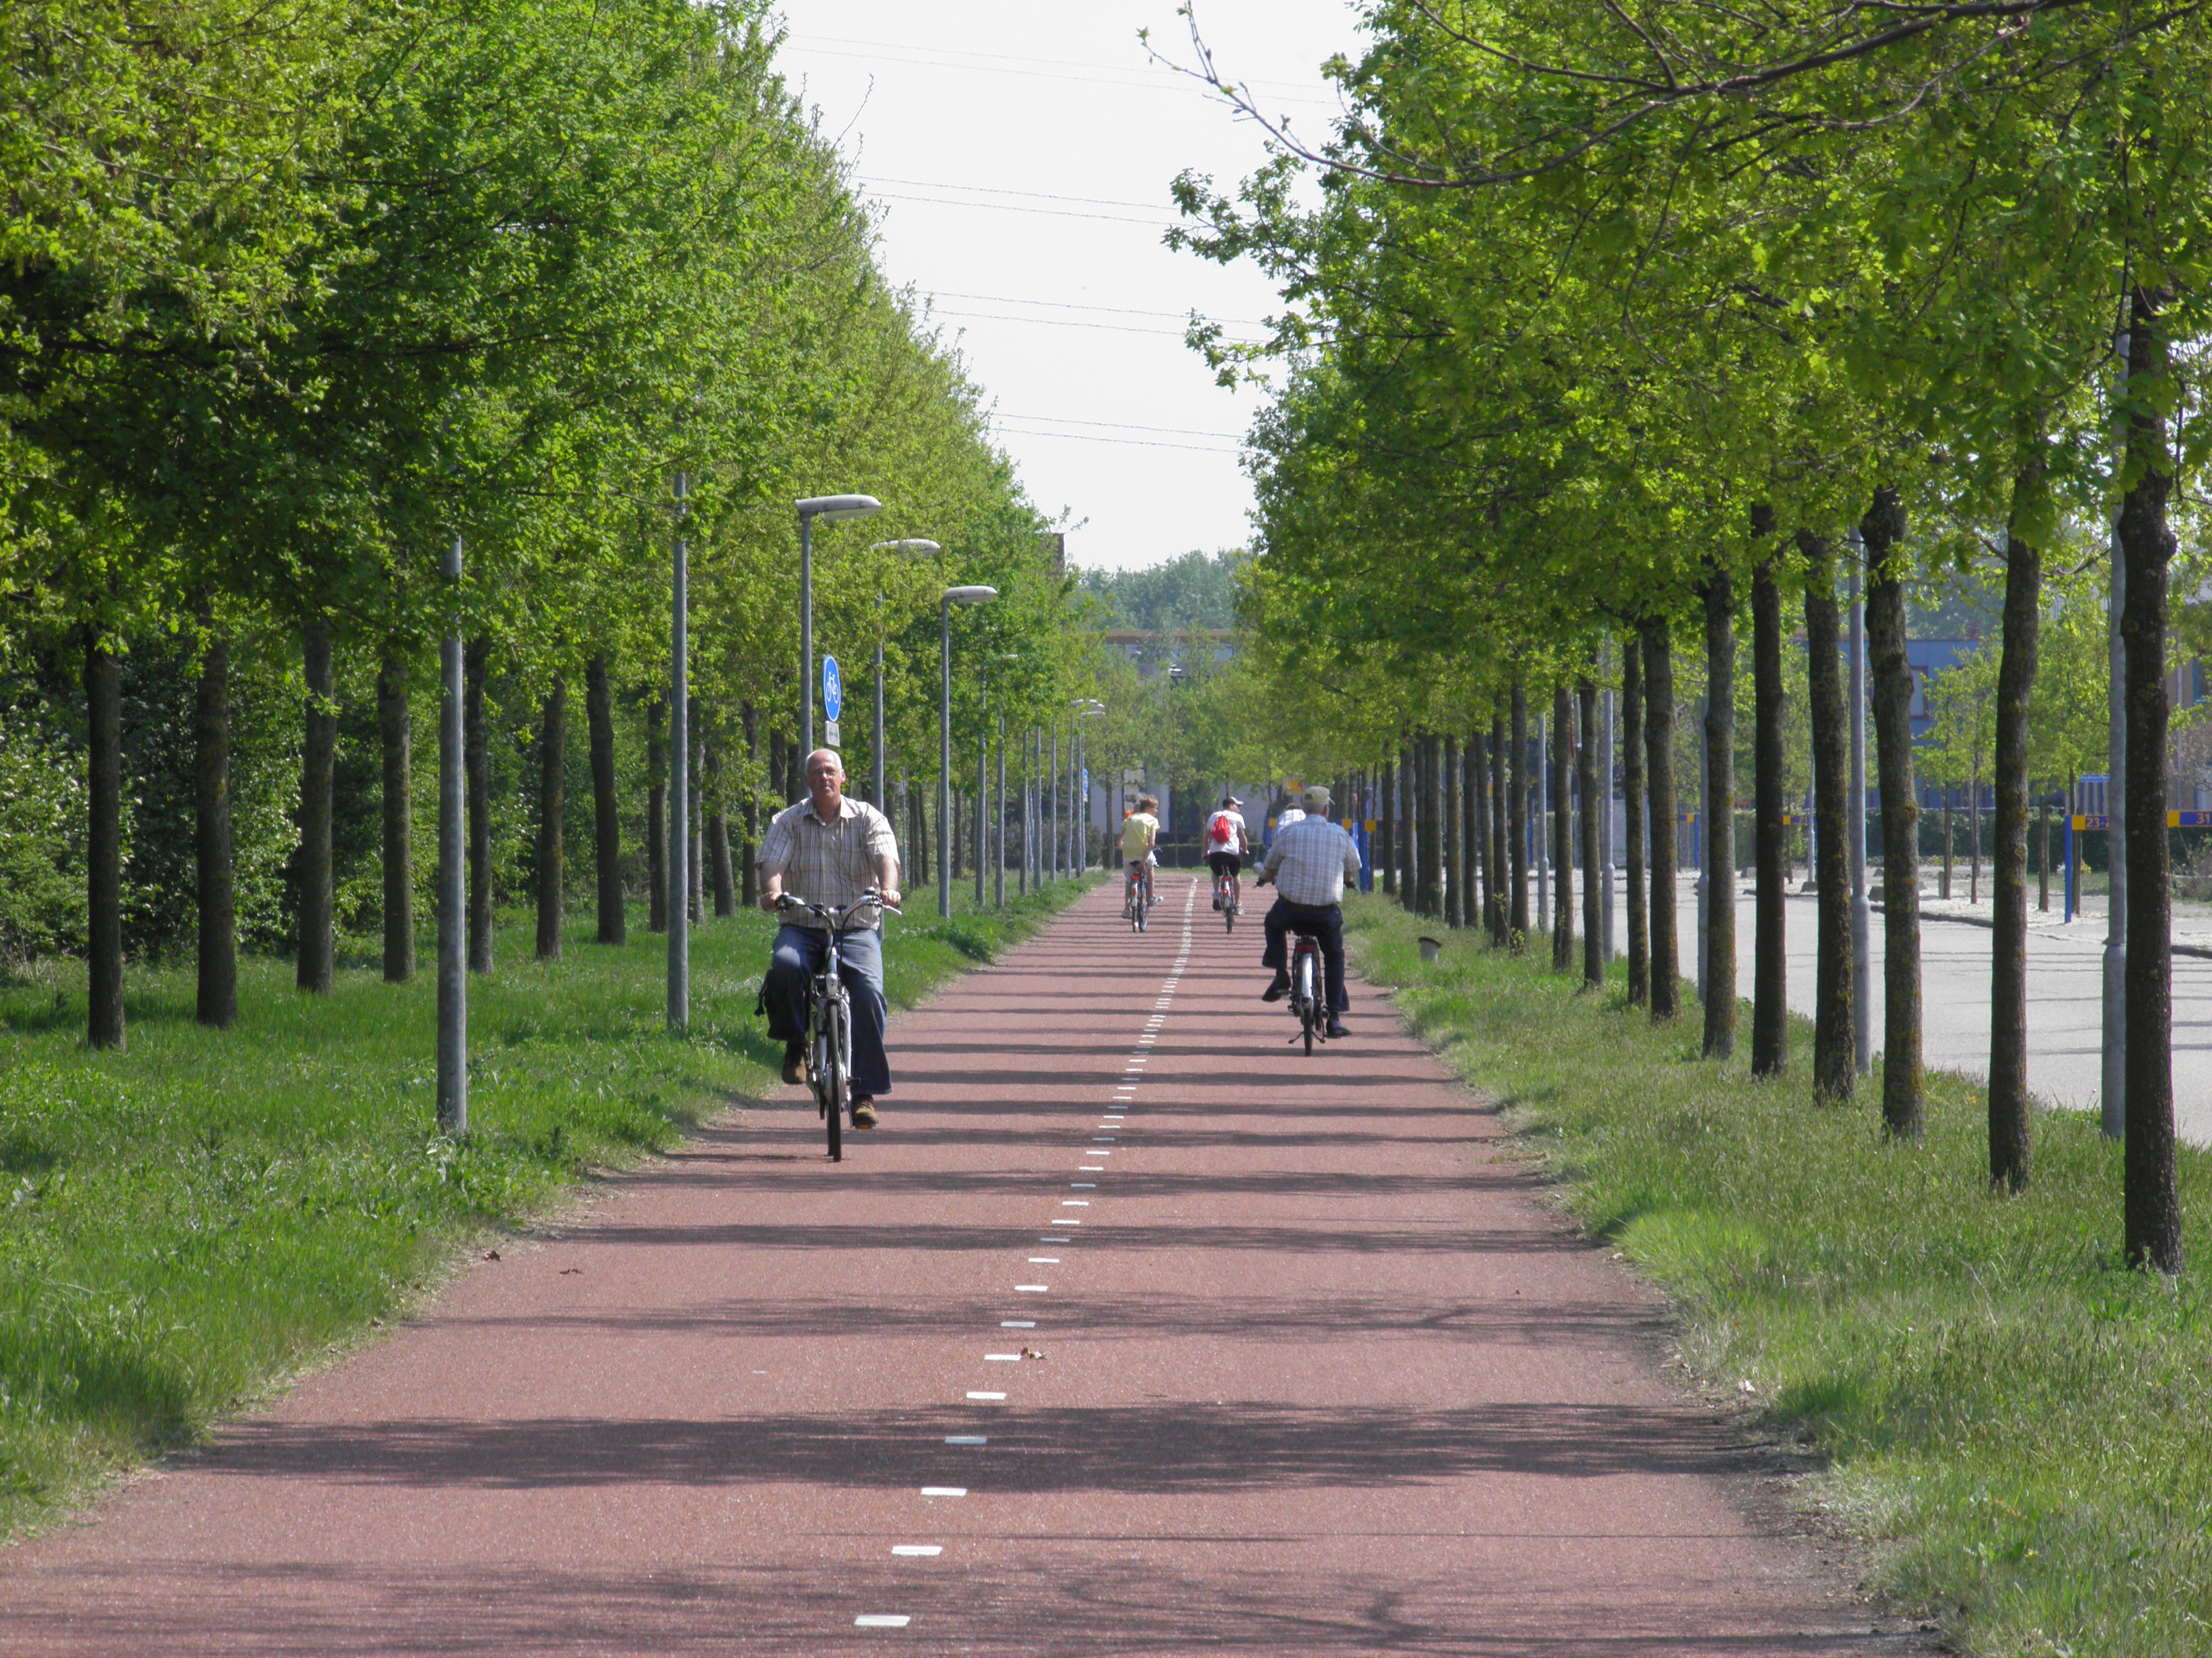
Bicycle infrastructure

Slide 5
Transportation system
Cyclist
City
Bicycle

Slide 6
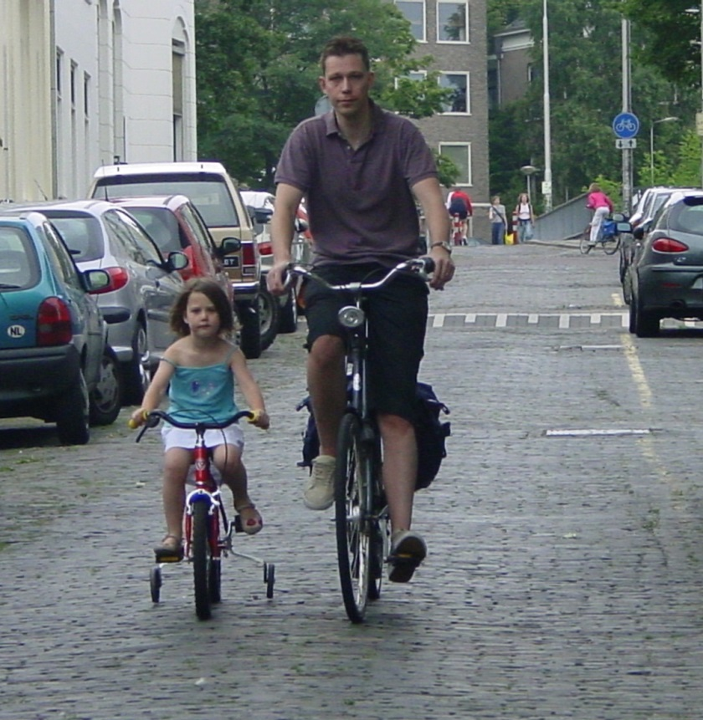
Characteristics cyclist
Human beings
Muscle power
Open air
Social activity
App 0.75m wide

Slide 7
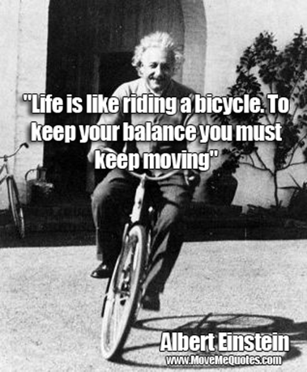
Characteristics bicycle
Balance (two wheels)
No suspension,
No crumple zones
No airbags
App. 0.75m wide

Slide 8
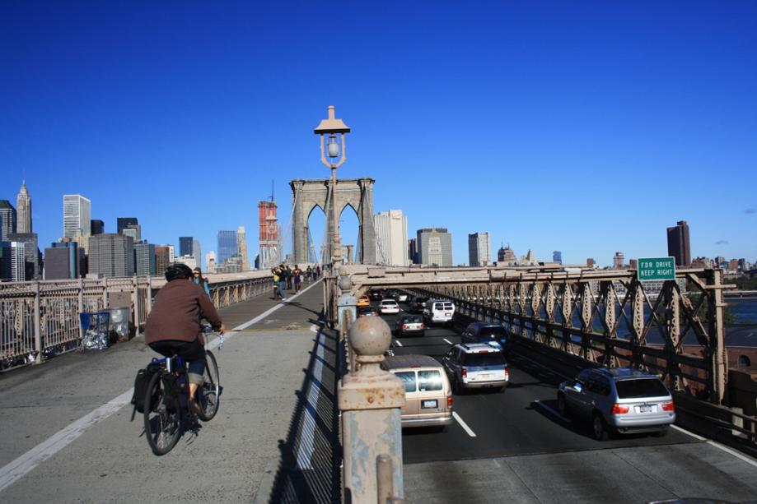
City - Infrastructure
(bicycle facilities)
Local opportunities
Limited space
Social activities
Existing patterns and buildings
Local policy goals

Slide 9
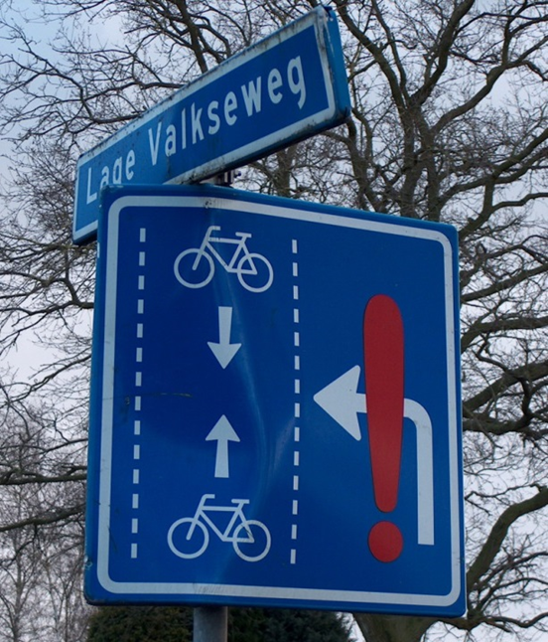
Main requirements
Coherence
Directness
Attractiveness
Safety & health
Comfort

Slide 10
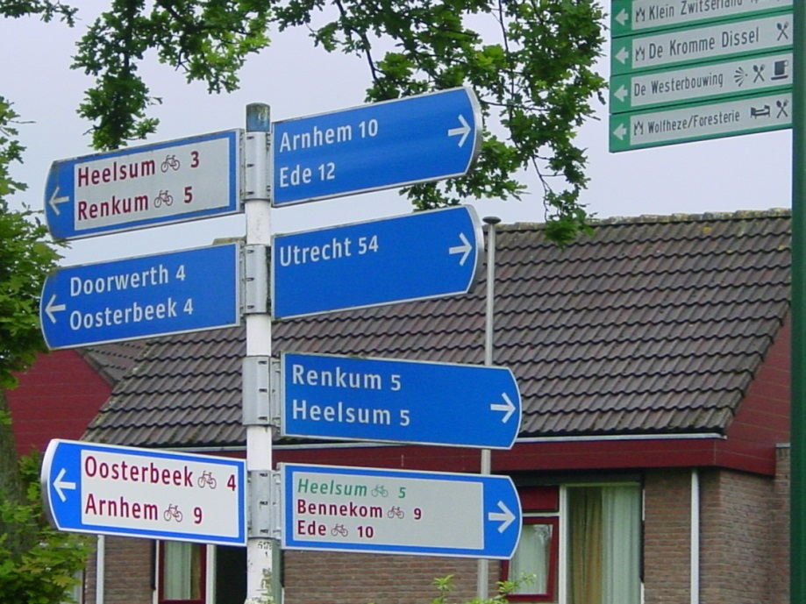
Coherence
Consistancy of quality
Ease of way finding
Mobility chain
Choise for more than one route
Notes:
Do not plan a bicycle facility and ignore the rest.
It is important that you offer a coherent bicycle network and routes that are logically linked together. And that can easely be recognised

Slide 11
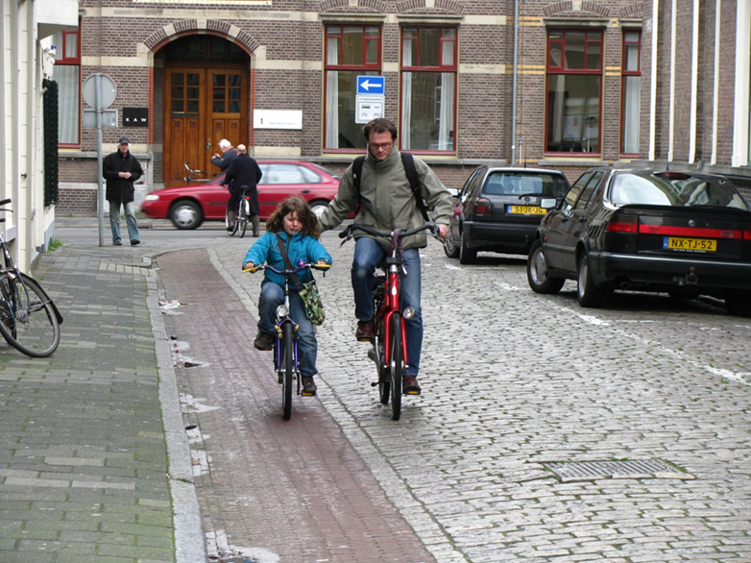
Directness
No unnecessary detours
Faster than car
Constant speed
Minimum delays
Notes:
Avoid detours
A cyclist has to make it’s own energy so a detour is bad

Slide 12
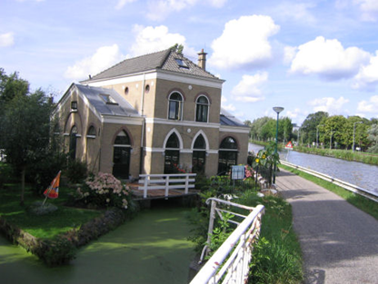
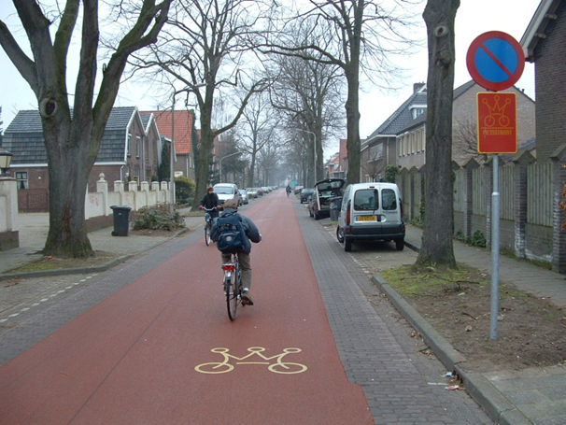
Attractiveness
Psychological elements
Perception
Social safety
Go side by side
Use environmental opportunities

Slide 13
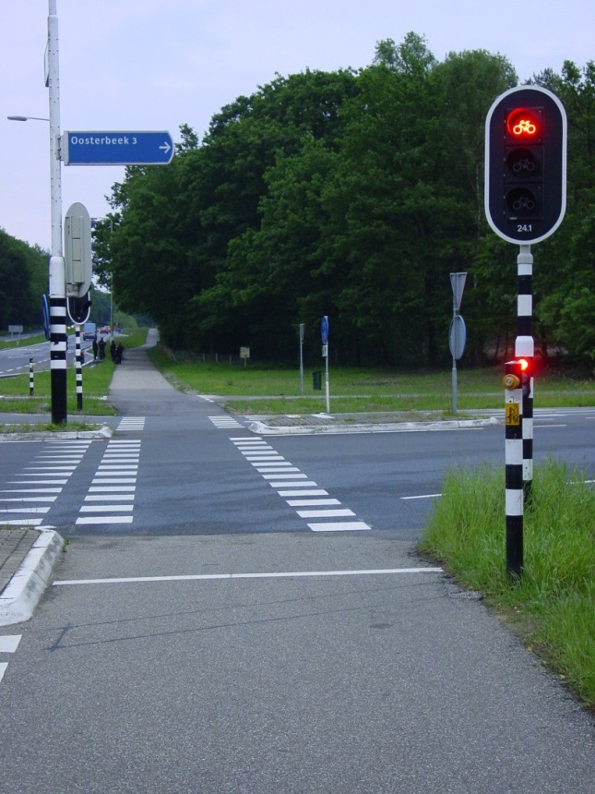
Safety & health
Mix if possible, seperate when necessary (low speed and low volume)
Infrastructure and land use
Vehicles (technique)
Road users (behaviour)
Alternative parallel (high volume motorized traffic)
Notes:
The safest cyclist is one walking next to his bicycle.
That can’t be serious. That’s why we do need safe routes and facilities but not at all costs

Slide 14
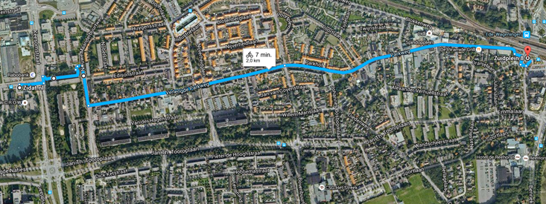
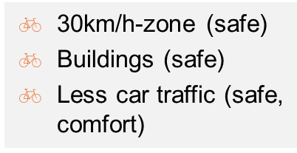
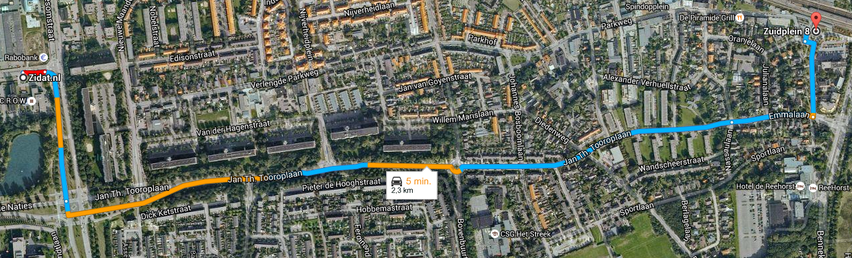
Ede
Railway station – CROW office

Slide 15
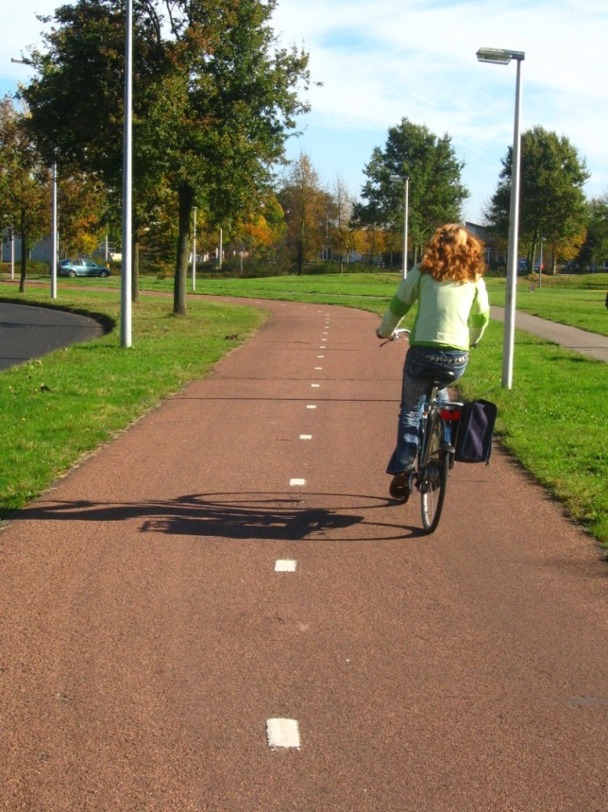
Comfort
Smooth suface
Minimum stops
Protection against weather
Enough space (side by side)
Avoid sharp curves
Design speed 30km/h (20m/h)
Avoid steep slopes
Notes:
A bicycle is on its two wheels a balance vehicle. For this a smooth surface is important as well as the guarantee for a surtain speed.
If you go beyond that speed a cyclist falls down because of unbalance
A cyclist is a social person. He loves to ride together and next to an other cyclist
A cyclist is not protected againt wheather invluences by any matal cage or anything.
Therefor it is important to offer shelter againt wind or if possible rain.
A bicycle does not protect its rider against bad persons That’s why cyclists like pedestrians prefer a well lit road in times of darkness.

Slide 16
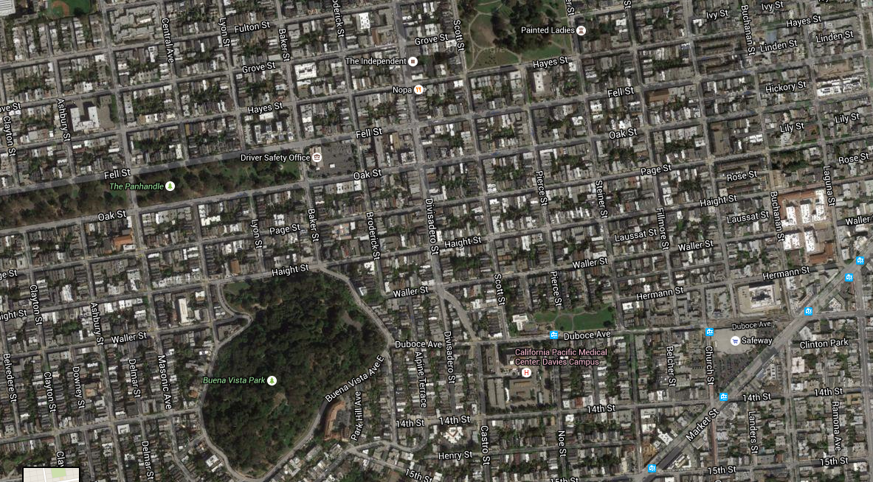
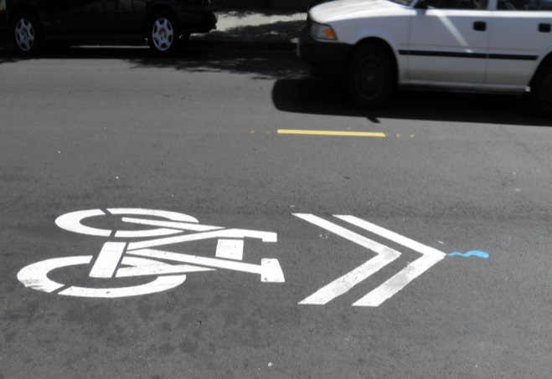
San Fransisco - The Wiggle
Between Market Street and residential areas
Follows course of old kreek
Avoid steep hills
Residential area

Slide 17
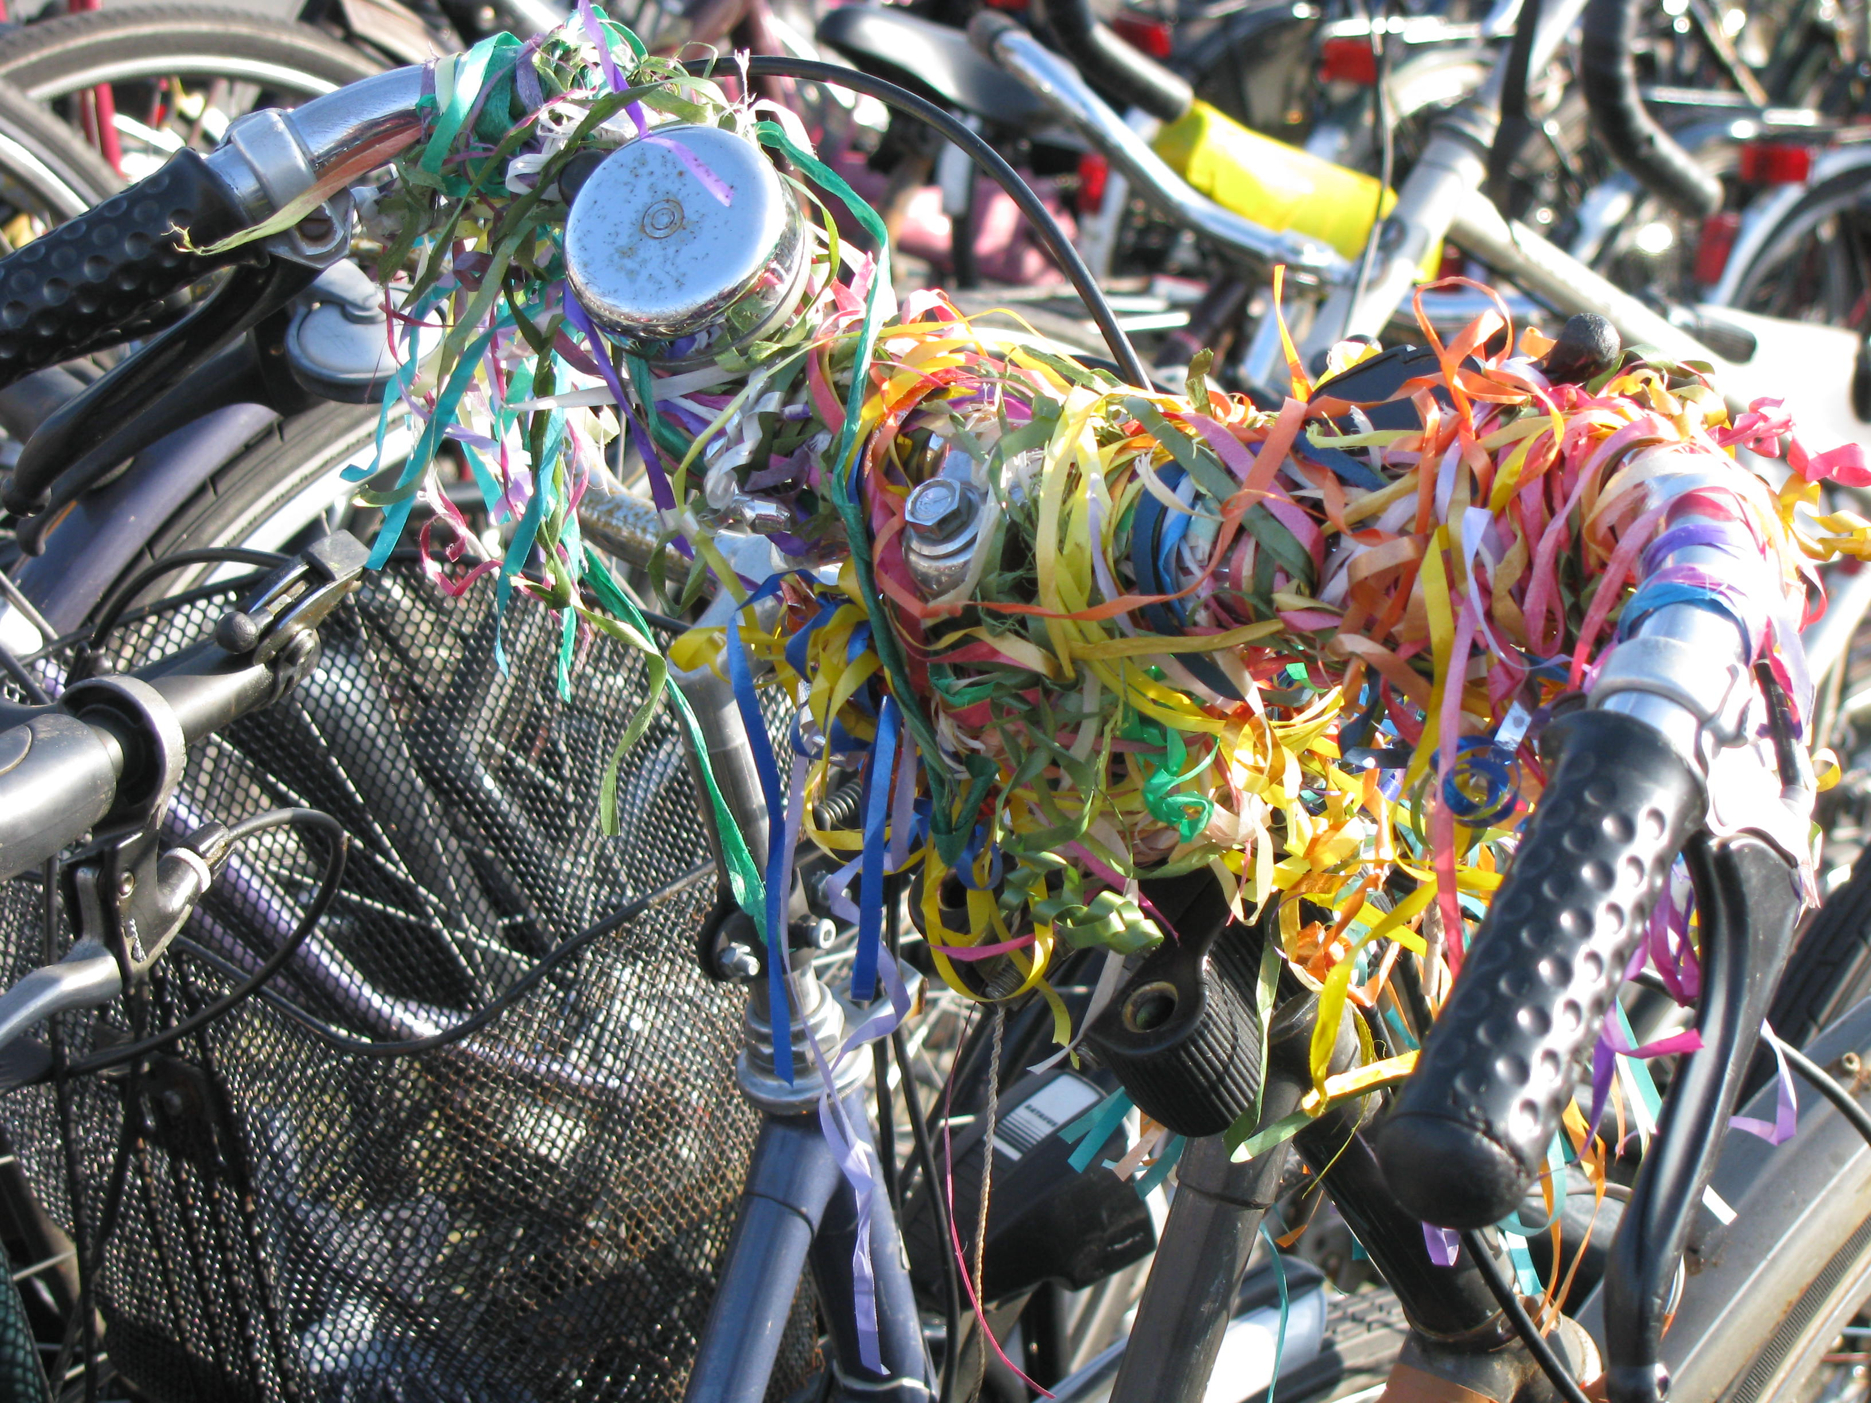
The whole equals is more than the sum of its parts
))))):
☺

Slide 18
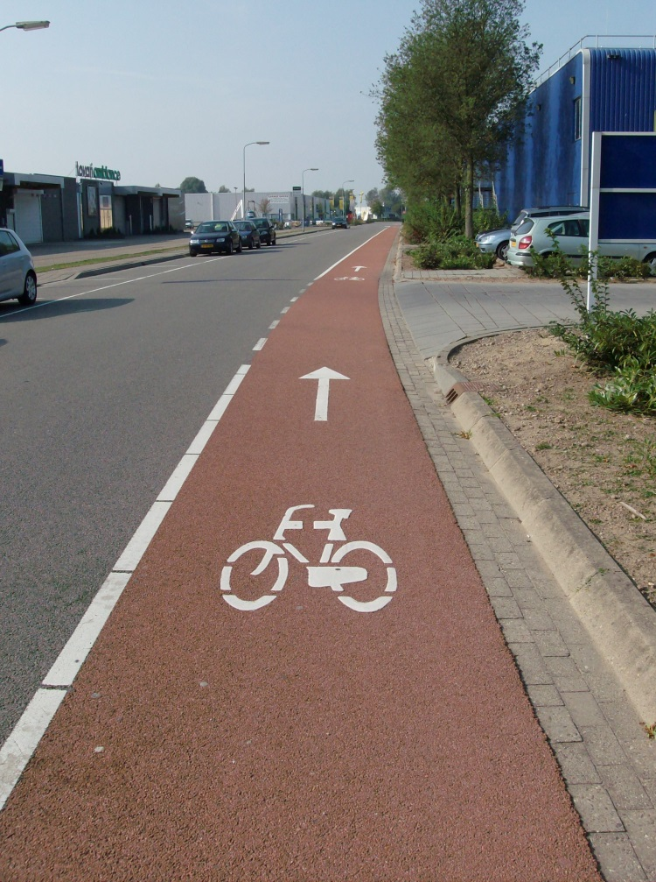
Bicycle infrastructure and facilities
Bicycle highways
  Priority
  Tunnels & bridges
Main bicycle network
  Bicycle streets
  Bike lanes
  Seperated bicycle paths
Basic network
  Short cuts
  Recidential streets (30km/h)
  Home zones

Slide 19
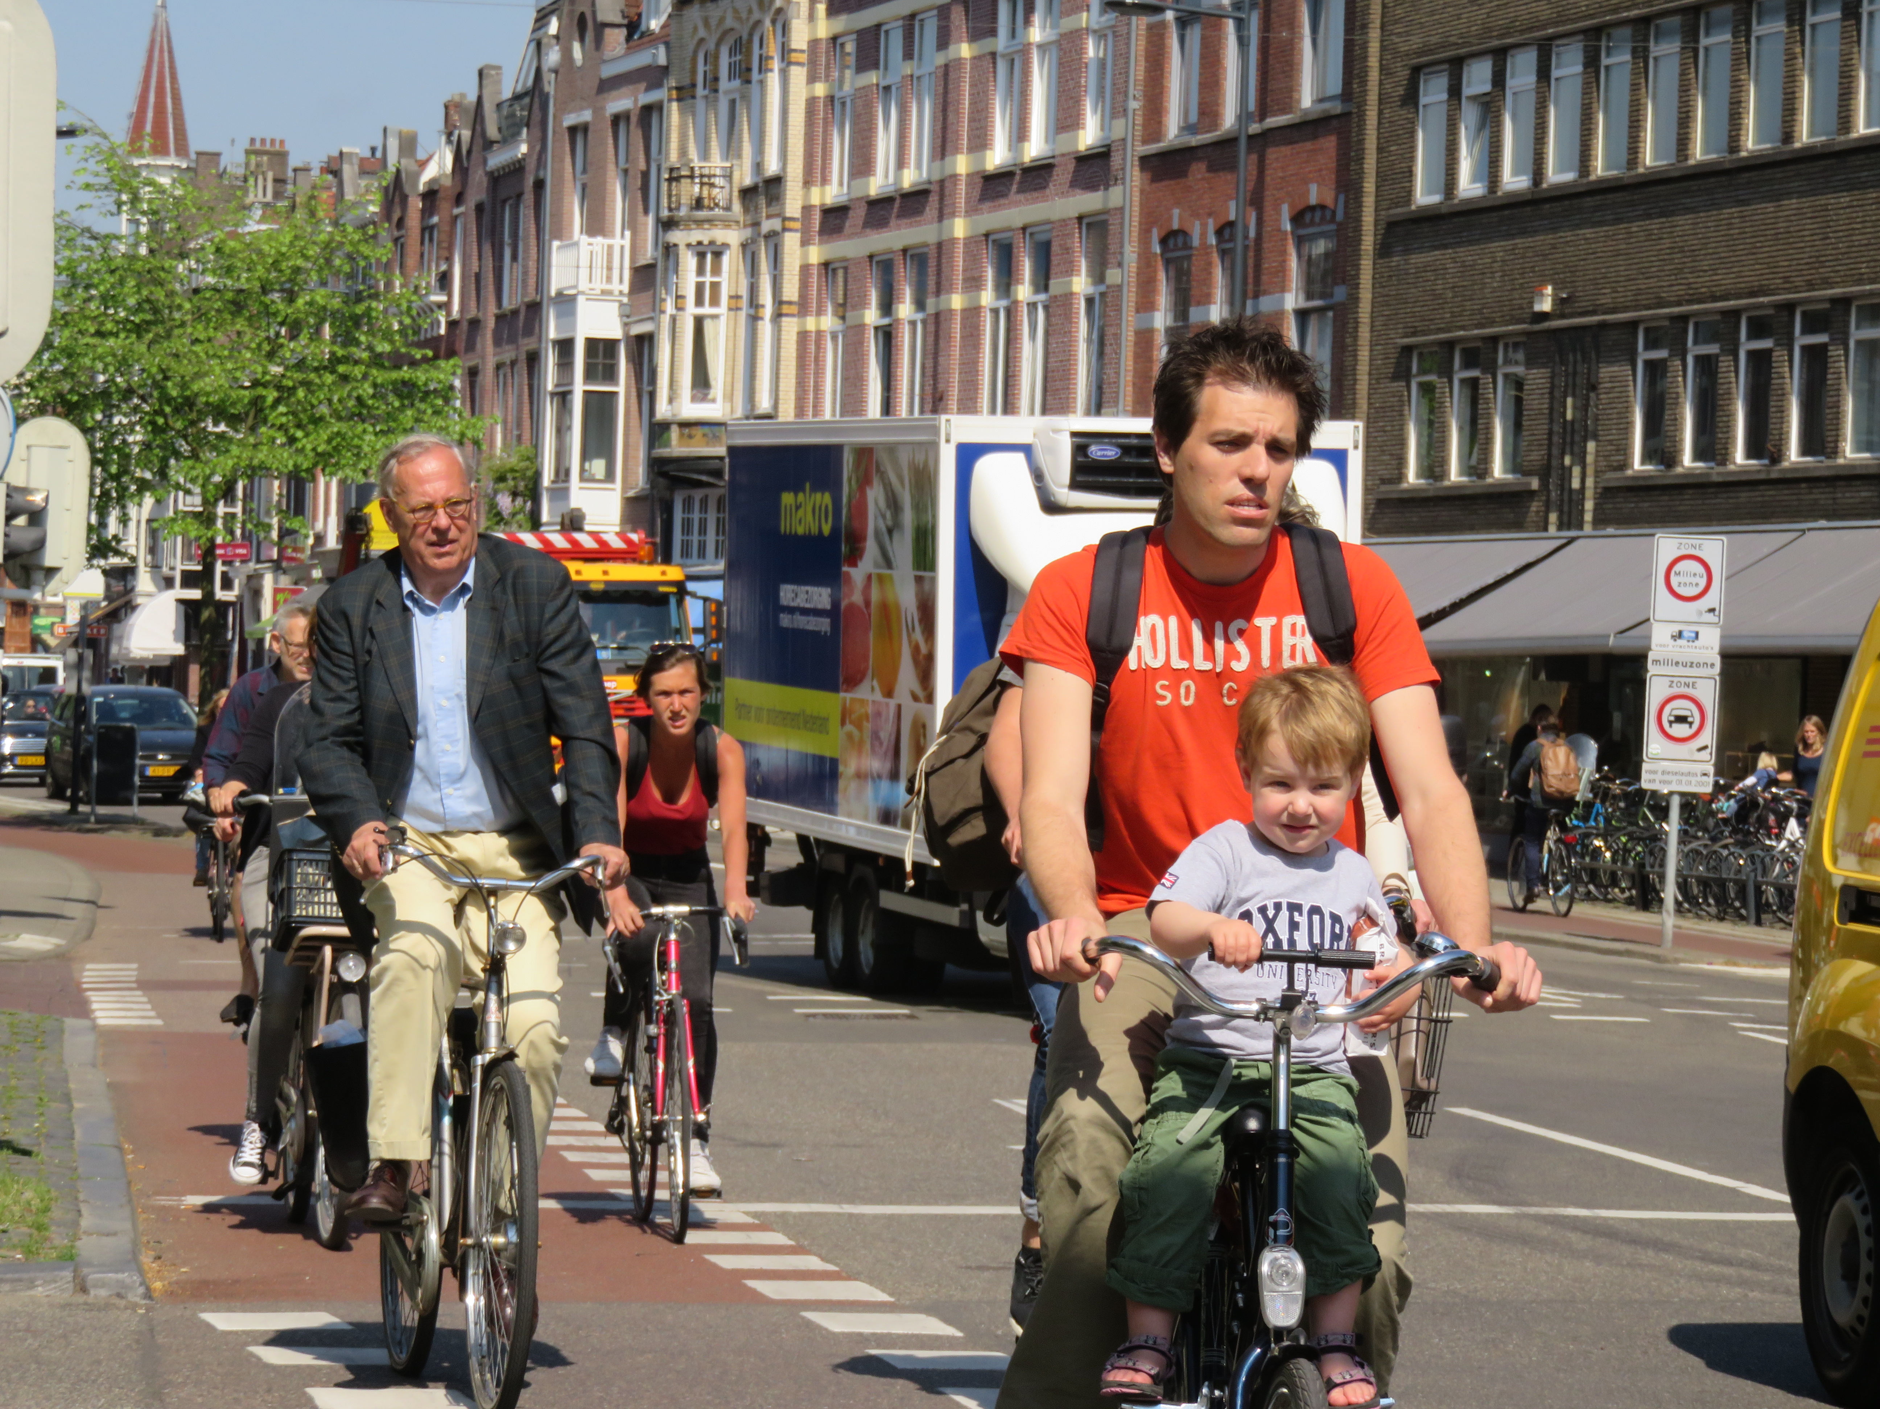
Laws, standards and guidelines
Basisregel voor ons werk

Slide 20
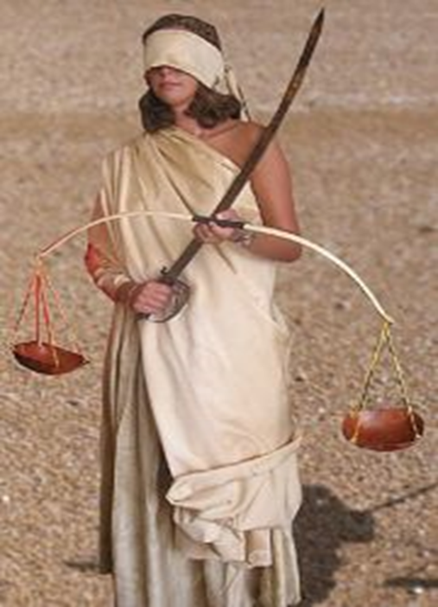
Definitions
Law, Royal Degree, order
  need to be followed
Standard
  deviate only in very special unforeseen situations
Guideline
  deviate only with good arguments

Slide 21
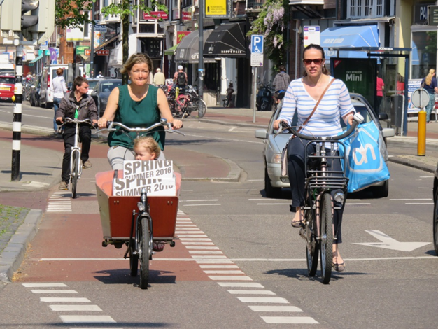
Guidelines the netherlands
Independent, collective
Represents the expertise and experience available in (and sometimes outside)
The Netherlands
Used in the court of law

Slide 22
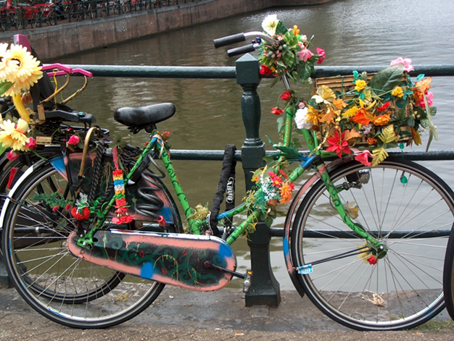
Guidelines for good design
Based on:
Sustainable safety
Results of scientific research
Results out of experiments in practice
Notes:
Richtlijnen zijn gebaseerd op de filosofie Duurzaam Veilig Verkeer.
Richt de weg zodanig in dat weggebruiker automatisch juiste rijgedrag gaat vertonen.
Dit bevordert de verkeersveiligheid.
De richtlijnen zijn gebaseerd op uitkomsten van wetenschappelijk onderzoek en resultaten van experimenten uit de praktijk.
Met andere woorden we proberen de wetenschappelijke rapporten toegankelijk te maken
En we volgen experimenten op de voet. En als daar iets uitkomt wat voor heel Nederland toepasbaar blijkt verwoorden we dat in richtlijnen.
Daarmee wordt voorkomen dat telkens het wiel opnieuw moet worden uitgevonden

Slide 23
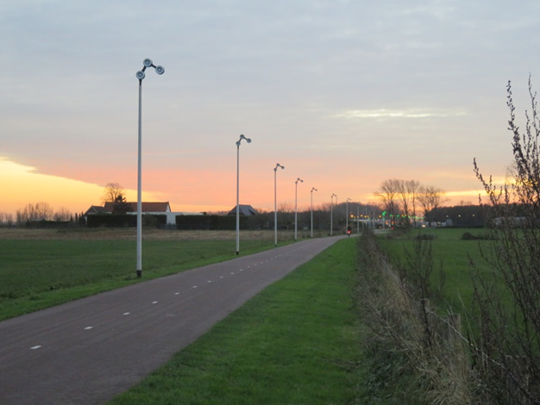
Guidelines for good design
Design in such a way, that:
The road user always knows what is expected from him;
And knows what can be expected from other;
No great differences in mass speed and direction;
The road will be used where it is designed for;
There is no dead penalty on failure.
Notes:
Wat houdt dat duurzaam veilig dan in hoofdlijnen in
**zie dia***

Slide 24
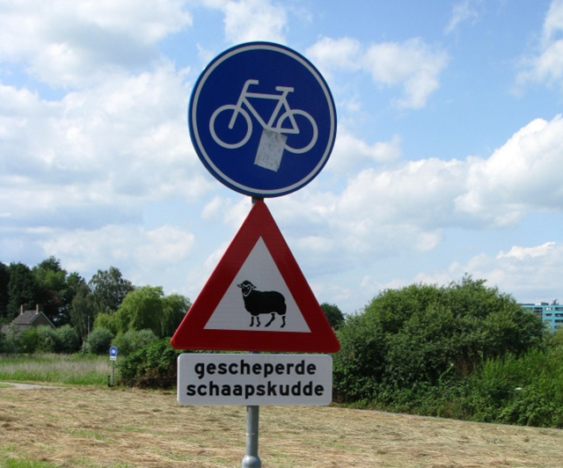
Guidelines for good design
Latest state of science and technology
Standard solutions
Deviate when guideline is not applicable
Custom-made design

Slide 25
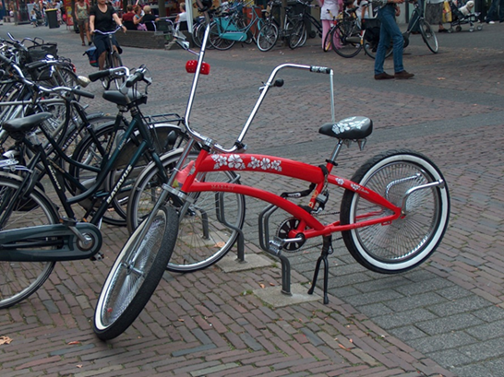
Guidelines for good design
Deviation is allowed only when:
well-considered;
in the spirit of the guidelines;
suited to the expectations of the road users

Slide 26
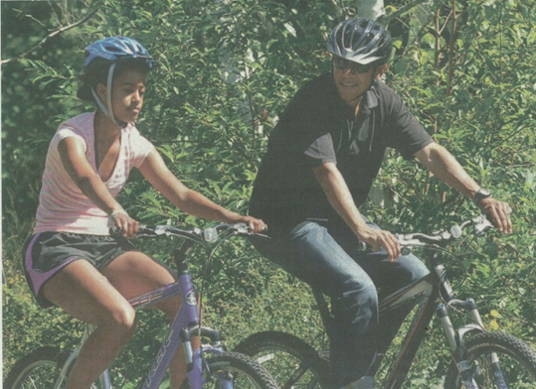
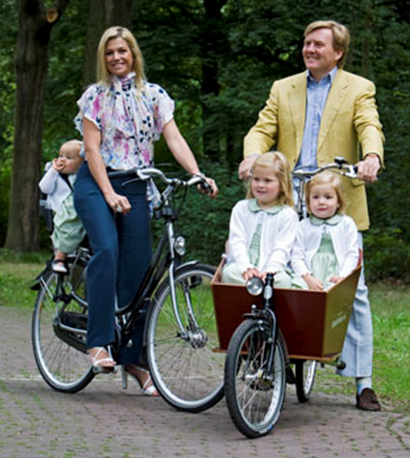
Conclusions
Conclusions
  Cyclist is not a pedestrian with wheels
  Bicycle facilities need to be tailor-made (use local opportunities)
  Handbooks should be for inspiration
  Cycling is not just a sport
  Cycling is not only for kids
  Bicycle is not a poor man’s Mercedes

Slide 27
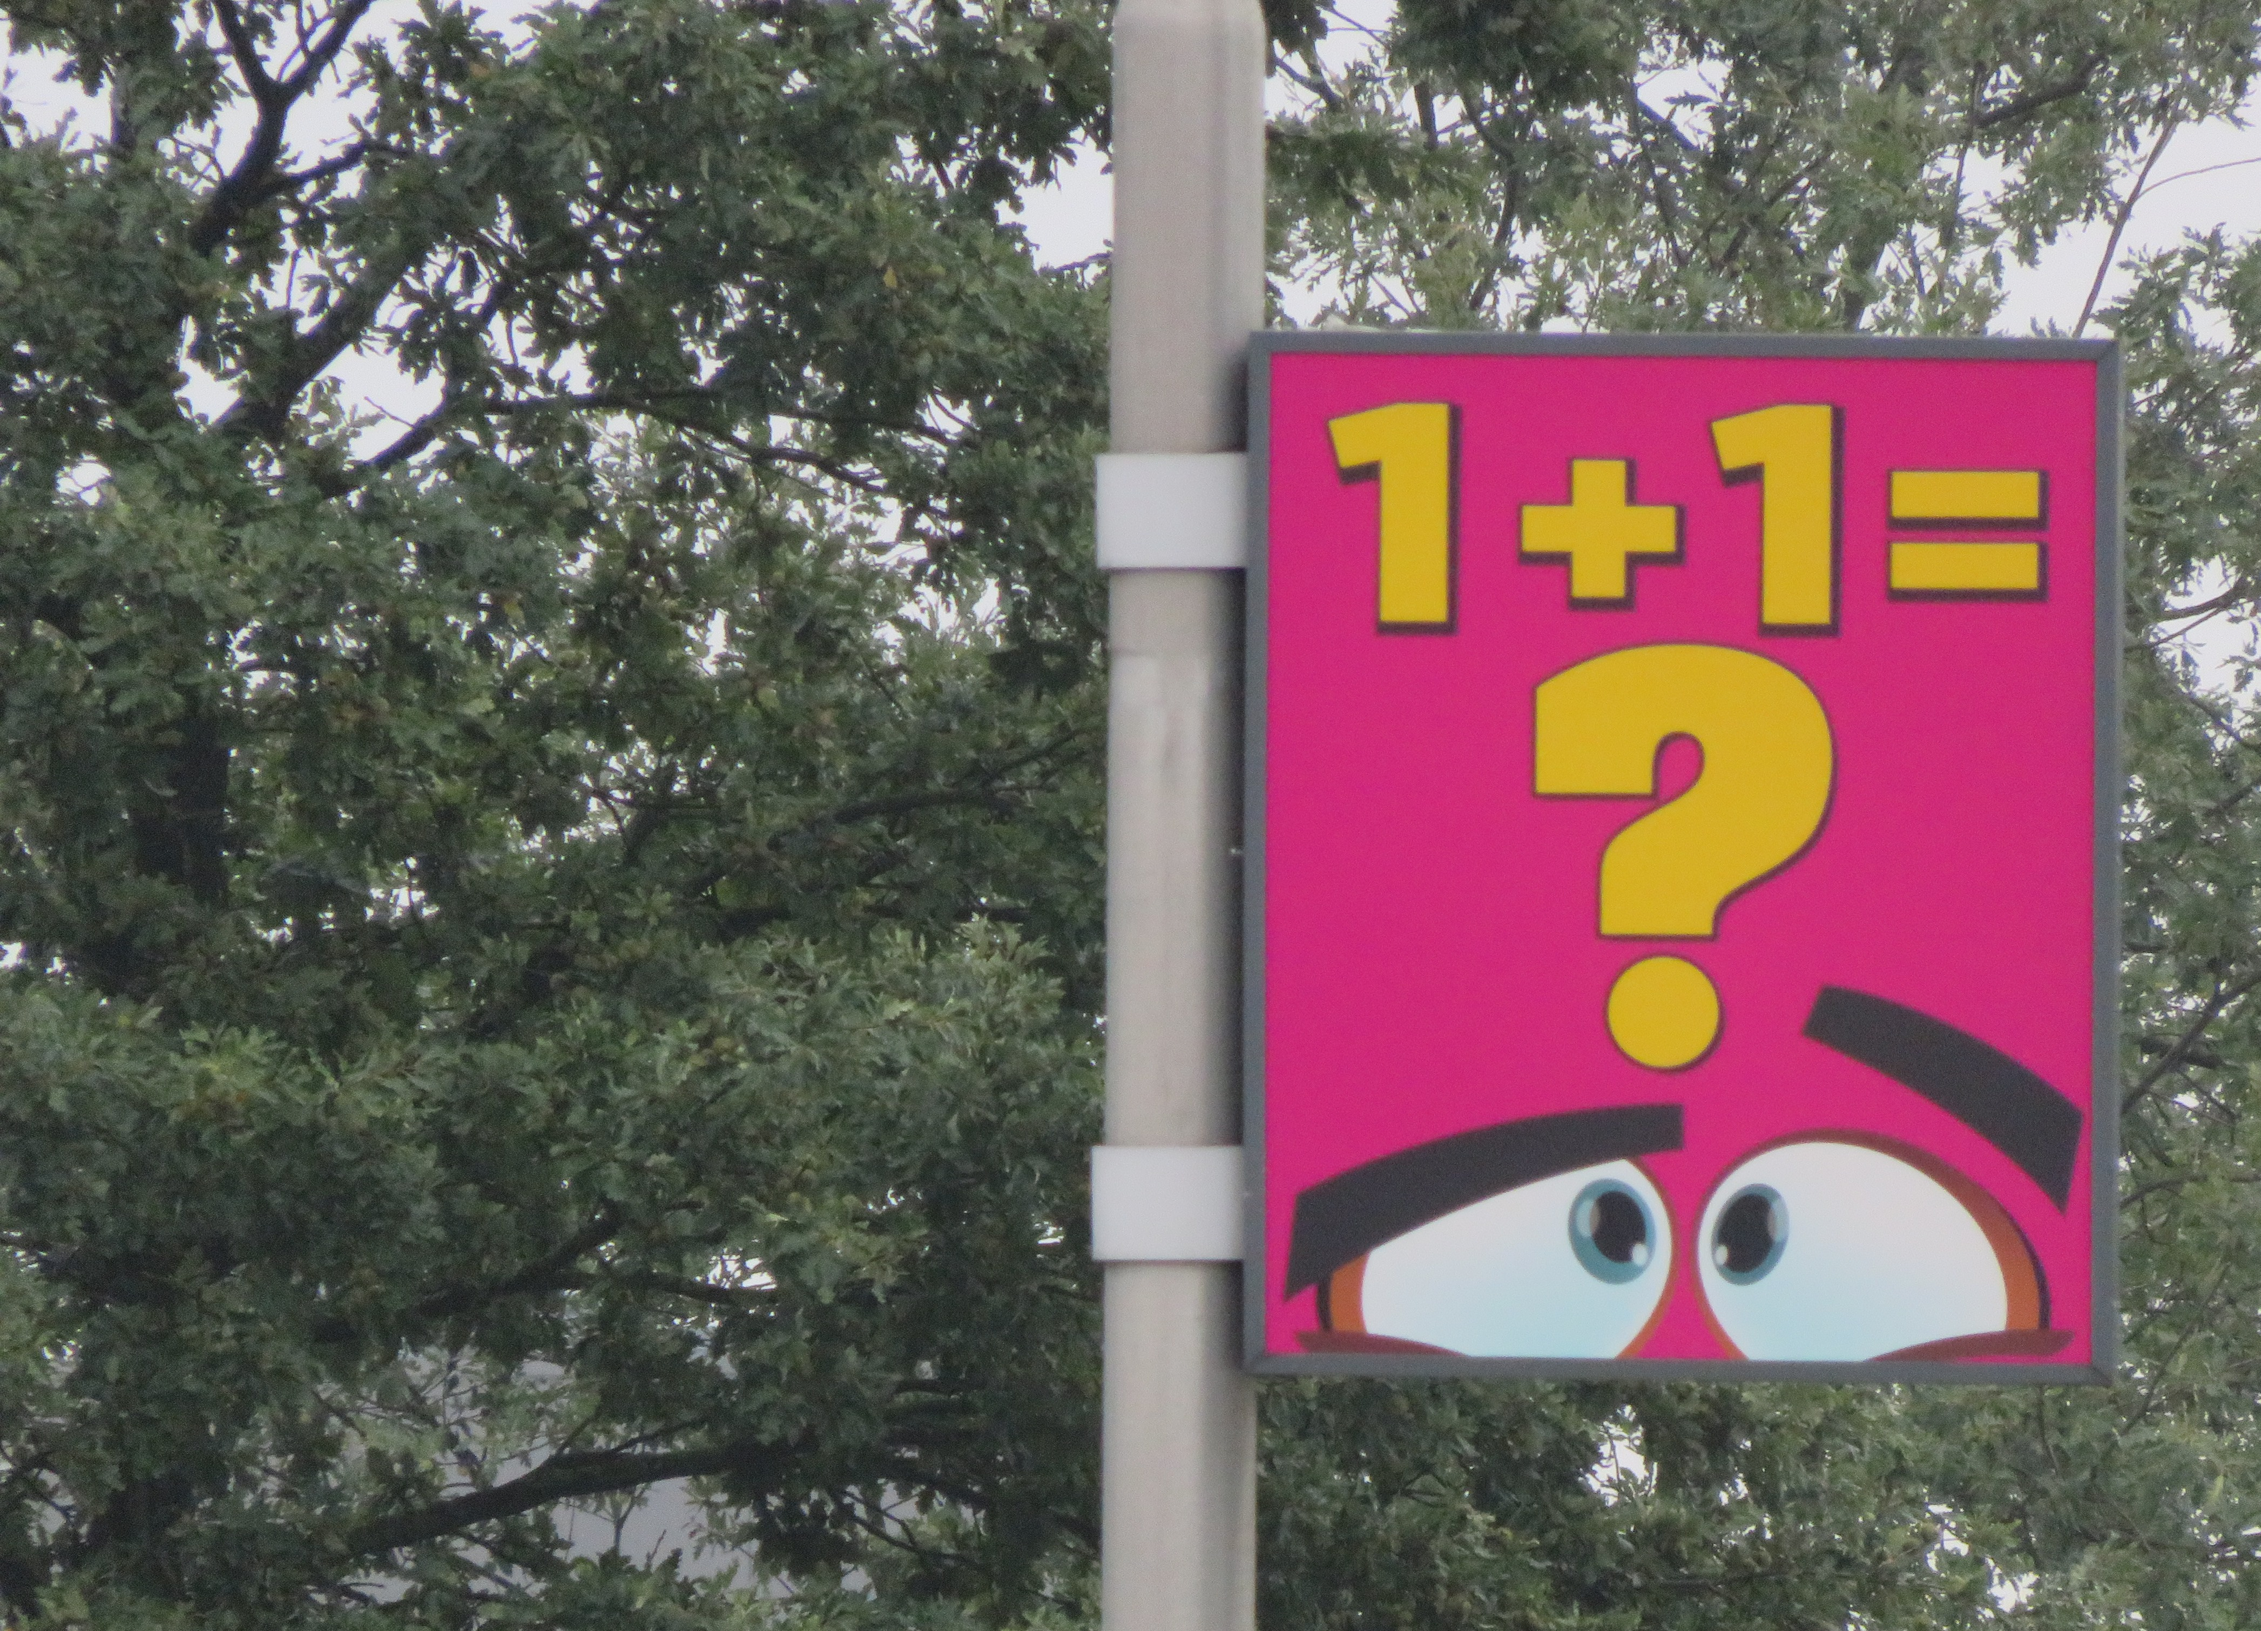
More information
hillie.talens@crow.nl

