Slide 1
#Eucyclingstrategy
 | ECF gratefully acknowledges financial support from the European Commission.
14th September 2016,
Permanent Representation of the Slovak Republic to the EU, Brussels
Adam Bodor
Advocacy and EuroVelo Director

Slide 2
Content
1
What happened so far/Coming up
2
Content and structure
3
Roadmap
Get involved
4
Objective
5
Notes:
- The Roadmap to get to blueprint EU Cycling Strategy(What happened so far, Expert group developing a blueprint for an EU Cycling Strategy)
- Content, structure
- Support the EU Cycling Strategy (mailing list; survey/questionnaire; logo)
- Ultimate objective: Commission to include EU Cycling Strategy in its Work Programme 2018

Slide 3
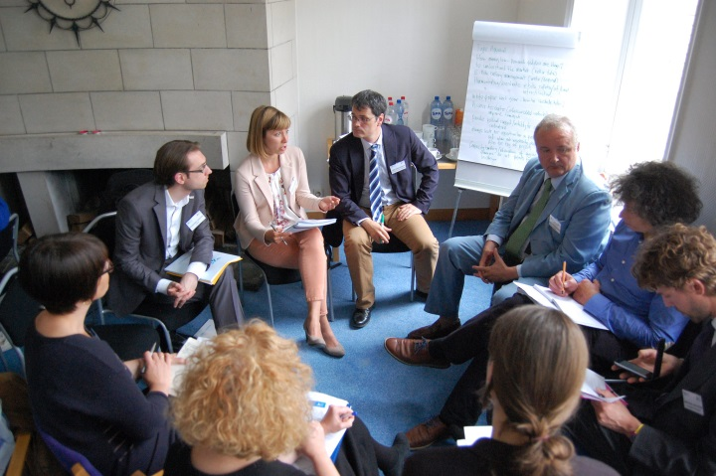
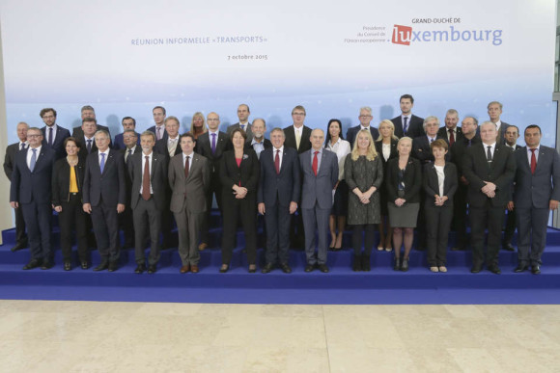
What happened so far 2015
Think Tank meeting
Luxemburg declaration
May
2015
Oct.
2015
Notes:
In a series of public events, ideas and support have been gathered for such an EU Cycling Strategy, including:
Think Tank meeting, May 2015, Brussels
https://ecf.com/news-and-events/news/ecf-launched-think-tank-eu-roadmap-cycling
Workshop on national and European Cycling Focal Points, organized by the Dutch EU Presidency, June 2016, Delft
‘Cycling Forum Europe’ breakfast meeting on an EU Cycling Strategy, June 2016, Brussels
https://ecf.com/news-and-events/news/making-cycling-mainstream-across-europe-through-eu-cycling-strategy

Slide 4
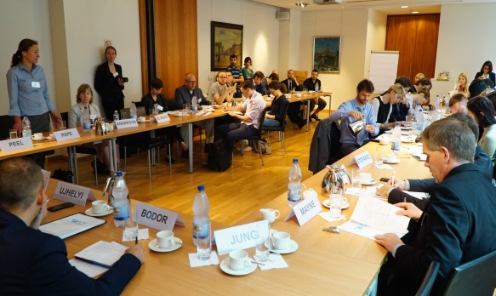
What happened so far 2016
Workshop on national and European Cycling Focal Points
‘Cycling Forum Europe’ breakfast meeting
Workshop at Eurobike
June
2016
June
2016
July
2016
Notes:
In a series of public events, ideas and support have been gathered for such an EU Cycling Strategy, including:
Think Tank meeting, May 2015, Brussels
https://ecf.com/news-and-events/news/ecf-launched-think-tank-eu-roadmap-cycling
Workshop on national and European Cycling Focal Points, organized by the Dutch EU Presidency, June 2016, Delft
‘Cycling Forum Europe’ breakfast meeting on an EU Cycling Strategy, June 2016, Brussels
https://ecf.com/news-and-events/news/making-cycling-mainstream-across-europe-through-eu-cycling-strategy

Slide 5
Coming up 2016
Workshop at CIVITAS 2016 conference
Workshop at Cycling into the future
Sept.
2016
Sept.
2016
Notes:
Coming up:
Workshop at CIVITAS 2016 conference, September 29, 2016, Gdynia

Slide 6
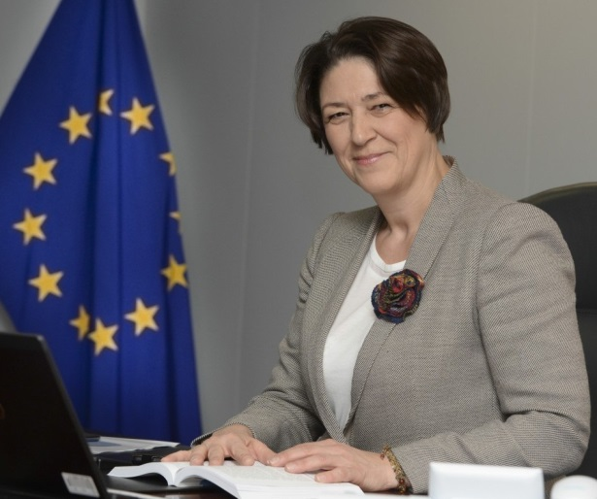
Coming up 2017
‘Blueprint for an EU Cycling Strategy’ to be presented at the Velo-city conference Arnhem-Nijmegen
Civitas Conference official handover of the draft
June
2017
2017
Notes:
Coming up:
Workshop at CIVITAS 2016 conference, September 29, 2016, Gdynia

Slide 7
Content and structure
11 Chapter for one EU Cycling Strategy!

Slide 8
Content and structure
Chapter 1: The current status of cycling in Europe
Notes:
1. The current status of cycling in Europe
· Cycle use in Europe/ potential for growth
· No of cycling fatalities: trends
· No of bicycle sales, including E-bikes
ECF

Slide 9
Content and structure
Chapter 2: The benefits of cycling and their contribution to EU policy goals
Notes:
2. The benefits of cycling and their contribution to EU policy goals
· Transport, environment/ climate, health, jobs, road safety, etc.
EPHA (tbc) – European Public Health Alliance

Slide 10
Content and structure
Chapter 3: Promotion of cycling (Behaviour)
Notes:
3. Promotion of cycling (Behaviour)
· EU urban mobility policy (SUMPs, logistics, access regulation, EMW); Smart Cities
· Tourism, leisure: Promotion of the EU as the worlds No 1 (cycle) tourism destination
· Cycle friendly highway codes: best practice collection and promotion
Multi-modality: Passenger rights (bicycle carriage on trains) + Mobility as a Service (MaaS)
· Road safety (e.g. Professional Drivers Qualification
Eurocities (tbc)

Slide 11
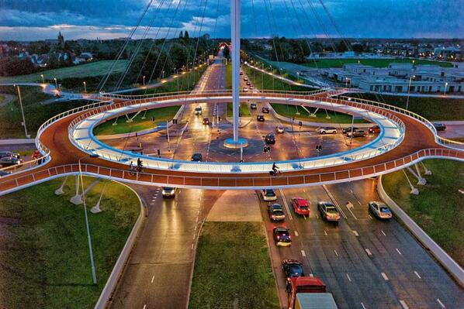
Content and structure
Chapter 4: Infrastructure
Notes:
4. Infrastructure
· Infrastructure guidance – standards for EU-funded projects
· EuroVelo, the European long-distance cycle route network, and TEN-T
· Road safety
CROW (tbc)

Slide 12
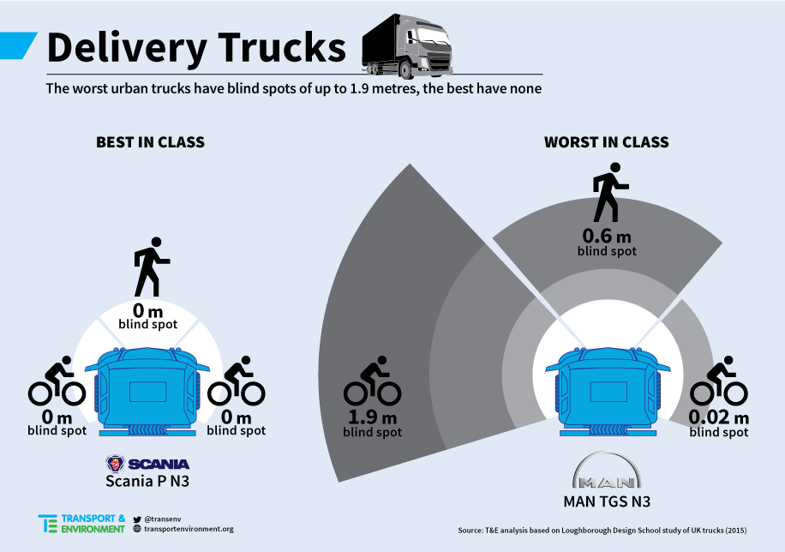
Content and structure
Chapter 5: Vehicle and technical standards
Notes:
5. Vehicle and technical standards
· Vehicle regulation of motorized vehicles – directly aiming at improving road safety of VRUs
· E-Bike standards (type approval)
· Technical standards E-Bike charger
· Road safety
· Autonomous vehicles
ETSC – European Transport Safety
Council

Slide 13
Content and structure
Chapter 6: EU as a global player
Notes:
6. EU as a global player
· Urban agenda, Habitat III
· Sustainable Development Goals
GIZ (tbc)
Or
DCE (tbc)

Slide 14
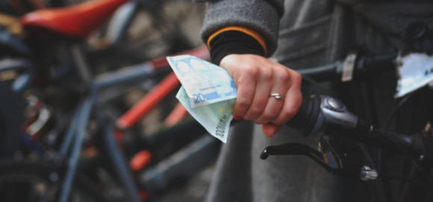
Content and structure
Chapter 7: A level-playing field for cycling with other modes of transport
Notes:
7. A level-playing field for cycling with other modes of transport
· Fiscal and taxation issues addressed in the European Semester
· EU funding opportunities for cycling (cohesion funds, CEF, Horizon 2020, etc.)

Slide 15
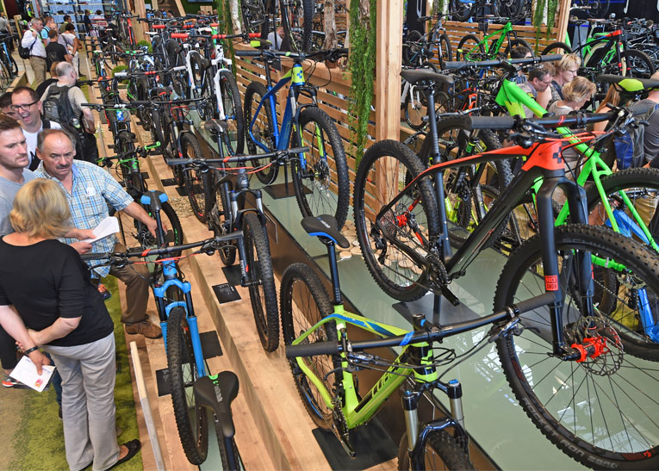
Content and structure
Chapter 8: Industrial policy for Europe’s bike manufacturing industry
Notes:
8. Industrial policy for Europe’s bike manufacturing industry
Capacities for projected volums and supply chains
Competitiveness of EU industry
Export opportunities
Workforce needs (education, training, etc.)
Industrial infrastructure (clusters, R&D, lean manufacturing expertise)
Trade issues
CONEBI (tbc)
Confederation of the European bicycle industries

Slide 16
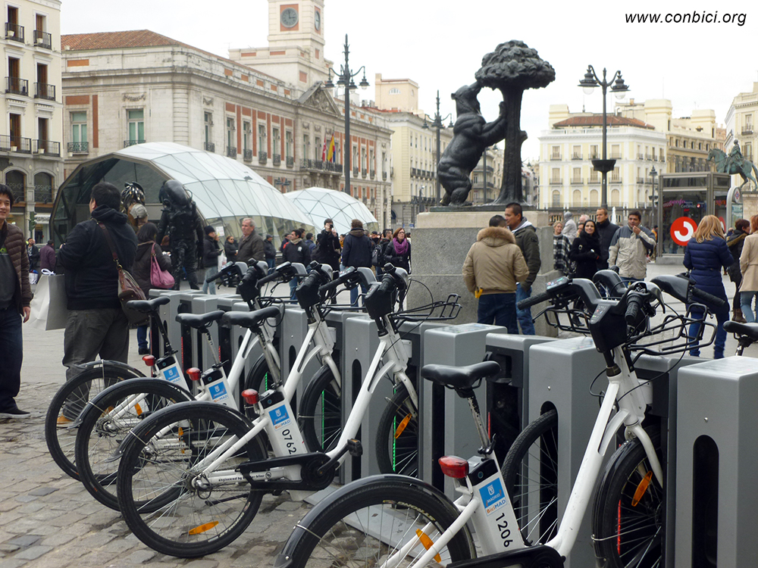
Content and structure
Chapter 9: Bicycle check in EU policies – Is cycling systematically considered in these policy fields?
Notes:
9. Bicycle check in EU policies – Is cycling systematically considered in these policy fields?
· E-mobility: promotion, infrastructure, fiscal incentives, etc.
· Public procurement to include (e)-bikes and (e)-cargo bikes
· Air quality, decarbonisation of transport, health, etc.
· (C-)ITS
· Digital Agenda/ ICT
· Vehicle regulation – aiming at improving overall road safety (e.g. ISA)
Polis (tbc)

Slide 17
Content and structure
Chapter 10: Governance
Notes:
10. Governance
· European Commission inter-service coordination
· EU Cycling Focal Point
· Cooperation with THE PEP/ national cycling officers and other stakeholders
· A Cycling clearing house/ expertise centre
Luxembourg (tbc)

Slide 18
Content and structure
Chapter 11: Monitoring and Evaluation
Notes:
11. Monitoring and Evaluation
· Data collection by Member States and Eurostat
· Indicators for measuring impact
Dirk Lauwers (University of Ghent) or
KU Leuven (tbc)

Slide 19
11 chapters for one

Slide 20
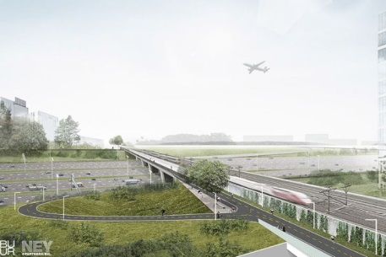
Content and structure
EU Cycling Strategy
Chapter 4: Infrastructure
Cycle Highways

Slide 21
Roadmap
14th Sept. 2016
“Cycling into the Future”
Nov/Dec 2016
Meeting 2: Presenting first draft content
March 2017
Meeting 3: Presenting results of chapters 1 – 9, 11
April 2017
Meeting 4: Resources, legal questions, governance (chapter 10)
May 2017
Meeting 5: Resume, adoption of recommendations
Notes:
In a series of 5 workshops, about 20 – 25 experts will be convened to develop the content for a blueprint for an EU Cycling Strategy. In addition, a public survey will be launched to collect input from a wider audience.
Developing the Blueprint for an EU Cycling Strategy
Timeline
“Cycling into the Future: A new approach to infrastructure, a new approach to policy-making at the European level”
Overall strategy
Announcement on topics & instruments
Announcement on process: timeline, stakeholders…
September 14, 2016
Meeting 2: State of play: Presenting first draft content
Nov/Dec 2016
Meeting 3: Presenting results of chapters 1 – 8, 10
March 2017
Meeting 4: Resources, legal questions, governance (chapter 9)
April 2017
Meeting 5: Resume, adoption of recommendations
May 2017

Slide 22
Our target:
‘EU Cycling Strategy’ for the
Work Programme of the European Commission 2018
Notes:
The aim is to get the development of an ‘EU Cycling Strategy’ into the Work Programme of the European Commission 2018.

Slide 23
Get involved
Mailing list
Survey
Show your support with a photo
Show your support with your organizations logo
Guest blogpost on www.cyclingstrategy.eu
Any other ideas?
Notes:
1. Sign up to the EU Cycling Strategy Campaign mailing list: www.cyclingstrategy.eu
2. Participate in the campaign’s survey (online from Sept 14).
3a. If you an individual: Have your photo posted on the campaign website supported by a short quote.
3b. If you are an organization: Have your logo posted on the campaign website.
4. Write a guest blog for the campaign website (about 300 – 500 words)
5. You think of other ways of getting involved?

Slide 24
More information
www.cyclingstrategy.eu
#EUcyclingstrategy

Slide 25
Thank you for your attention !
For more information
a.bodor@ecf.com
www.ecf.com

