Slide 1
Cycling into the future
An EU Roadmap for cycling
Cllr Kevin Peel (UK/PES)
14 September 2016 09:30-14:00
Oliver HEIDEN, Commission for Territorial Cohesion Policy and EU Budget (COTER)

Slide 2
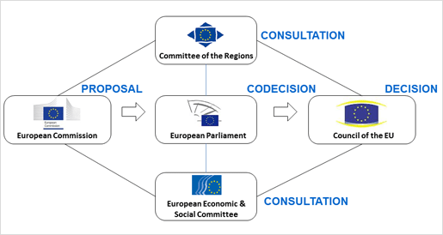
European Committee of the Regions

Slide 3
European Committee of the Regions
CIVEX
COTER
ECON
SEDEC
ENVE
NAT
CFAA
EPP
PES
ALDE
EA
ECR
Political Groups
Commissions
National delegations

Slide 4
The opinion: An EU Roadmap for Cycling
26 April Stakeholder consultation
mid-May EPRS In-depth analysis on ‘Moving cycling forward’
A coordinated EU approach towards cycling for local and regional authorities
31 May COTER meeting: Exchange of views: final Working
Document
21 June COTER members’ amendment proposals
4 July COTER meeting: Discussion and adoption
23 September CoR members’ amendment proposals
12 October CoR Plenary: Discussion and adoption

Slide 5
The opinion: An EU Roadmap for Cycling
Clear benefits:
Growth and Jobs
Health
Environment and Climate
Tourism
Efficient Transport
Spatial planning

Slide 6
The opinion: An EU Roadmap for Cycling
Main messages:
Doubling cycling across the EU
Sustainable transport hierarchy
Ring-fencing EU transport funding: 10% of the transport budget
Guidelines: for national and local authorities
Eurovelo: long-distance cycling route network to be included in TEN-T
Road safety measures: in particular considering perception

