Slide 1


THE PEP Partnership on cycling
Current status and next steps

Slide 2

Transport Health Environment
Pan-EuropeAn Programme (THE PEP)
UNECE/WHO platform for environmental friendly and health enhancing mobility
Transport, Health, Environment Ministers of the 56 Member States in the UN Euro Region.
Established at 1st High-Level Meeting 2001 in Geneva
Follow-up of the London Charter on Transport, Environment and Health (3rd Ministerial Conference on Environment and Health, London 1999)

Slide 3
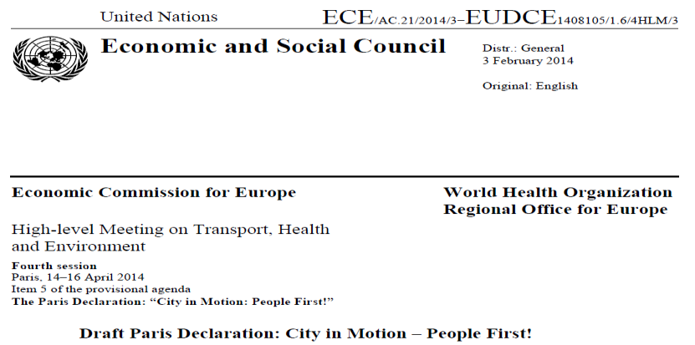

Motivation – THE PEP Paris declaration

Slide 4

Motivation – THE PEP Paris declaration
THE PEP Partnership on Cycling launched at 4 HLM THE PEP in Paris April 2014

Slide 5
What are we aiming at?
Strengthen and extend the existing network of cycling officers within the partnership ➔ organizational and professional background for all activities
Identify the topics to be dealt with on the pan-European level
Development of the pan European master plan
Sharing good practices within the network of cycling officers
Develop guidelines and tools to put the necessary actions resulting from the pan-European master plan into practice

Slide 6
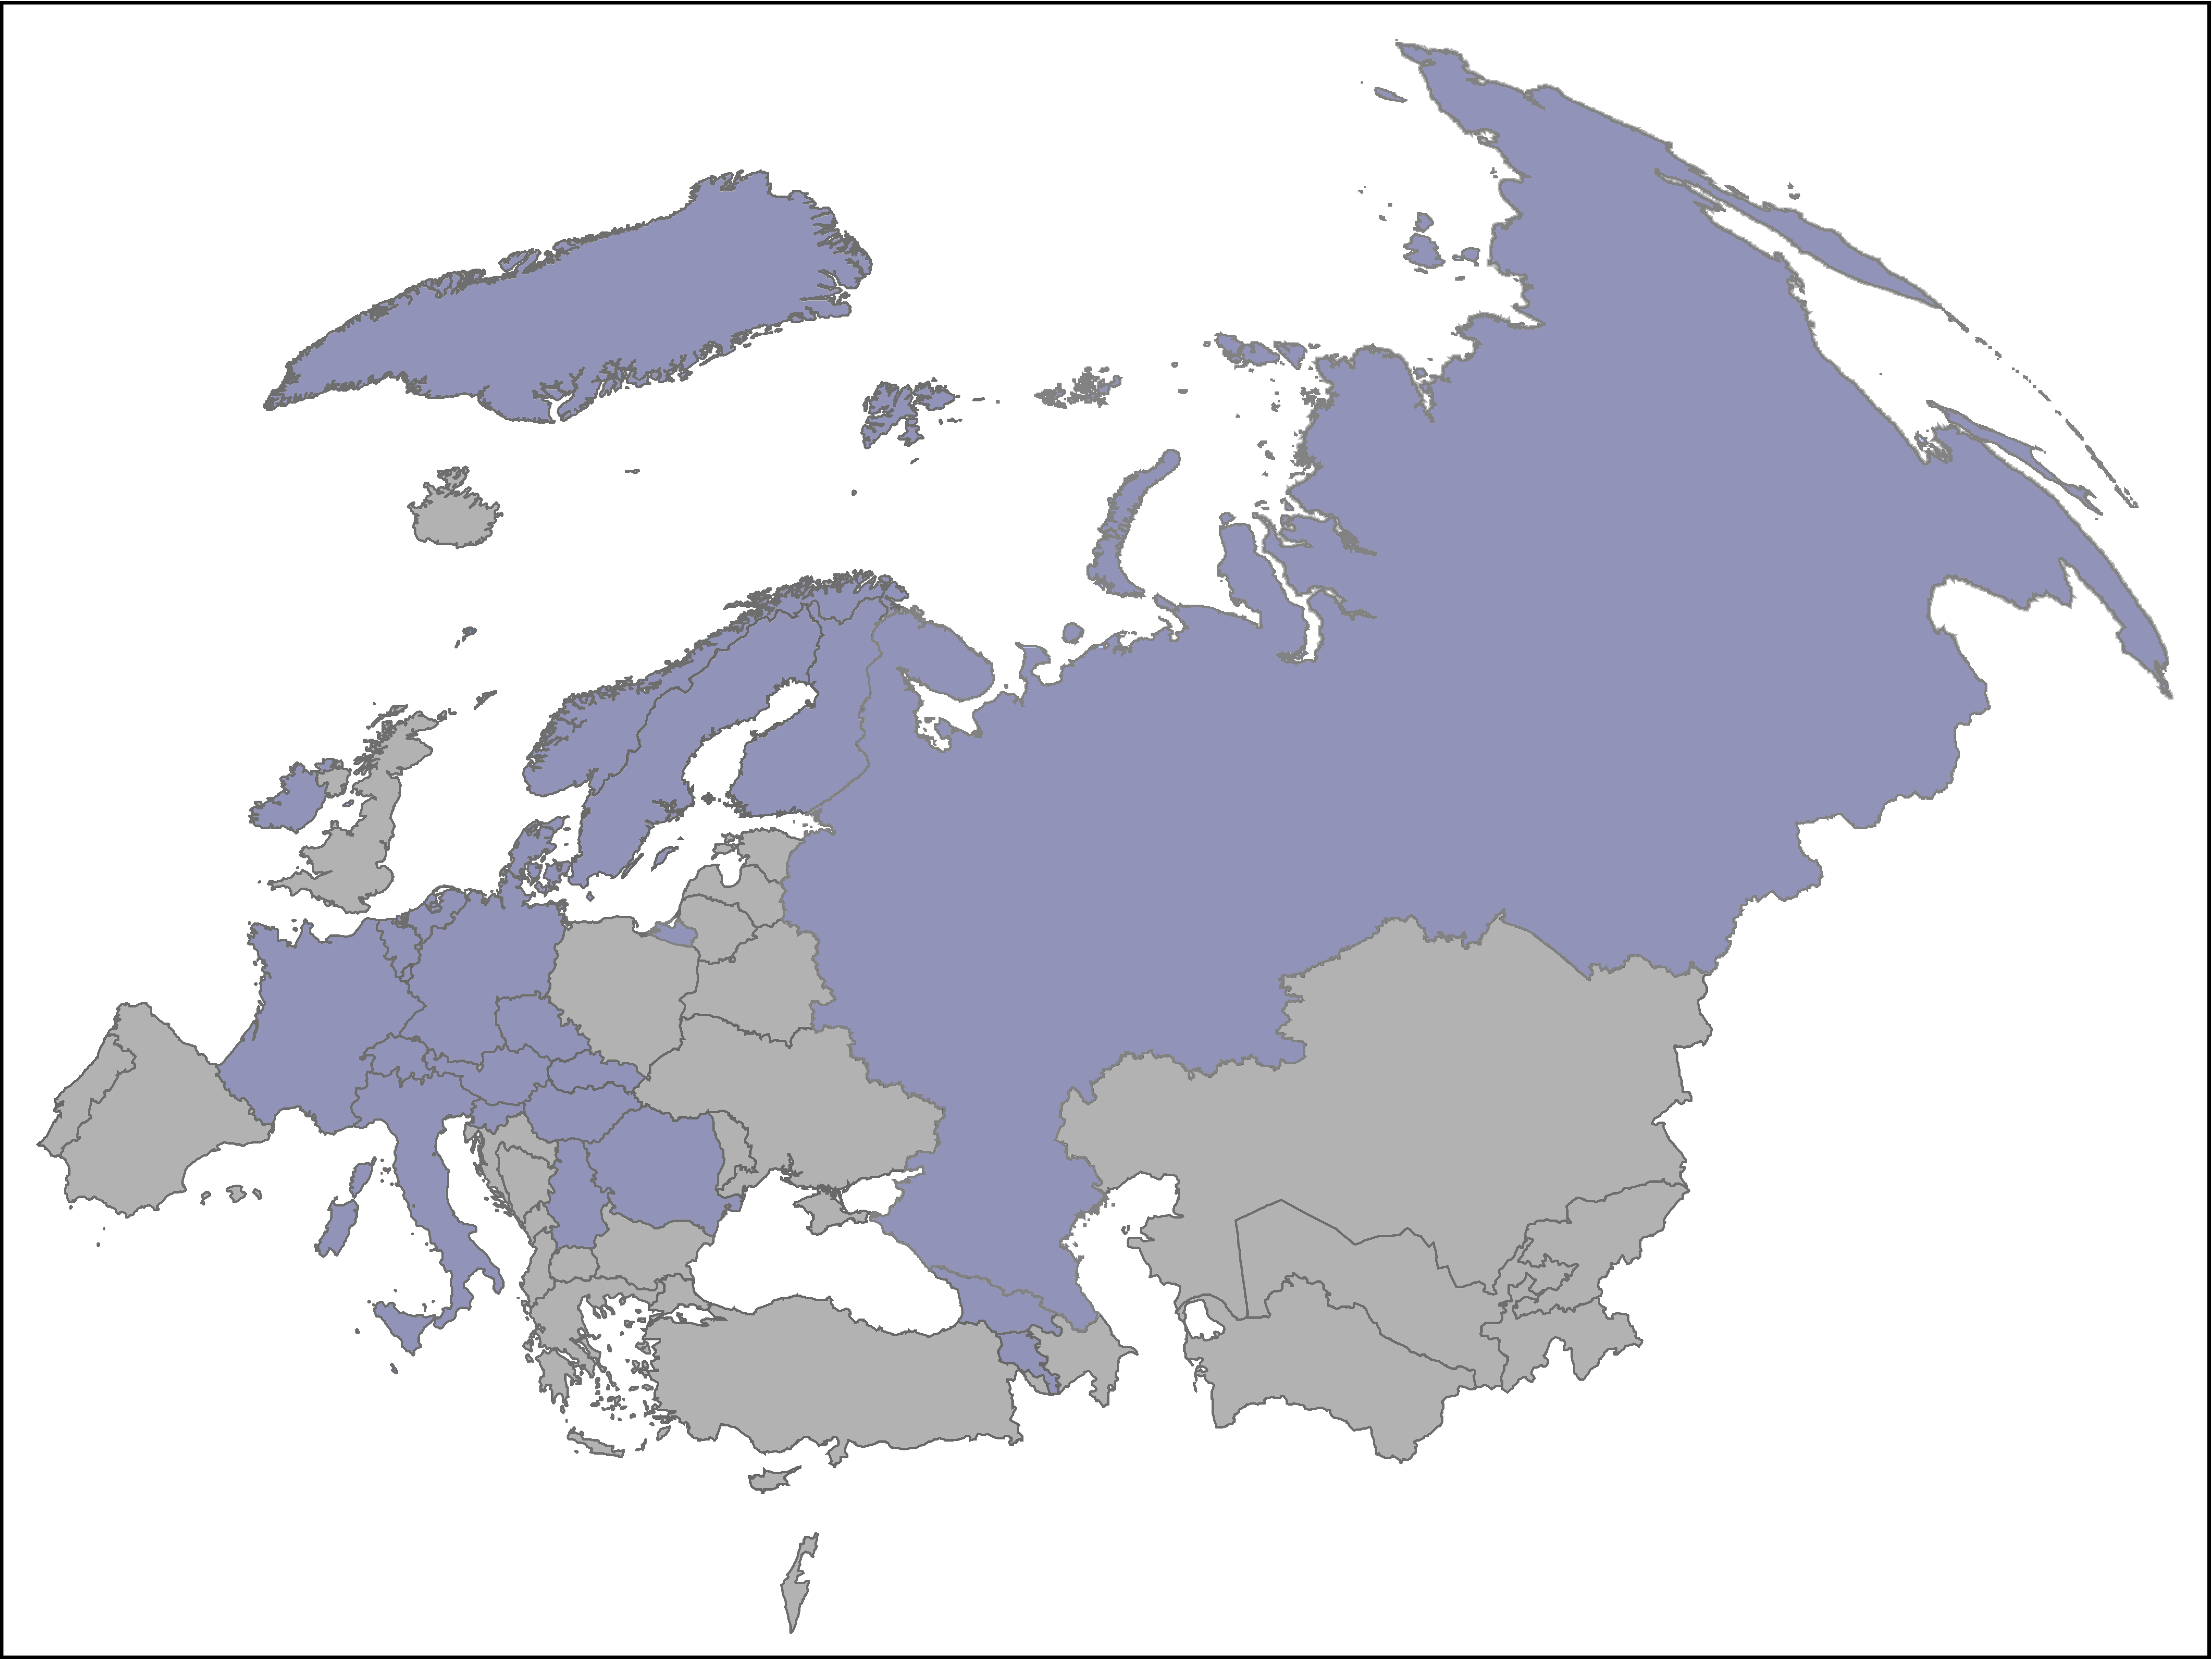
Who is on board?
Armenia
Austria
Belgium
Bosnia and Herzegovina
Czech Republic
Denmark
Finnland
France
Georgia
Germany
Hungary
Ireland
Italy
Poland
Luxembourg
Netherlands
Romania
Russia
Serbia
Slovak Republic
Slovenia
Sweden
Switzerland
European Cyclists Federation ECF
UNECE / WHO
23 out of 56 countries involved

Slide 7
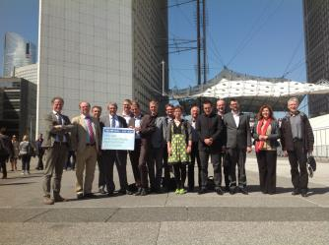
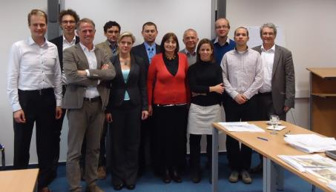
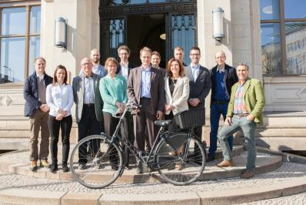
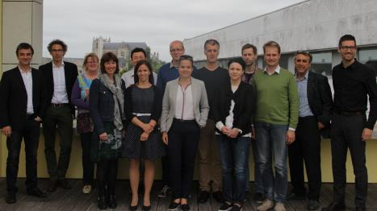
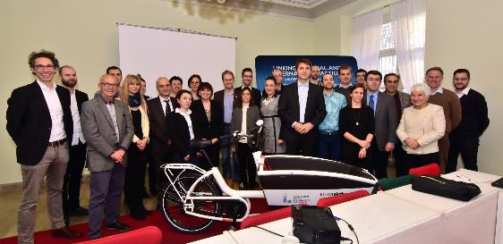
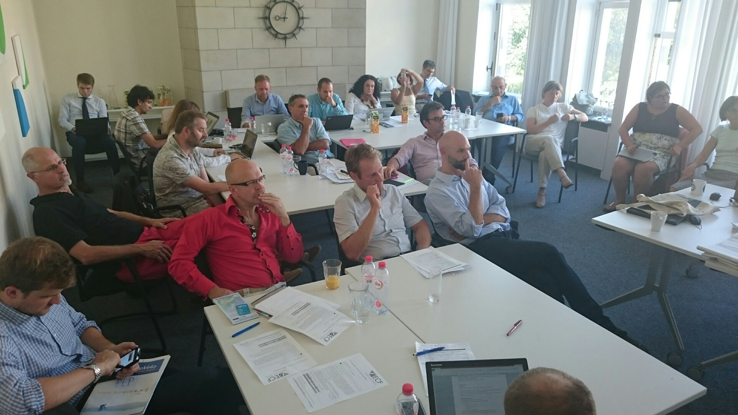
What have we done so far?
6 partnership meeings

Slide 8
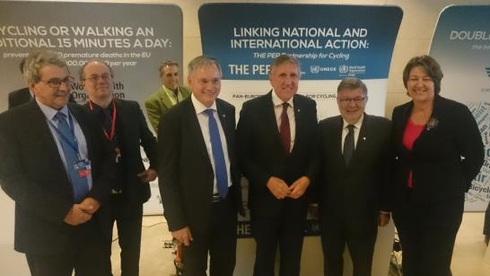
What have we done so far?
Informal Meeting of EU Ministers for Transport

Slide 9
Where are we at the moment?
Pan-European Master Plan for Cycling Promotion
Preparation phase: Definition of main topics
Elaboration phase: Elaboration of inputs for main topics + consolidation ➔ draft master plan
Negotiation phase: Negotiation of draft master plan among THE PEP member countries
Adoption of master plan for cycling promotion
Implementation phase: Identification of projects and funds
Nov 2014 -March 2015
March 2015 – June 2017
June 2017
Dec 2018
5 HLM THE PEP Vienna Austria 2019

Slide 10
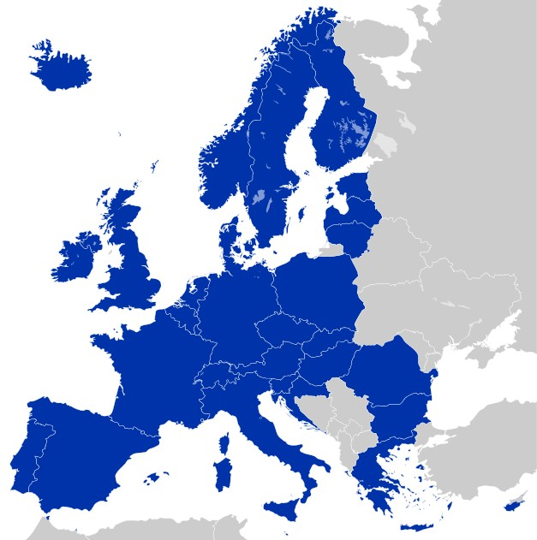

EU Cycling Strategy
PAN-European Masterplan Cycling
European Union level
Main target group & adopted by
European Union Institutions
2016-2019
Transnational Level
Main target group & adopted by
WHO/UNECE THE PEP Member States
2014-2019
Recommendations

Slide 11
Join the partnership!
Towards 5th HLM THE PEP Vienna 2019

