Slide 1
Shopping by Bike
Gavin Wood
Cycling Development Officer, Cycle Logistics Project
CTC, The UK’s National Cycling Charity
Notes:
Intro
Cycling Development Officer for CTC for the last 4 years. Lead officer in the UK for the Cycle Logistics Project. Keen cyclist in all its forms, for leisure and more importantly for utility purposes
Explain Cycle Logistics if Gary hasn’t explained it - EU funded project, part of the Intelligent Energy Europe program, promotes a more rational use of resources, Urban environment improvement (reducing pollution and noise/ increasing space) / increasing the energy efficiency of freight distribution (last mile delivery by bike, improved inter-modal solutions such as rail/bike), 3 strands - Goods delivery / Municipal services / Private goods transport
Hope to give you some idea of the current situation around our travel habits
Some of the findings and results from CTC’s Shopping by Bike trials
Lessons and best practice that we can learn and draw on from mainland Europe, and some of the countries where shopping by bike is more commonplace, and finally how we can go about creating an environment where it’s convenient to shop by bike

Slide 2
Notes:
Here are some baseline figures, based on the Dept. For Transport’s 2010 travel survey
Just over 1.5% of journeys are made by bike in the UK, which sadly makes it the least popular way of moving ourselves around
Over 64% are made by car: ½ < 5 miles; ¼ < 2 miles; currently more car journeys than there are bike journeys <=1 mile (The average Briton makes 23 trips of <=1 mile as a driver and only 2 as a cyclist)
Furthermore, if we isolate just those journeys made for shopping purposes (which is about 1 in 5 journeys), then cycling’s share actually drops to less than 1%.
What does all this tell us? Even stripping out people who live miles away from the shops, and for whom shopping by bike would be very impractical, the potential market for shopping by bike is massive. However, there is a huge amount of work to do before it becomes a common sight on our streets.

Slide 3
Shop by Bike Campaign
100+ volunteers
800 trips travelling over 4,000 miles
People transported TVs, logs, laundry
Estimated future impact of 25,000 miles/year
Small Shift = Massive Impact
Notes:
So what are CTC doing about it?
As part of our role in the CL project we are charged with running a series of Shop by Bike Campaigns.
The aim of the Shop by Bike campaign was to try bring about a change in the way people transport personal goods, from motorised to human powered means
The first trial we ran last year, with another trial launching next week with volunteers in Sheffield, and other trials planned throughout the year.
Participation was incentivised with a voucher to spend at an online bike shop
Volunteers were expected to shop by bike at least once a week for 4 weeks
113 volunteers, of which 77 completed a trial and returned a questionnaire
They completed over 800 trips, and travelled nearly 4,000 miles.
Saved about 1.3 tonnes of CO² and 400kg of fuel – equivalent of about 4 cars
All bar 1 said they would continue using their bike for at least some of their shopping trips, and only 4 hadn’t recommended it to friends/family.
People didn’t just use their bikes for shopping, they transported all manner of stuff; tv’s, recycling, logs, sports equipment, laundry, and 2 people transported musical instruments (a guitar / accordion).
People reported that they had found shopping by bike a relatively easy thing to accomplish and that it had been an invigorating experience.
Based on the info they provided we estimated the future impact to be a further 25,000 miles per year
The success of the trial was its relative simplicity; we targeted existing cyclists who didn’t use their bikes for utility purposes and offered them a reward for doing so.
What is now needed is more of these campaigns, giving more people a taste of just how easy it can be to shop without a car, with hopefully similarly positive results.
Just a small shift in travel behaviour will have a massive impact on some of our busiest roads

Slide 4
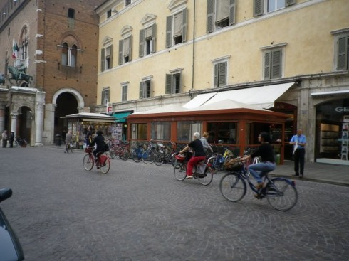
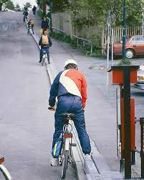
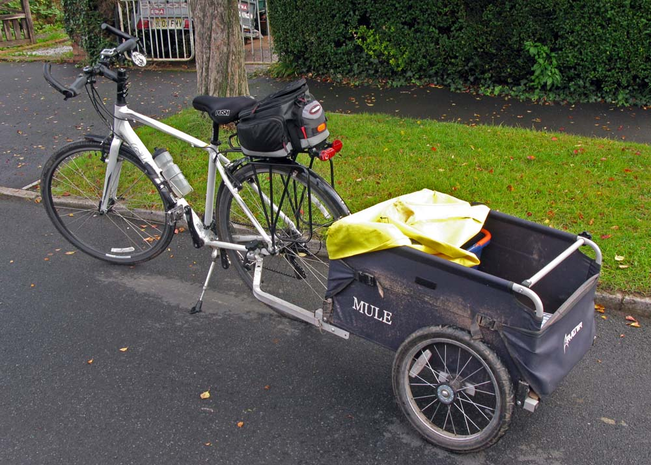
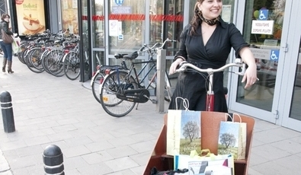
What can we learn from Europe?
Notes:
The UK is a little way behind Europe, or at least some of Europe, as you might expect.
Whilst many British cities seem to have given top priority to the car, there are examples across Europe where more vulnerable road users are given priority and this is reflected in the travel habits of the people living in those towns and cities.
It’s normal at this point to trot out some of the stats relating to Amsterdam or Copenhagen, where cycle friendly topography and transport policies that favour non-motorised traffic combine to increase trips made by bike, both cities enjoy something like a 20% + modal share, and almost all of those cyclists use their bikes for shopping purposes too.
However, there are other examples:
in Belgium, a large supermarket chain, Delhaize, is working with the Fietersbond (the Flemish Cyclists Union) and the GRACQ (Francophone daily cyclists) to upgrade and install better facilities for cyclists, they are also encouraging shopping by bike by offering good quality bike bags at a heavily discounted rate (sold 1,600 sets). This is the kind of collaboration I’ll be approaching UK multiple retailers about.
Again in Belgium, To promote cargo-bikes as a sustainable alternative to the car for transporting goods and children, the first public cargo-bike-sharing scheme in Europe was developed in Ghent. A pilot project, launched in May 2012, introduced 4 cargo-bikes into the existing car sharing scheme. There are two stations with two cargo-bikes each and after use, the bike needs to be returned to the station it came from. These schemes are hopefully about to start cropping up in the UK; Hereford Pedicabs are about to launch a community bike sharing scheme in late spring and if successful will be rolled out elsewhere.
The city of Ferrara in Italy has an almost car-free town centre, cyclists and pedestrians dominate public space; as a consequence, cars move slowly and defer to bicycle movement in the area. The town enjoys a modal share of over 30%! It’s no coincidence that the towns and cities in the UK that have similar restrictions enjoy a higher modal share of cyclists.
And perhaps my favourite example of best practice from Europe is in the hilly city Trondheim, Norway. Trondheim was the first city in the world to have a dedicated bike lift which transports people from the main shopping district to the top of the steep hill out of town. It would be great to see this kind of thing in some of the hillier towns and cities of the uk!

Slide 5
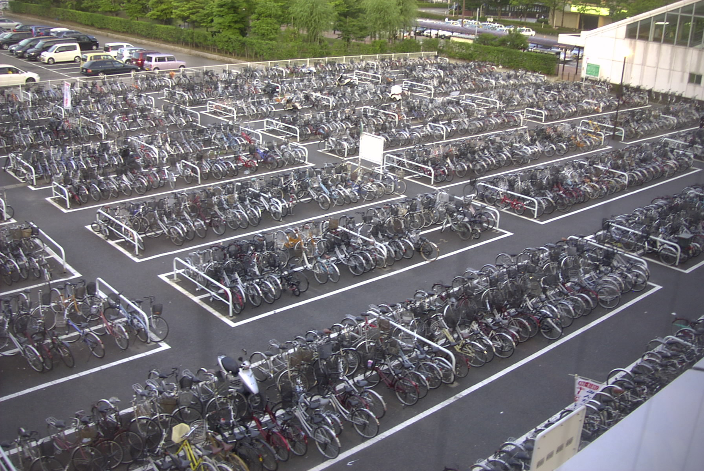
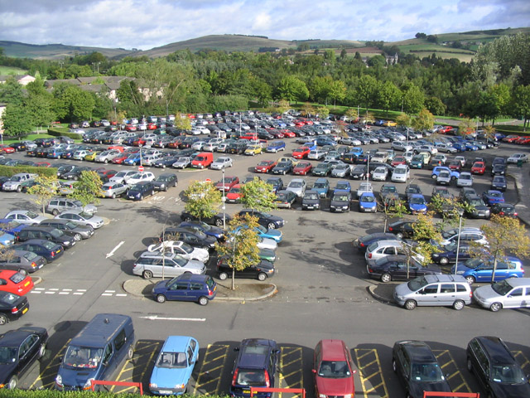
Notes:
What can we do about it in the future? How can we create an environment that makes it an attractive proposition to shop by bike? How can we get more people moving around and transporting things in a sustainable way?
How do we get from this: picture 1
To this: picture 2
It may seem difficult, but what is needed to grow cycling as a means of transport and transporting things is to convince the people that it's a convenient, time-saving, safe way of making their everyday journeys. Creating an attitude of cooperation and tolerance on the roads, a focus on making cycling a more pleasant, convenient alternative. With this in mind, the over-riding needs are for supermarkets, markets and high street shops to provide cycle facilities that are attractive to customers, and for town planners and decision makers to start implementing policies that favour more sustainable modes of transport.
Cycle parking should be attractive:
Visible, accessible and well-located: Cycle parking should be situated as close to a store’s entrance as possible, with signs marking clearly its location. Having dedicated access lanes for cyclists and pedestrians would be perfect.
Security: People are very reluctant to use a facility that doesn’t feel safe. Cycle parking should be well lit, and monitored by the store or high street CCTV system.
Easy to use and well laid out: There should be ample locking points for bikes of differing shape and size, with plenty of room for people to get in and out with their bags without struggling.
Space: Provision of plentiful, covered bike parking spaces with lots of room for anyone who wants to arrive by bike.
Greater restrictions on motorised transport in and around towns and cities will offer greater protection to cyclists and pedestrians, if restrictions on access are not possible then lower speed limits such as the 20mph limit that is becoming more commonplace, and high quality cycling facilities designed with cyclists in mind, that give priority to more vulnerable road users.
Just imagine, towns and cities with streets that are overflowing with bikes. Markets, supermarkets and the humble high street, all with full to busting bike racks. Bikes with panniers, baskets, trailers, all stuffed with shopping...
Sounds like an unobtainable ideal doesn't it? But if just a few more people chose the bike as one of their modes of transport for this kind of trip, it would become a reality. Urban space would be freed up, we'd have towns that were quieter, cleaner, and nicer places to live - who doesn't want that? I know I certainly do.

Slide 6
Gavin Wood
Cyclists’ Touring Club
( 07825 785 490
* gavin.wood@ctc.org.uk

